Slide 1


Region 6 - San Jacinto Regional Flood Planning Group
Planning Meeting May 12, 2026 9:00 AM

Slide 2

ITEM 1 Call to Order

Slide 3
ITEM 2 Welcome and Roll Call

Slide 4
ITEM 3 Registered Public Comments on Agenda Items (Limit of 3 Minutes Per Person)

Slide 5
ITEM 4 Texas Water Development Board Update

Slide 6
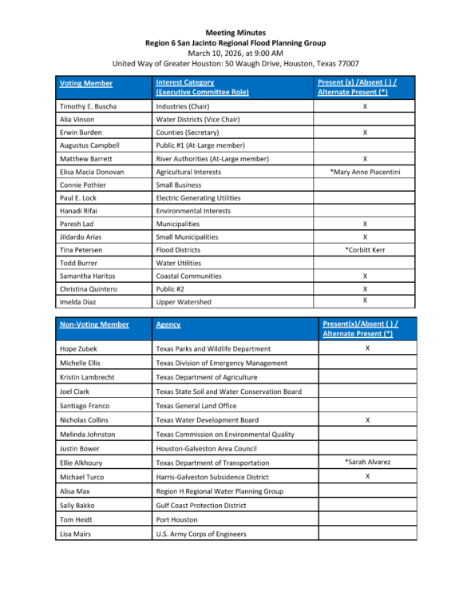
ITEM 5 Approval of Meeting Minutes

Slide 7
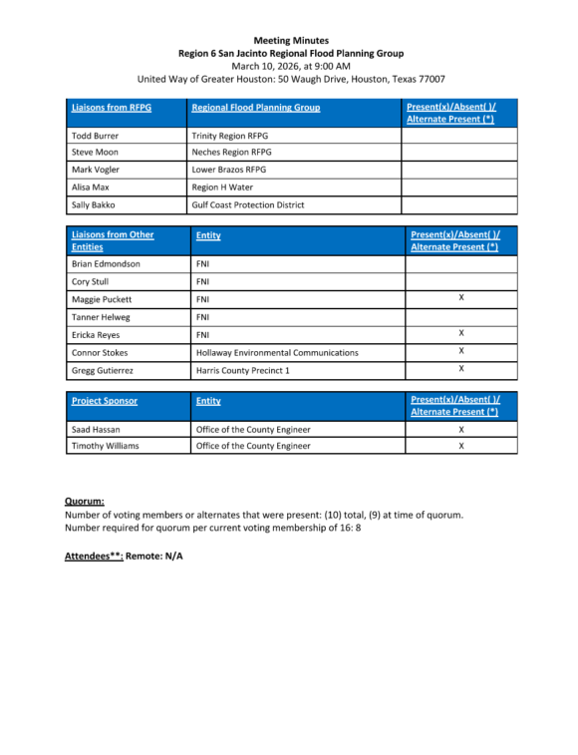
ITEM 5 Approval of Meeting Minutes

Slide 8
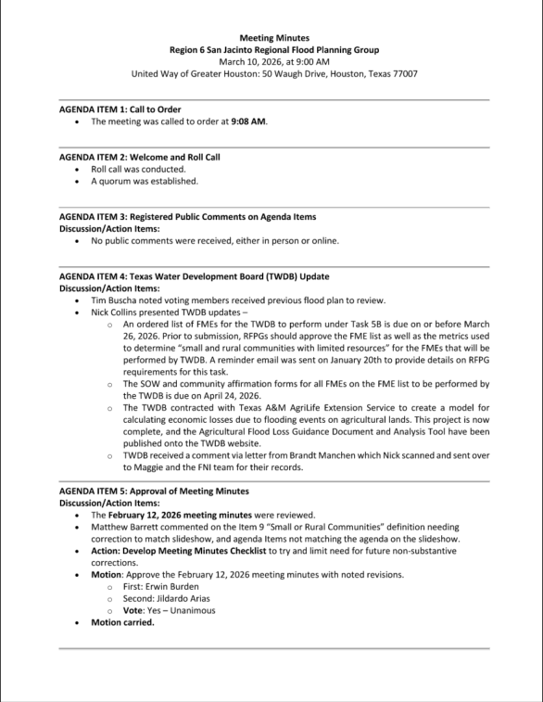
ITEM 5 Approval of Meeting Minutes

Slide 9
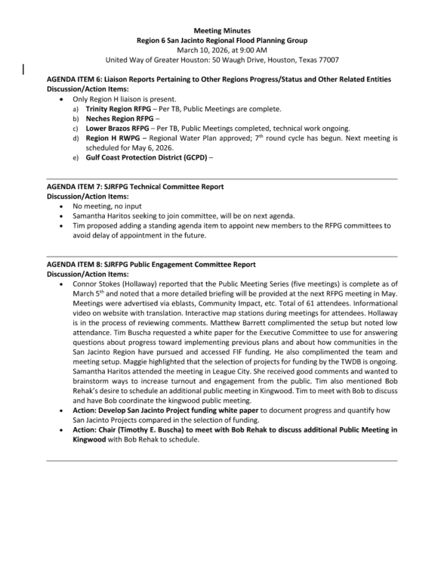
ITEM 5 Approval of Meeting Minutes

Slide 10
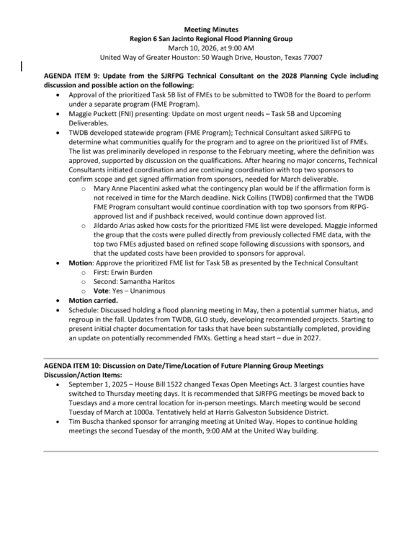
ITEM 5 Approval of Meeting Minutes

Slide 11
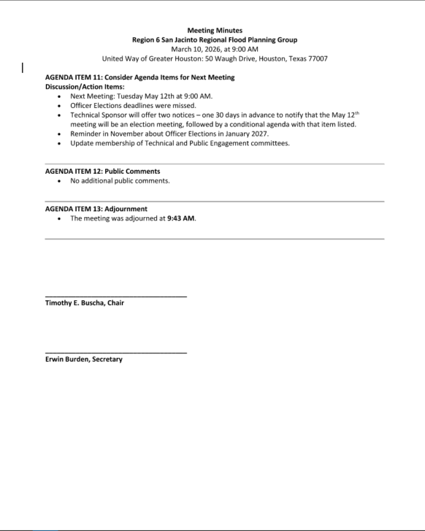
ITEM 5 Approval of Meeting Minutes

Slide 12
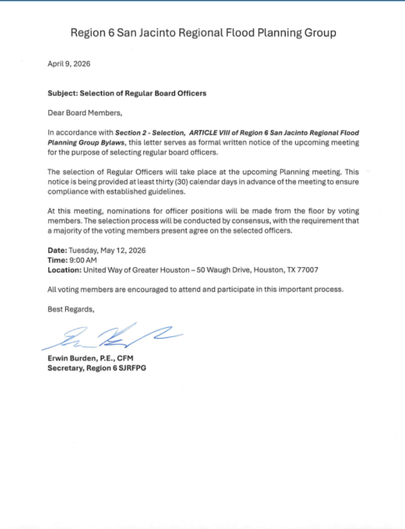
ITEM 6
SJRFPG Officer Elections

Slide 13
ITEM 7 Task 1 Discussion – RFPG Public Survey and data collection.
Liaison Reports Pertaining to Other Region(s) Progress and Status and other Related Entities:
a. Trinity Region
b. Neches Region
c. Lower Brazos Region
d. Region H Water
e. Gulf Coast Protection District (GCPD)

Slide 14
ITEM 8 Presentation by the TWDB consultant developing the Nature-Based Solutions for Flood Resilience Guidance Manual

Slide 15



Nature-Based Solutions for Flood Resilience
Region 6 San Jacinto Regional Flood Planning Group
Texas Water Development Board
Freese and Nichols, Inc.
The Nature Conservancy
Notes:
George
Give intros here

Slide 16
Agenda
Purpose of the NBS for Flood Resilience Guidance Manual
Definition and Examples of NBS for Flood Resilience
Publishing Schedule
Guidance Manual Content
How to Promote NBS through Regional Flood Planning
Key Takeaways
Notes:
Performed this study in collaboration with TWDB, purpose was…, today we will be presenting key findings, will talk about when the manual will be available, the manual will include…and where it will be located, key takeaways.

Slide 17
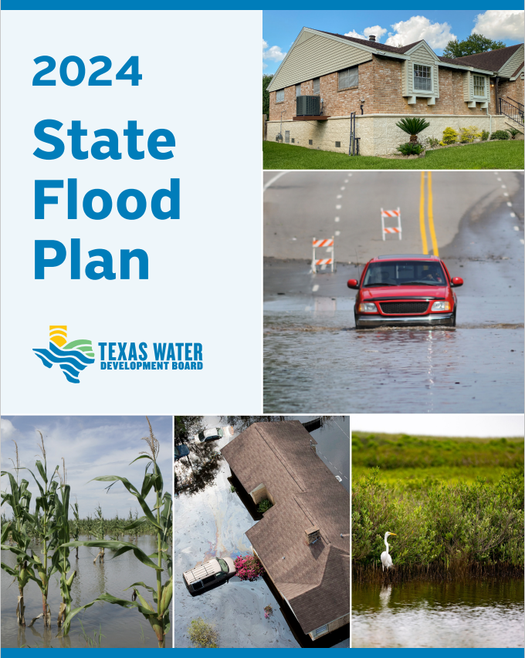
NBS in the State Flood Plan
FMP Type | Recommended FMP Count
Low Water Crossing or Bridge Improvement | 94
Infrastructure | 148
Regional Detention Ponds | 73
Regional Channel Improvements | 79
Storm Drain Improvements | 47
Dam Improvements, Maintenance, and Repair | 5
Flood Walls and Levees | 4
Coastal Protections | 1
Nature-Based Solutions | 8
Comprehensive Regional Projects | 83
Property or Easement Acquisition | 13
Elevation of Individual Structures | 4
Flood Readiness and Resilience | 53
Other | 3
Total | 615
17
Notes:
The legislature tasked TWDB with preparing the first State Flood Plan. In the process of preparing the state flood plan, TWDB identified common misperceptions on NBS, its effectiveness, cost, & maintenance. This signaled a need for guidance and more information about implementing these practices in flood mitigation. TWDB is looking for more NBS, multi-beneficial, resilience projects to put on the next plan. To help with getting more NBS in the SFP, we’re presenting to each of the RFPGs. The intention of this presentation is to educate RFPGs to better understand and classify NBS.
TWDB initiated this project to develop a guidance manual on the use of NBS for flood resilience in Texas because they are looking for more nature-based, multi-beneficial projects in the next planning cycle.
The snip you see above is from the State Flood Plan and you can see only 8 of the 615 FMPs in that plan were identified as NBS. This is a bit misleading…
In the 2023 SFP, there are 202 out of 615 recommended FMPs and 58 out of XXX FMSs that identified a percentage of the project by cost was NBS.
To help with getting the word out in the effort to get more NBS in the SFP, we’re presenting to each of the RFPGs to introduce this resource and open up further discussions on incorporating NBS into regional flood planning efforts, and hopefully local efforts as well.
I do want to note that another way TWDB promotes NBS is through the project ranking criteria. They offer up to 5 points by including an NBS in your project.
To put into perspective how much these points are worth, 1 more point in the ranking score can be the difference of making that project jump 5 or even 10 places up in the final rankings.

Slide 18
Project Goals
Synthesize Research & Guidance on the use of NBS for Flood Mitigation into a Single, Statewide Manual for Texas Communities
Provide Strategies & Tools to Address Common Barriers & Challenges
Support The Implementation Of NBS Into The Regional Flood Planning Process & Community-Driven Efforts
01
02
03
18
Notes:
So what are the goals of this project?
1 – Synthesize guidance on NBS into a single statewide manual to support flood mitigation and flood planning efforts at all levels and develop a better understanding of the use of these approaches. There are a lot of general resources out there on NBS, but most are not focused of flood risk reduction, and few are specific to Texas. This Guidance Manual focuses on the intentional use of nature-based solutions for flood risk reduction. While natural features and landscapes have always contributed to community flood resilience, NBS represent a deliberate strategy to recognize those benefits in community planning and include the beneficial functions of nature in flood risk reduction projects.
2 – Provide strategies and tools that address common barriers and challenges identified through our research. This is a new-ish approach to flood risk reduction, and this manual provides insights into overcoming some common identified barriers to implementing NBS. * Expand how we landed on barriers & challenges*
3 – Outline how to integrate NBS into all phases of the planning process including Regional Flood Planning Process and local community-driven efforts. This included specific consideration on the different natural regions across Texas. Again, the goal of the Manual is to provide guidance to communities on the use of NBS for flood risk reduction projects and flood planning efforts. This includes identifying strategies, tools, and processes for planning and implementing NBS and outlining how to integrate NBS concepts and best practices into all phases of project development with specific consideration of local context.

Slide 19



Intended Users
City Engineer CIP Planning (Master Drainage Plans/Studies, Preliminary Engineering, etc.)
RFPG & Technical Consultant Teams Project alternative identification
Local government officials or representatives charged with planning, developing, or managing community infrastructure or assets
City Engineers
Floodplain Managers
Planners
Regional Flood Planning Group (RFPG)
Practitioners
Developers
Floodplain Administrator Example floodplain regulation, polices and incentives for more flood resilient community (e.g. floodplain buffers/setbacks)
19
Notes:
The intended users of the Guidance Manuals are Local government officials, practitioners, and developers
To give an example of how local government staff can use the Manual you can look towards the right side of the slide:
City Engineers – CIP, how can you incorporate NBS into Drainage Master Plans, PERs, etc.
Regional Flood Planners & Their Consultant Teams – When they are identifying projects, When technical committees develop FMPs can reference manual, when local consultants submit projects, can use manual to recommend NBS instead of typical grey infrastructure
And for your local Floodplain Administrators – It will be a good place to reference examples of resilience regulations, policies, and incentives

Slide 20
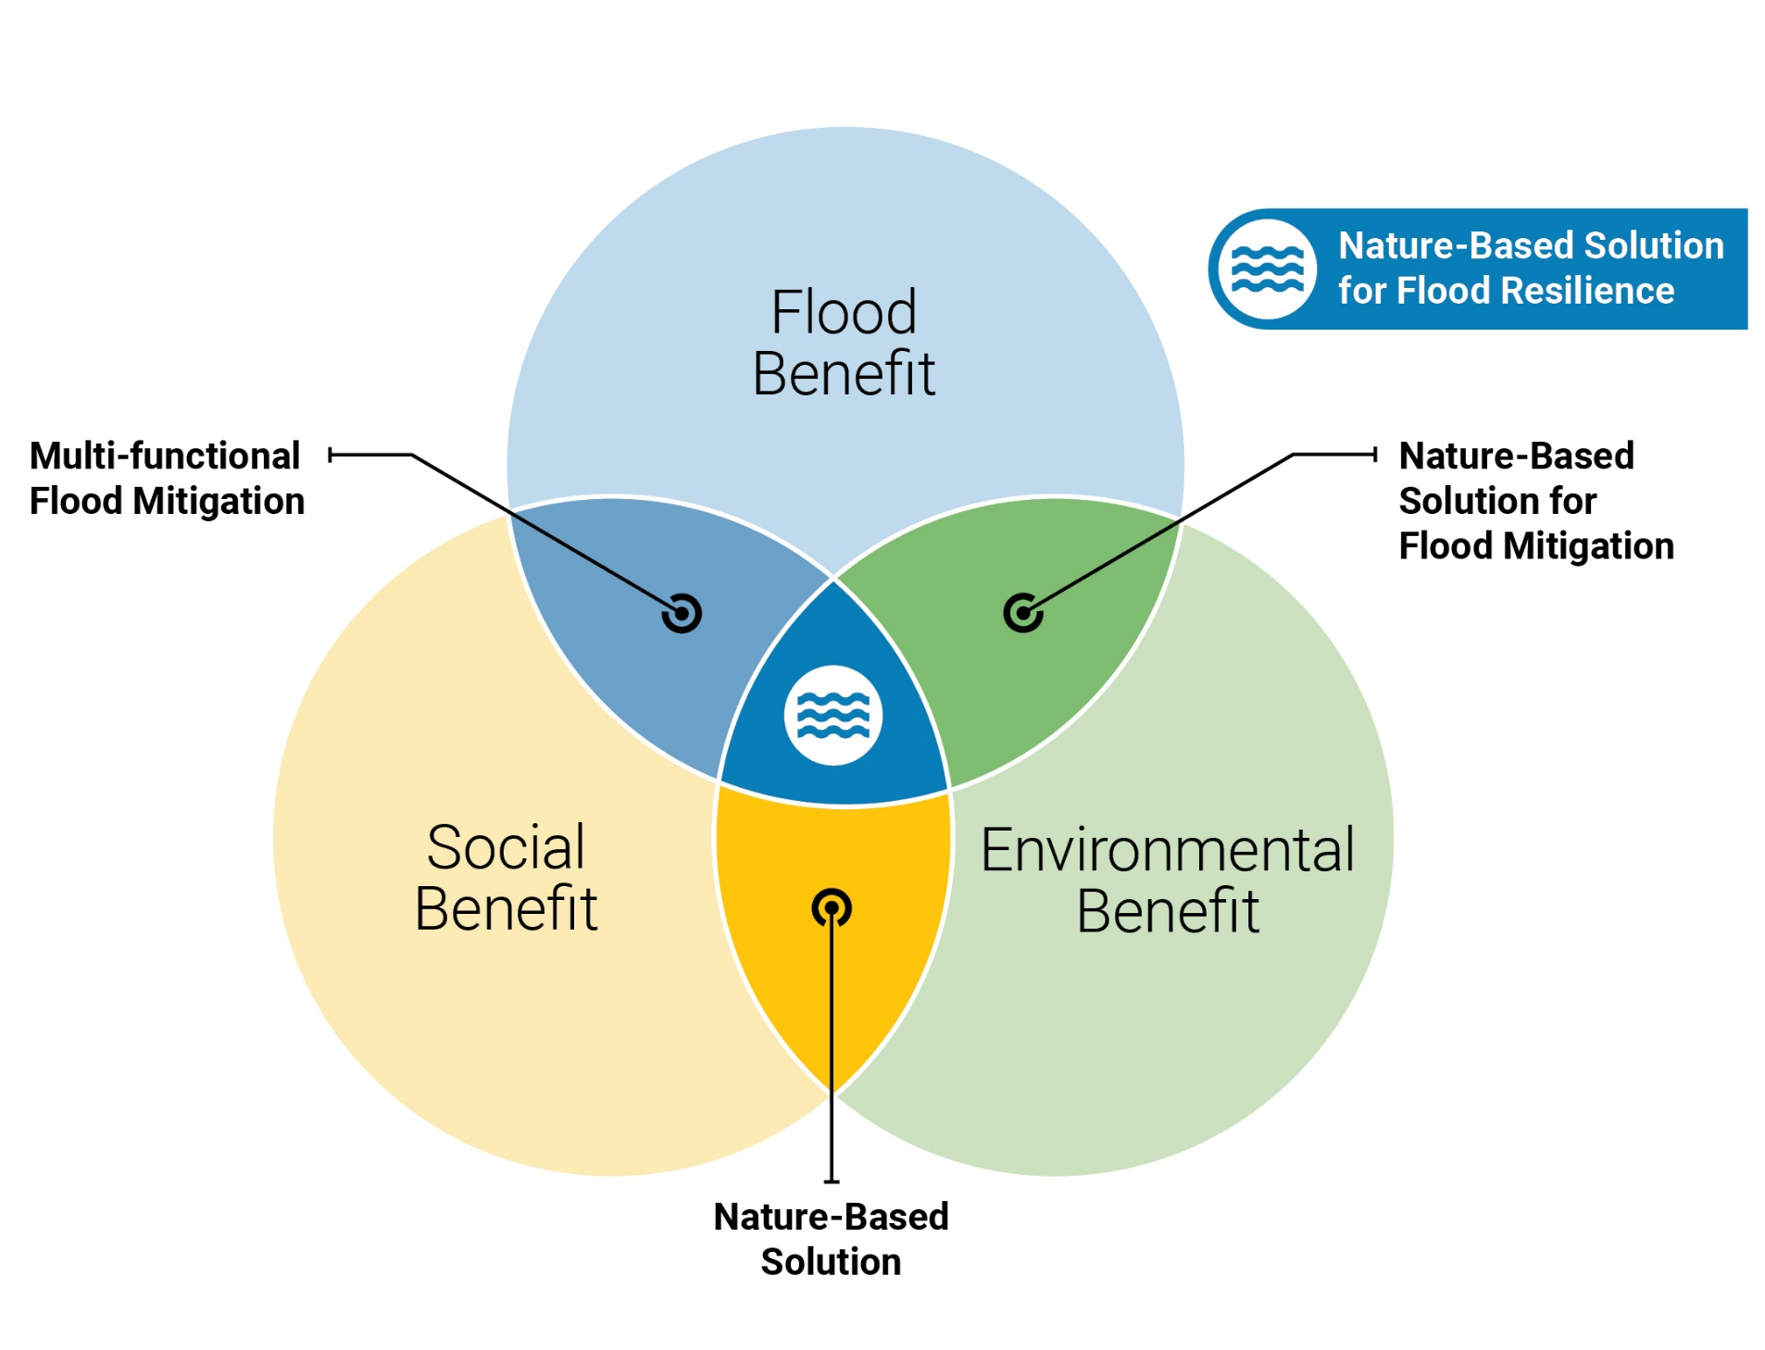
Defining Nature-Based Solutions (NBS)
NBS use or imitate natural features and/or processes to increase resilience while providing sustainable benefits to people and the environment.
Co-benefits Examples:
Water Supply and Drought Mitigation
Water Quality and Public Health
Urban Heat Reduction and Air Quality
Recreation and Social Assets
20
Notes:
George
Definition – using nature to solve problems in a sustainable way.
That’s sustainable both from the environmental point of view, meaning it benefits nature such as habitat and water quality improvements, but also from a social point of view – meaning it provides benefits to people that can be relied upon over the long term.
The ways nature can help us with flood issues involves storing, slowing and infiltrating floodwater or stormwater.
And there are structural and nonstructural approaches to NBS – they can be projects that control runoff and floodwater or strategies that recognize that existing natural features and processes can function as infrastructure such as floodplain management that seeks to maintain the beneficial functions of floodplains
Ideally projects are in the middle of venn diaghram, but many projects in the state flood plan are in the blue only, ideally more benefits can be combined and achieved for new projects identified by the RFPGs
Umbrella concept:
Natural or Green Infrastructure
Low Impact Development
Natural and Nature Based Features
Stormwater Best Management Practices

Slide 21
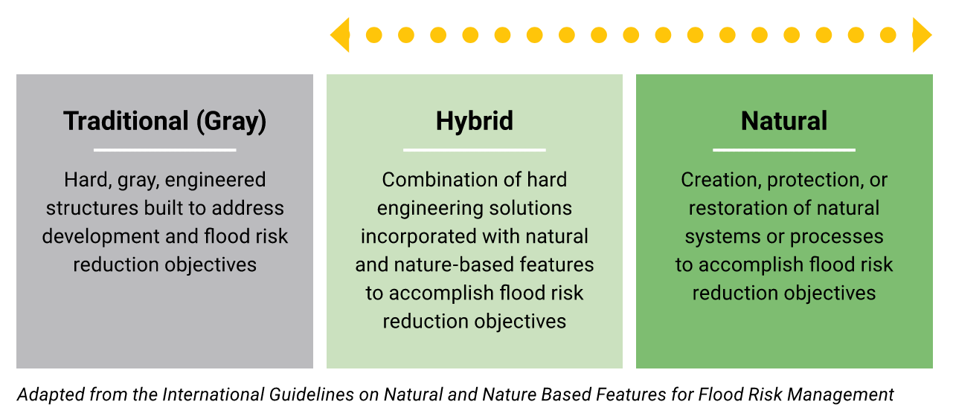
NBS for Flood Resilience Spectrum
Nature Based Solutions
21
Notes:
George
Traditional – example - Concrete channels - usually only one goal, hydraulic benefit.
Hybrid – Wet pond (flood storage with wetland vegetation)
Natural – example - floodplain bench - achieves multiple benefits (social and environmental). These benefits have a monitarial value. This monitarial value can be used in Federal and State cost benefit analysis to justify the project when seeking gederal and state grants.

Slide 22
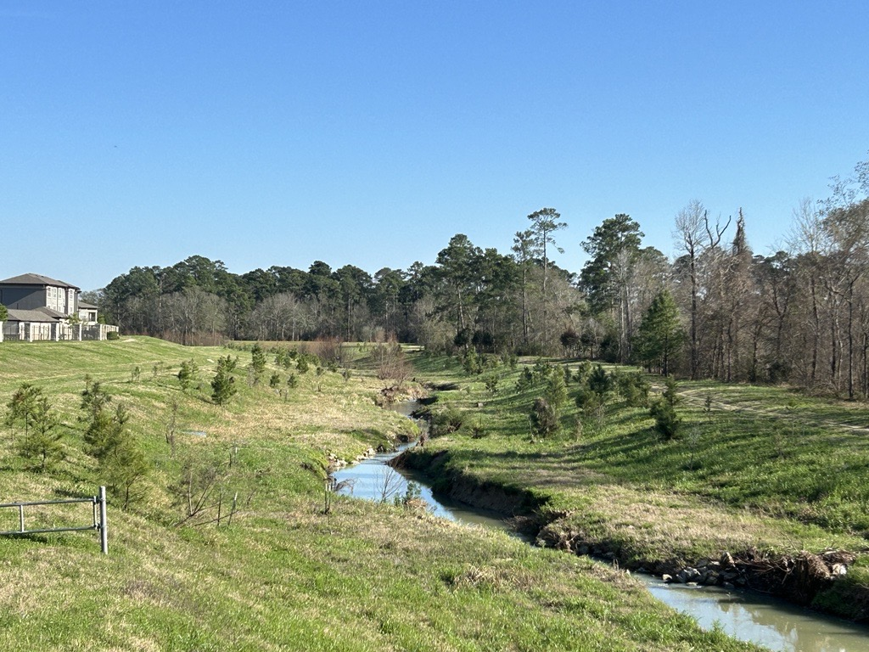
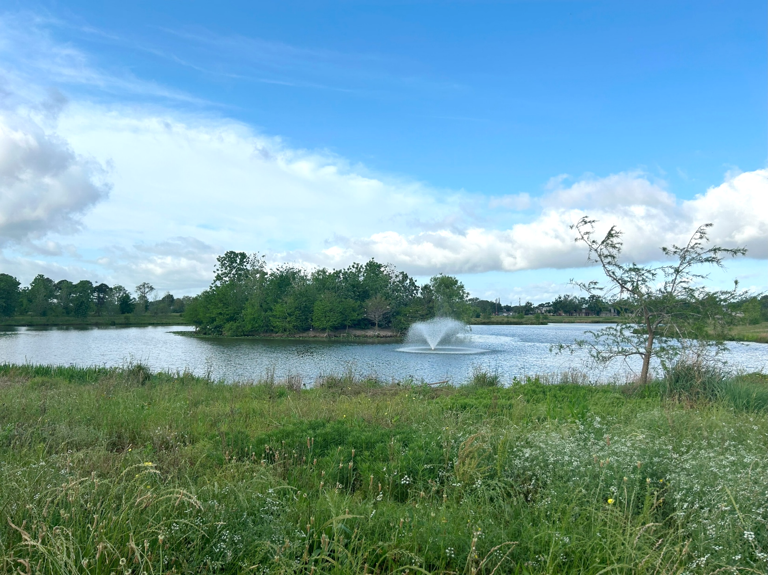
NBS for Flood Resilience Examples
Stream and Floodplain Restoration
Wet Pond with Constructed Wetlands
22
Notes:
George
Most of the FMPs are channel projects and regional detention basins
Floodplain restoration – often requires wider corridor than a concrete channel, but more function (slowing velocity, reduced erosion) compared to concrete lined
Wet pond – mention that berm also the pond to hold significant flood volume above normal conservation level, regular volume contributes to water quality treatment, ecosystem services. Mosquito fish are great for managing mosquitos, mention safety considerations for encouraging creation around flood infrastructure

Slide 23

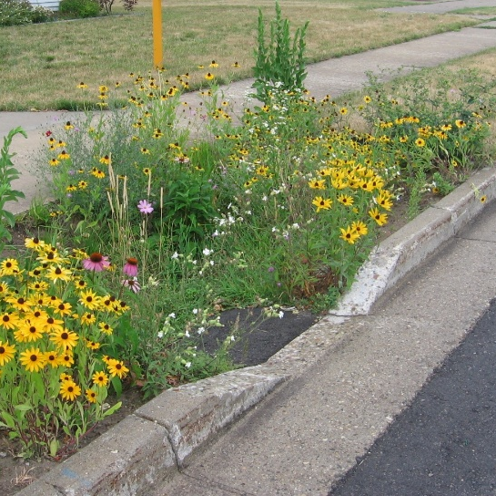
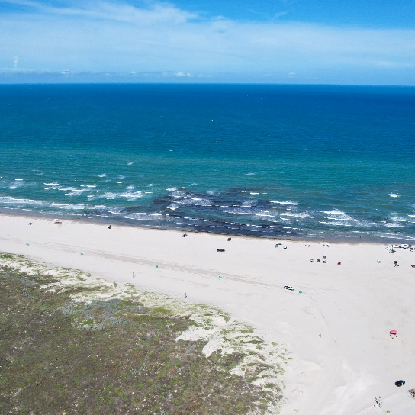
Structural NBS for Flood Resilience
Stream Restoration
Floodplain Restoration
Levee Setback
Wetland Restoration
Playa Lake Restoration
Watershed
Neighborhood
Coastal
Bioretention
Vegetated Swale
Permeable Pavement
Vegetative Filter Strips
Wet Ponds
Constructed Wetlands
Tree Trenches
Rainwater Harvesting
Stormwater Parks
Beach Nourishment and Dune Restoration
Coastal Marsh, Seagrass, and Prairie Restoration
Natural Breakwaters and Oyster Reefs
Waterfront Parks
23
Notes:
George
I One of the goals of the manual is to synthesize existing research, consult NBS experts and apply it to Texas.
Texas’ annual rainfall ranges from 50+ inches in the east to 10 inches in the west therefore the climate and the nature base solutions to work within the climates has to vary to be successful. Drought tolerant NBS in the west and wet loving in the east.
Texas’ topography ranges from the swamps in the east, the plains in the north central and mountainous in the west. For example, north central Playa Lakes are a NBS (there are natural analogues of playa lakes).
II For the Lower Brazos regional floodplain boundary, here are some examples
Watershed: Build interconnected systems of natural areas and open space.
- Remember, NBS apply to all regions where rainfall runoff flows to. This image in the top left shows a large river with water with a City in the background, NBS can be used on small creeks which are generally dry most of the time in a suburban area.
Applicability to this regional flood plan
Levee setbacks (explain what a levee set back is). Now is a great time to explore which levees can be set back while the landscape is on the land side of the levee is relatveily undeveloped. (Fort bend County, Brazoria County). The manual explains how to find levees (which sometimes are not on FEMA flood maps).
-NBS are synergetic with solutions with Project Brazos which combines erosion mitigation with flood water reduction. The manual presents resources on how to thoughtfully design floodplain benches to work with the geomorphology of the floodplain (define geomorphology).
b. Coastal: Stabilize shorelines & reduces erosion, Buffers the coast from storm impacts & designed to support coastal resilience
c. Neighborhood: Manage rain where it falls to reduce stormwater runoff, Often built into a site or neighborhood without extra space
III Touch on application at small scale/rural or smaller communities vs. large communities and/or with more capacity
a. rural scale often have a hard time to financially justify flood mitigation solutions.
– preventing damage to agricultural lands can be counted
-Incorporating NBS elements into a flood mitigation solution grant application will make the application more competitive which helps offset lower property values.
b. Smaller communities
c. Larger communities
- Urban channel design - how to incorporate natural elements into narrow spaces, for example natural channel design of a dry creek that has homes on either side.

Slide 24
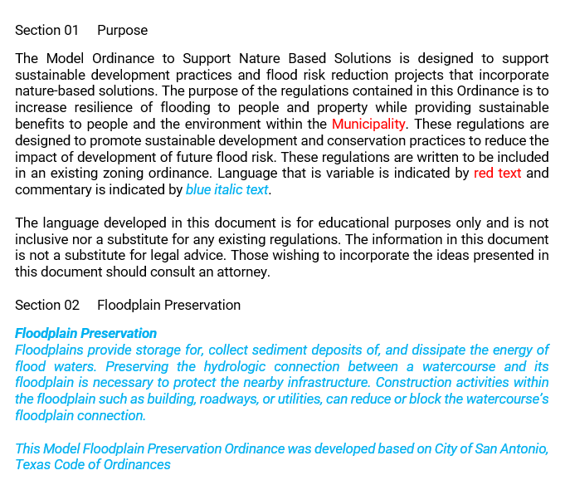
Non-Structural NBS for Flood Resilience
Model Ordinance
Property Acquisition and Conservation
Regulating Development in Floodplains
Promoting Native Vegetation in Design Criteria
24
Notes:
George
This is an important strategy for smaller populated communities with large rivers or small dry creeks. If we applied what we know now to land development strategies 60 years ago, imagine how many flooding issues could be avoided today. Applying this thinking to today’s land development strategies will mitigate flooding issues 60 years in the future. Why do we want our kids and our kids’ kids to look back and wish decisions made in 2026 would have been made differently.
Communities with undeveloped land uses in/adjacent floodplain
Smaller communities
-Leaving room for the floodplain, non-structural NBS, drainage easement (generally more restrictive than FEMA floodplains which allow up to a foot rise).
-Preserving upland mature vegetation. Explain what a curve number is. Woods, good condition CN is 70 (type C soils), replace with ¼ acre residential lots, CN is now 83 (TR-55), a 19% increase in runoff (peak, volume and frequency). Remember, detention strategies only address peak.
Guidance manual will include Model Ordinance to use as resource in promoting NBS in local ordinances

Slide 25
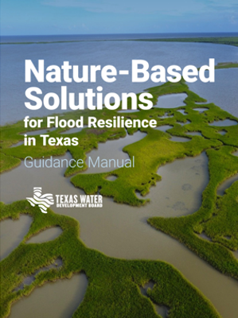
NBS Guidance Manual Schedule
Summer 2026 Draft Guidance Manual for Public Comment
Fall 2026 Final Guidance Manual Published
https://www.twdb.texas.gov/flood/research/Nature-based-Solutions-2022/index.asp
25

Slide 26
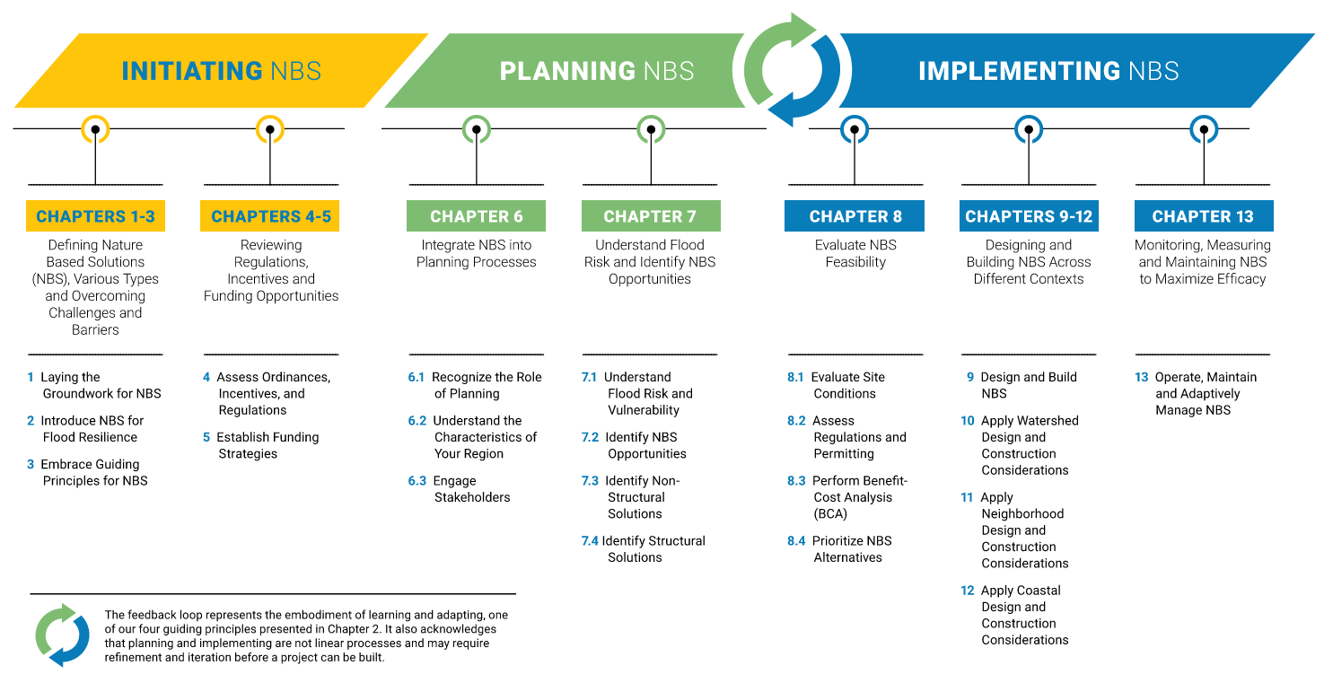

26
Notes:
The guidance manual presents a framework to approach NBS planning and implementation. This framework also acts as a visual guide of the outline of the manual.
The initiating section includes an introduction to the concept of NBS and topics to work through before you start planning or identifying projects. For example, understanding the available funding opportunities, will grant funding or local funding (like drainage utility or bond funds) be used?
The planning and implementing sections walk reader through setting project goals, engaging with stakeholders, identifying structural or non-structural NBS, evaluating feasibility, and design, construction, and maintenance. There is not a clear divide between these sections. A planning level evaluation of the site should be considered while identifying NBS projects. Similarly, stakeholder engagement does not end with the planning section. Lessons learned should be shared to improve future planning.
Lastly, there is an important feedback loop between planning and implementation. There is not always a definitive transition between “Planning” and “Implementing” and learning by doing should be the understood approach. Because NBS are living systems that adapt over time our management and understanding of them should adapt with it.
The RFPGs fit into this process:
Providing educational opportunities for community leaders on funding opportunities (especially FIF)
Recommending or adopting floodplain management standards
Recommending FMEs to identify flood mitigation solutions
Recommending FMPs and FMSs to reduce flooding
Performing BCAs
NBS can be incorporated into all of these steps

Slide 27
Promote NBS through Regional Flood Planning
Task 3
Task 4A
Task 4C
Task 5A
Set goal for NBS implementation
Recommend NBS floodplain management practices
Discuss NBS opportunities with local sponsors
Identify potential FMPs and FMSs
Consider potential for co-benefits when selecting FMEs to evaluate
Develop NBS alternatives while performing FMEs
Document project benefits, % NBS by cost
Include ecosystem services, co-benefits in project BCAs
NBS Guidance Manual Resource
NBS Guidance Manual Resource
NBS Guidance Manual Resource
NBS Guidance Manual Resource
Guiding Principles
Example NBS floodplain management practices
Model Ordinance for NBS
How to: developing a proactive stakeholder engagement strategy
How to: identify structural and non-structural NBS
Matrix of flood mitigation, environmental, and social benefits by NBS type
Example alternative prioritization approach
Matrix of site suitability characteristics by NBS type
One Pager by NBS Type
How to: calculate expected flood damages
Monetary value of ecosystem services
Conceptual BCA for NBS
27
Notes:
Task 3 – Floodplain management practices, needs analysis, and flood protection goals
Task 4A – Identification and evaluation of potential flood management evaluations and potentially feasible flood management strategies and flood mitigation projects
Task 4C – Performance of flood management evaluations
Task 5A – Recommendation of Flood Management Evaluations, Flood Mitigation Projects, and Flood Management Strategies

Slide 28
Key FMP Criteria to Capture for NBS
Nature-Based Solution (% by cost)
Engineering Judgement
Other/Multiple Benefits
28
Notes:
FMP type: Consider all projects against definition of NBS presented to ensure project type classification (this does not factor into the current SFP ranking)
Current SFP ranking does consider:
NBS % by cost: this should be 0% for a project that is concrete lining a channel but 100% for a stream restoration project. (100% would maximize the possible points available in the current SFP ranking), ** develop example between **
Other/Multiple: consider the benefits we’ve discussed today and that will be published in the manual to document additional benefits a project provides, make sure those benefits are reflected on the FMP and FMP details table and to best reflect to projects value in the overall SFP ranking. (This is a text field in the gdb)

Slide 29
Key Takeaways – NBS for Flood Resilience
Have more co-benefits than mono-functional flood infrastructure
Should be considered in planning phase, before design begins
Offer additional funding opportunities
29
Notes:
Michelle falger, maintenance funding wasn’t there for the quinn soccer fields.

Slide 30
Questions?
Allison Hand, PE, CFM | Allison.Hand@freese.com

Slide 31
ITEM 9 SJRFPG – Technical Committee Report and discussion and possible action for nominations of additional members to serve on the SJRFPG working subcommittees.

Slide 32
ITEM 10 SJRFPG – Public Engagement Committee Report

Slide 33
ITEM 11
Update from the SJRFPG Technical Consultant on the 2028 Planning Cycle

Slide 34
Technical Consultant Update
May 12, 2026
Notes:
Introduction

Slide 35
Agenda
Draft Chapters 1 & 2
Task 4C – FME Modeling Update
Task 5B – Small/Rural Communities FME Program Update
Public Meeting Series
2028 Regional Flood Planning Schedule

Slide 36
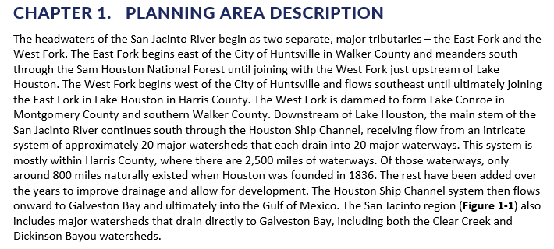
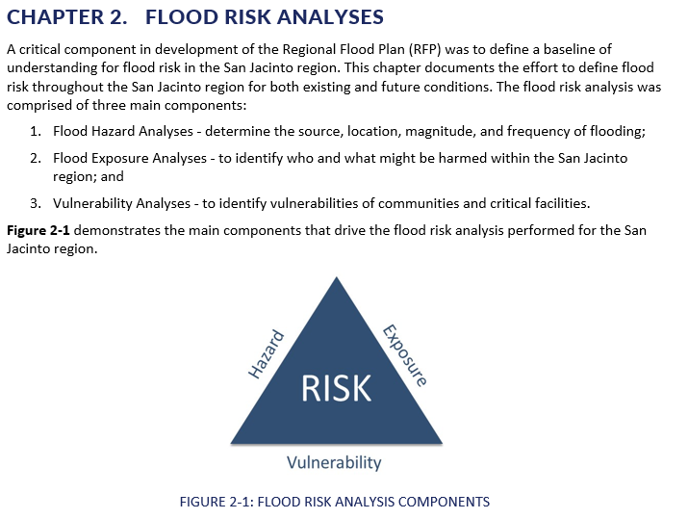
Draft Chapters 1 & 2
Draft Chapters 1 & 2 posted to website under Meetings page
Continuation of documentation effort from Tech Memo
Chapter 1 – Planning Area Description
Chapter 2 – Flood Risk Analyses
Review and comments requested by June 12th SJRFPG.TechCon@freese.com

Slide 37
Task 4C – Modeling Update
Remaining budget to be utilized on approved ranked FME list

Slide 38
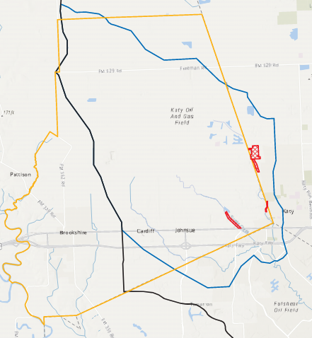
Task 5B – Small/Rural Communities FME Program
10 FMEs submitted to TWDB in April, to be studied over the next 5 years
First 2 FMEs authorized to begin by TWDB
Brookshire-Katy Drainage District Watershed Study
Liberty County Water Control District 1 Study

Slide 39
Q1 2026 Public Meeting Series

Slide 40
Purpose of the Public Meetings
Inform the public about the regional flood planning process
Gather feedback on flood-prone areas and community priorities
Align projects with TWDB funding opportunities – Flood Infrastructure Fund (FIF)
Foster transparency and trust in Region 6

Slide 41
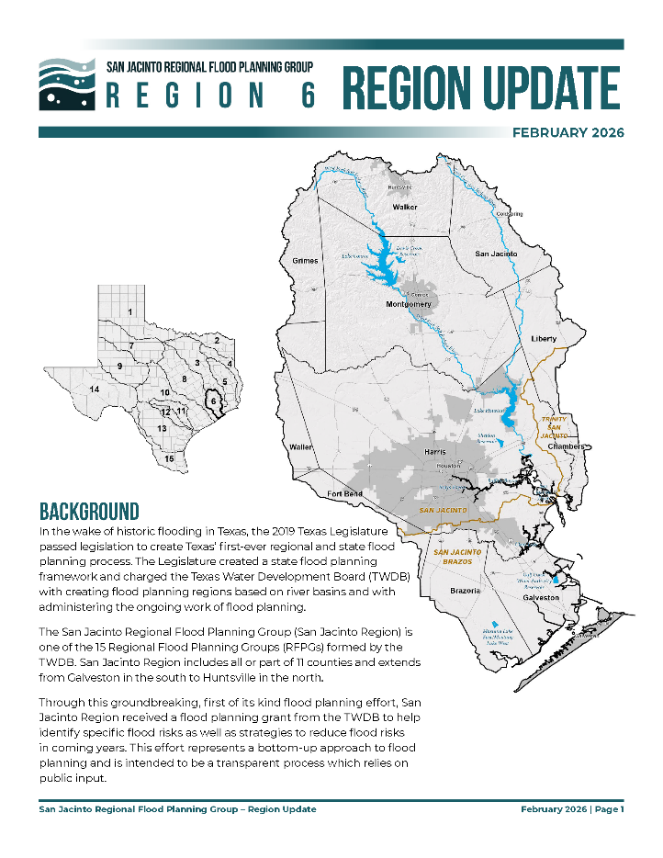
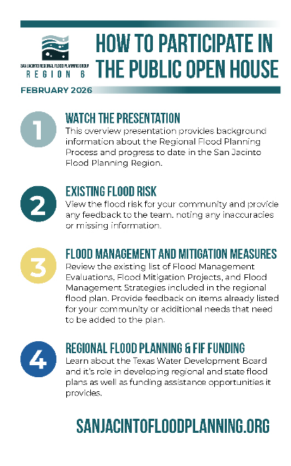
Public Meeting Format & Materials
Topic Stations
Open house style format
Looping Video Presentation
About the TWDB Flood Planning Process
About Region 6
Existing Flood Risk
Identified FMXs
Meeting Materials
Informational video
Informational handout/newsletter
“How to Participate” Handout
Frequently asked questions (FAQs)
Maps/exhibits pertaining to identified topic stations
Interactive digital maps for identifying flood-prone areas

Slide 42
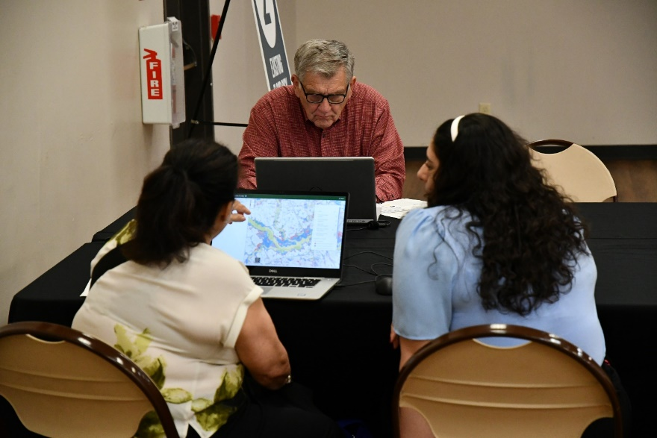
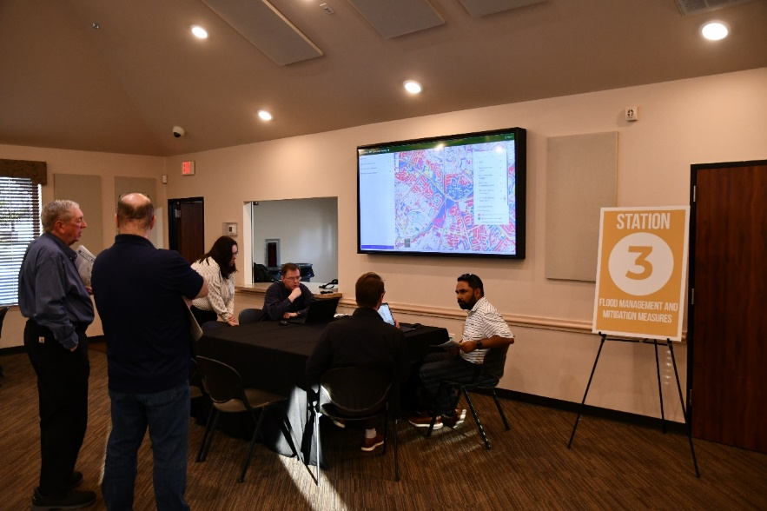
Meeting Locations, Schedule, & Attendance
East- Tuesday, February 17, 2026
DOW Active Complex - 4 attendees
North- Thursday, February 19, 2026
C.K. Ray Recreation Center - 14 attendees
West- Tuesday, February 24, 2026
Fry Road MUD Building - 20 attendees
South- Tuesday, March 3, 2026
Johnnie Arolfo Civic Center - 11 attendees
Central- Thursday, March 5, 2026
White Oak Conference Center - 12 attendees
Project team working with stakeholders at one of the interactive stations at the February 19th meeting.
Stakeholders at one of the interactive stations at the February 22nd meeting.

Slide 43
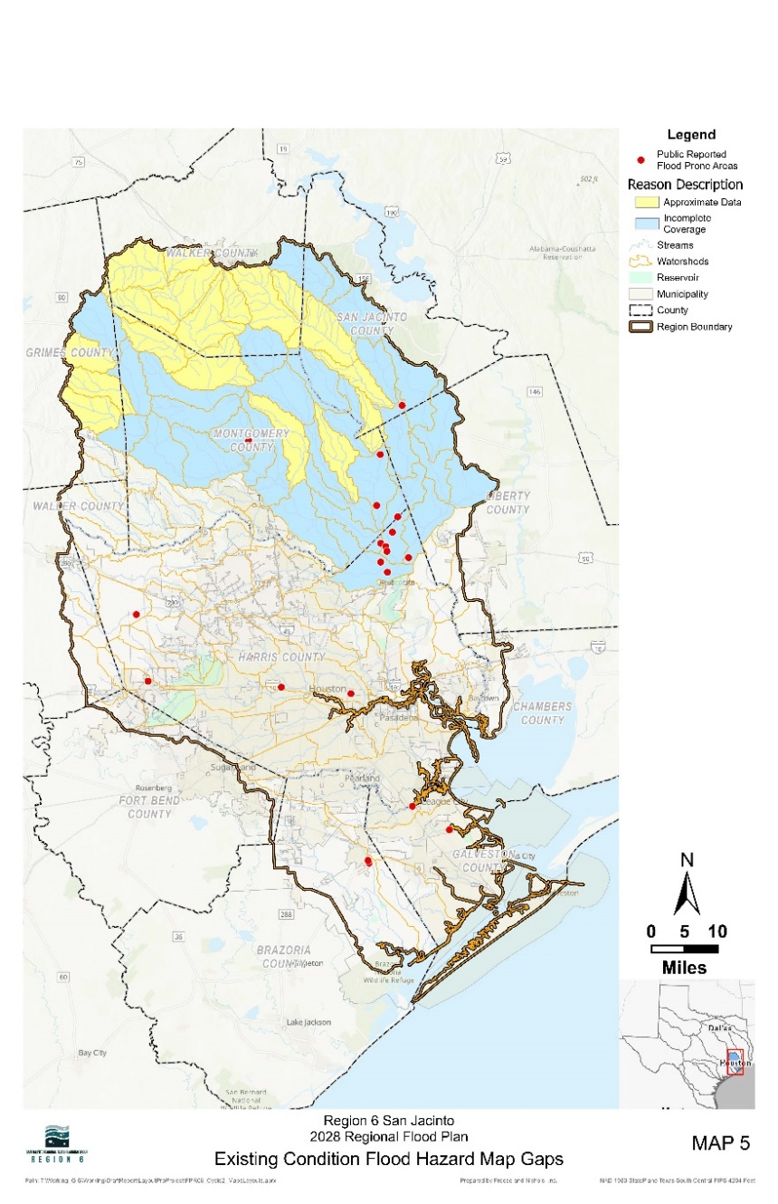
Feedback Summary
San Jacinto RFP Comment Survey
Flood Prone Areas (Points) - 25 responses
Flood Prone Areas (Polygons) - 10 responses
FMX Public Comment (Polygons) - 0 responses
Written Comment Forms
3 total submissions
Key Findings
Need for expanded and continuous drainage improvements Requests to deepen channels, concrete structures, and extend existing projects highlight gaps in current flood mitigation coverage
Flooding is impacting access and threatening homes Problem areas are blocking key neighborhood exits and putting nearby structures at risk
Concerns about property rights and project impacts Some residents are wary of flood mitigation efforts leading to land acquisition or use of eminent domain for non-flood purposes

Slide 44
Future Meeting Dates & Content
Meeting | Milestone/Action
May 2026 | RFPG Meeting Nature-Based Solutions Manual presentation Presentation of Chapter 1, 2 documentation Update on potential recommended FMXs in 2028 RFP
Aug 2026 | RFPG Meeting Report of Task 4C effort – performing FMEs Presentation of Chapter 3 documentation GLO RBFS presentation on recommended projects
Sept 2026 | RFPG Meeting FMX list to recommend – Action Needed Presentation of Chapter 7 documentation
Nov 2026 | RFPG Meeting Presentation of Chapter 4, 8 documentation
Jan 2027 | RFPG Meeting Presentation of Chapter 5, 6, 9, 10 documentation

Slide 45
ITEM 12
Discussion on date, time & location of future planning group meetings.
Next meetings will be held at United Way of Greater Houston:
8/18/2026
9/8/2026
11/10/2026

Slide 46
ITEM 13
Consider Agenda Items for Next
Meeting

Slide 47
ITEM 14 Public Comments – Limit 3 Minutes Per Person

Slide 48
ITEM 15 Adjournment

