Slide 1


Region 6 - San Jacinto Regional Flood Planning Group
Planning Meeting March 10, 2026 9:00 AM

Slide 2

ITEM 1 Call to Order

Slide 3
ITEM 2 Welcome and Roll Call

Slide 4
ITEM 3 Registered Public Comments on Agenda Items (Limit of 3 Minutes Per Person)

Slide 5
ITEM 4 Texas Water Development Board Update

Slide 6
ITEM 5 Approval of Meeting Minutes

Slide 7
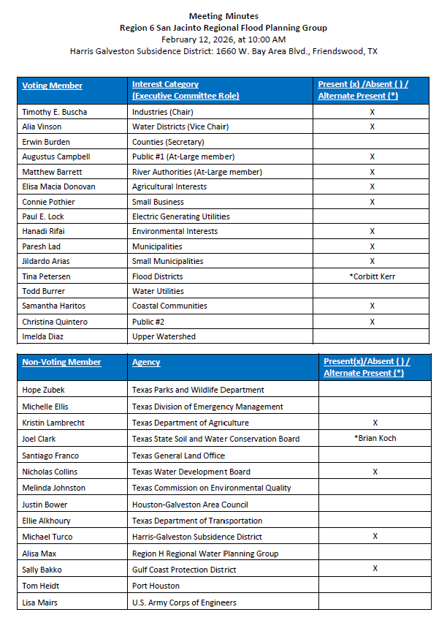
ITEM 5 Approval of Meeting Minutes

Slide 8
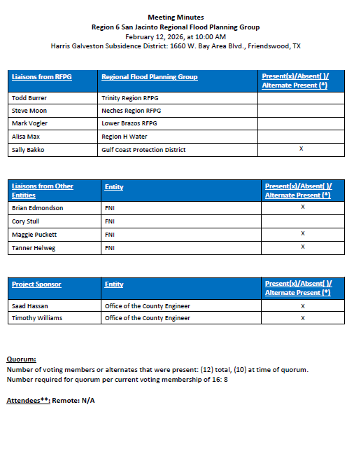
ITEM 5 Approval of Meeting Minutes

Slide 9
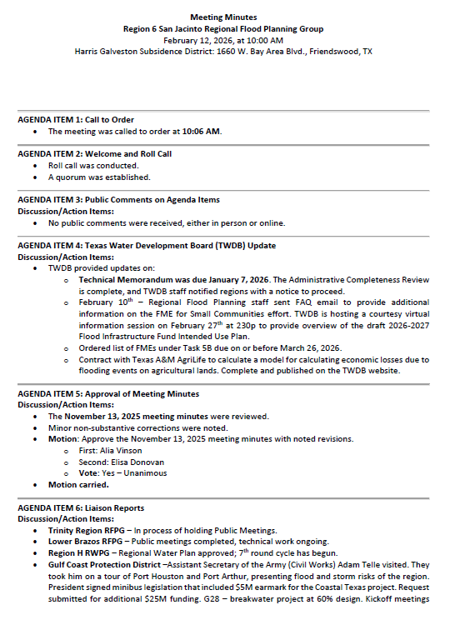
ITEM 5 Approval of Meeting Minutes

Slide 10
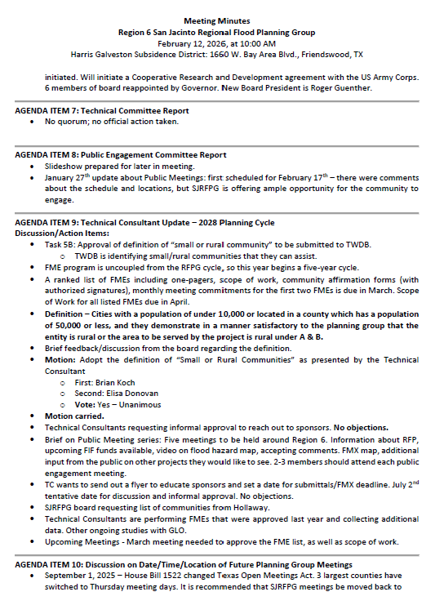
ITEM 5 Approval of Meeting Minutes

Slide 11
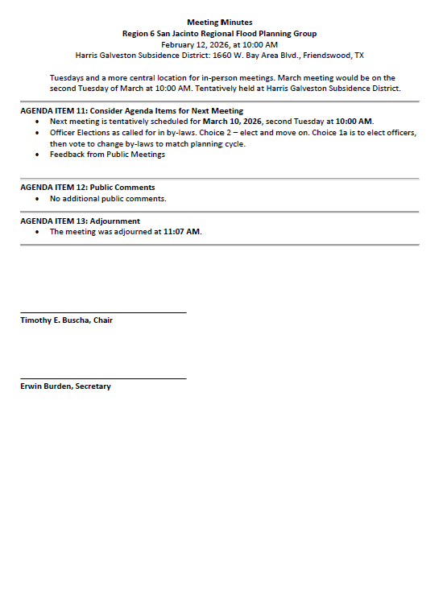
ITEM 5 Approval of Meeting Minutes

Slide 12
ITEM 6 Task 1 Discussion – RFPG Public Survey and data collection.
Liaison Reports Pertaining to Other Region(s) Progress and Status and other Related Entities:
a. Trinity Region
b. Neches Region
c. Lower Brazos Region
d. Region H Water
e. Gulf Coast Protection District (GCPD)

Slide 13
ITEM 7
SJRFPG – Technical Committee Report

Slide 14
ITEM 8 SJRFPG – Public Engagement Committee Report

Slide 15
ITEM 9
Update from the SJRFPG Technical Consultant on the 2028 Planning Cycle including discussion and possible action on the following:
a. Approval of the prioritized list of FMEs to be submitted to the TWDB for the Board to perform under a separate program (Task 5B).

Slide 16
Technical Consultant Update
March 10, 2026
Notes:
Introduction

Slide 17

Agenda
Red icon indicates need for action from the RFPG
Task 5B – Prioritized List of FMEs to be Submitted to the TWDB
2028 Regional Flood Planning Schedule

Slide 18
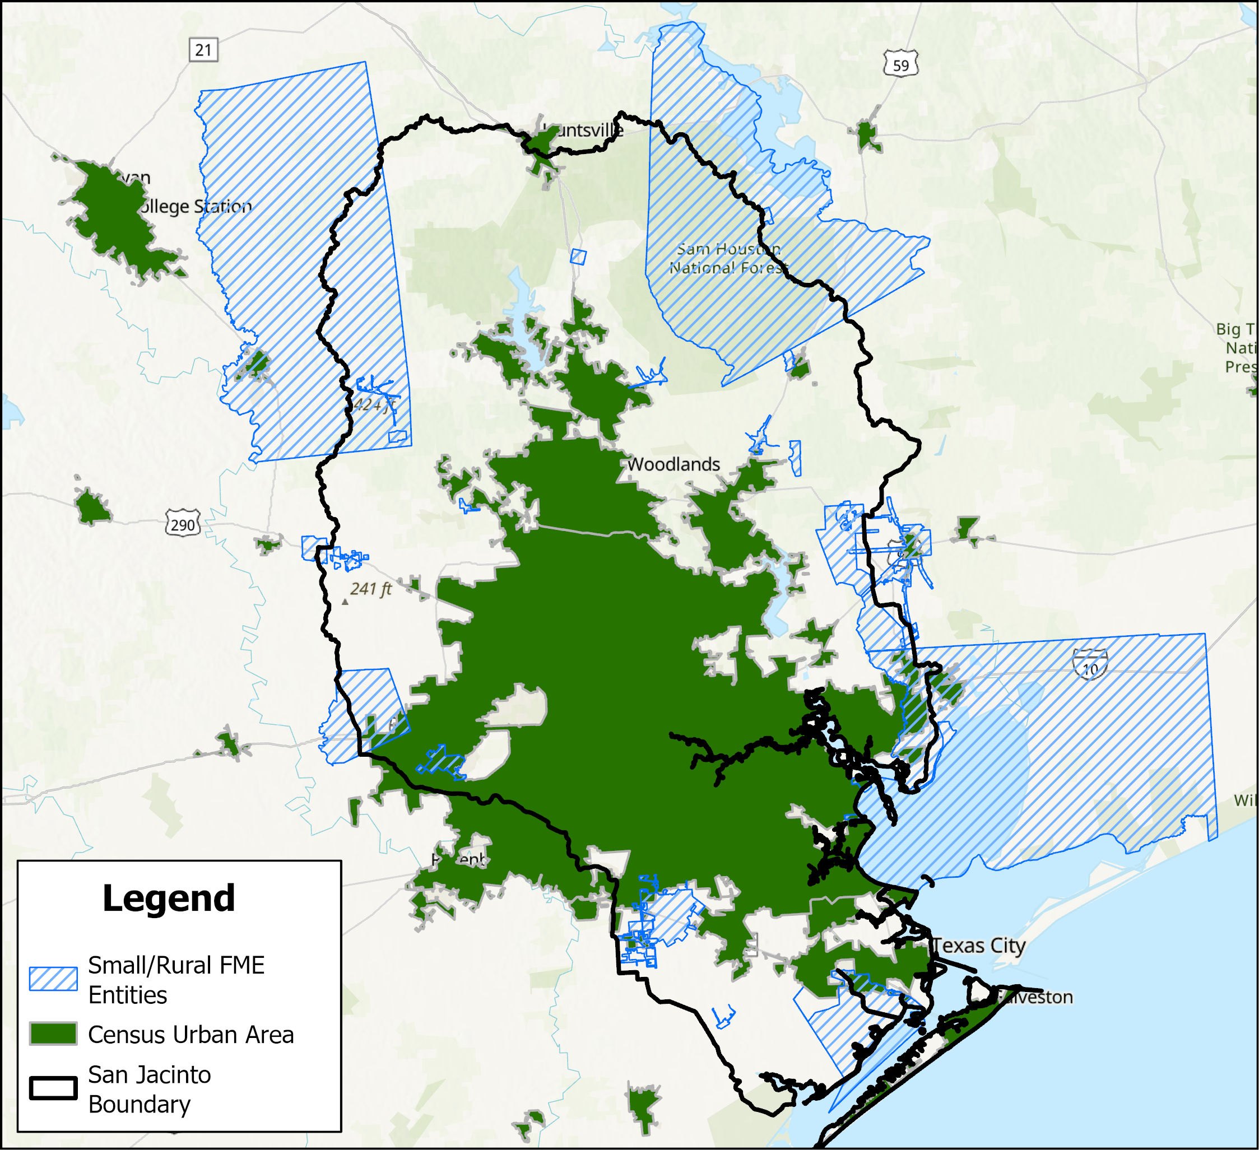
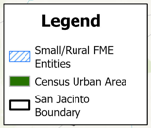
Task 5B – Prioritized FME List
Scope and fee subject to change with further coordination.

Slide 19
Future Meeting Dates & Content
Meeting | Milestone/Action
Mar 2026 | RFPG Meeting – Action Needed Vote to prioritized list of FMEs for submittal to TWDB (Task 5B)
May 2026 | RFPG Meeting Nature-Based Solutions Manual presentation Presentation of Chapter 1, 2 documentation GLO RBFS presentation on recommended projects Update on potential recommended FMXs in 2028 RFP
Aug 2026 | RFPG Meeting Report of Task 4C effort – performing FMEs Presentation of Chapter 3 documentation
Sept 2026 | RFPG Meeting FMX list to recommend – Action Needed Presentation of Chapter 7 documentation
Nov 2026 | RFPG Meeting Presentation of Chapter 4, 8 documentation
Jan 2027 | RFPG Meeting Presentation of Chapter 5, 6, 9, 10 documentation

Slide 20
ITEM 10
Discussion on date, time & location of future planning group meetings.

Slide 21
ITEM 11
Consider Agenda items for Next
meeting

Slide 22
ITEM 12 Public Comments – Limit 3 Minutes Per Person

Slide 23
ITEM 13 Adjournment

