Slide 1


Region 6 - San Jacinto Regional Flood Planning Group
Planning Meeting January 08,2026 10:00 AM Planning Meeting

Slide 2

ITEM 1 Call to Order

Slide 3
ITEM 2 Welcome and Roll Call

Slide 4
ITEM 3 Registered Public Comments on Agenda Items (Limit of 3 Minutes Per Person)

Slide 5
ITEM 4 Texas Water Development Board Update

Slide 6
ITEM 5 Approval of Meeting Minutes

Slide 7
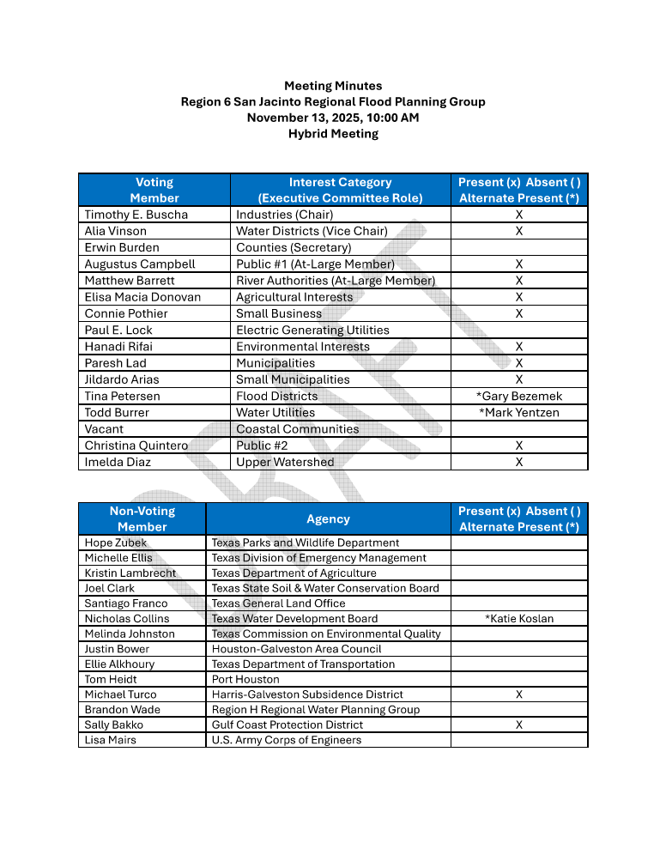
ITEM 5 Approval of Meeting Minutes

Slide 8
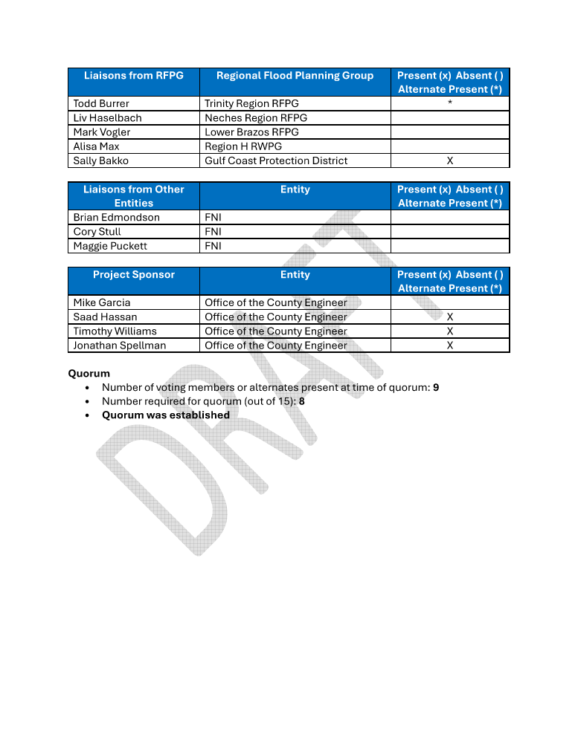
ITEM 5 Approval of Meeting Minutes

Slide 9
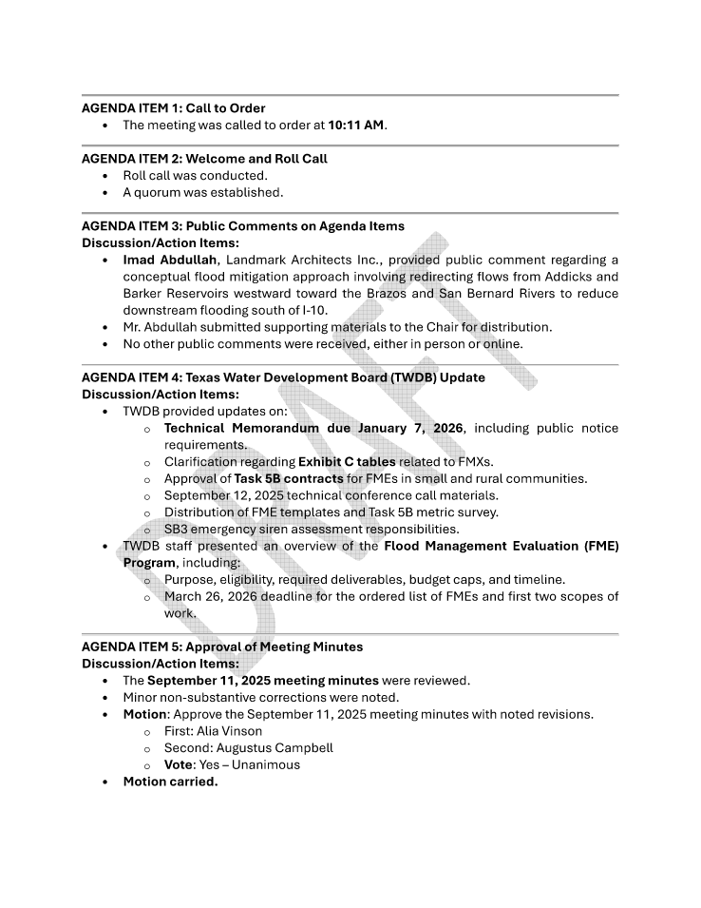
ITEM 5 Approval of Meeting Minutes

Slide 10
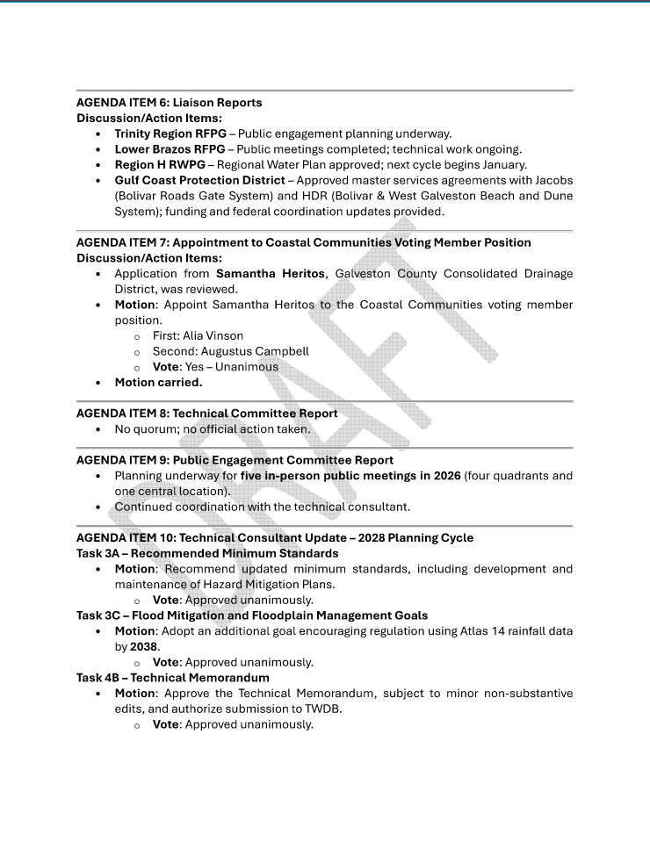
ITEM 5 Approval of Meeting Minutes

Slide 11
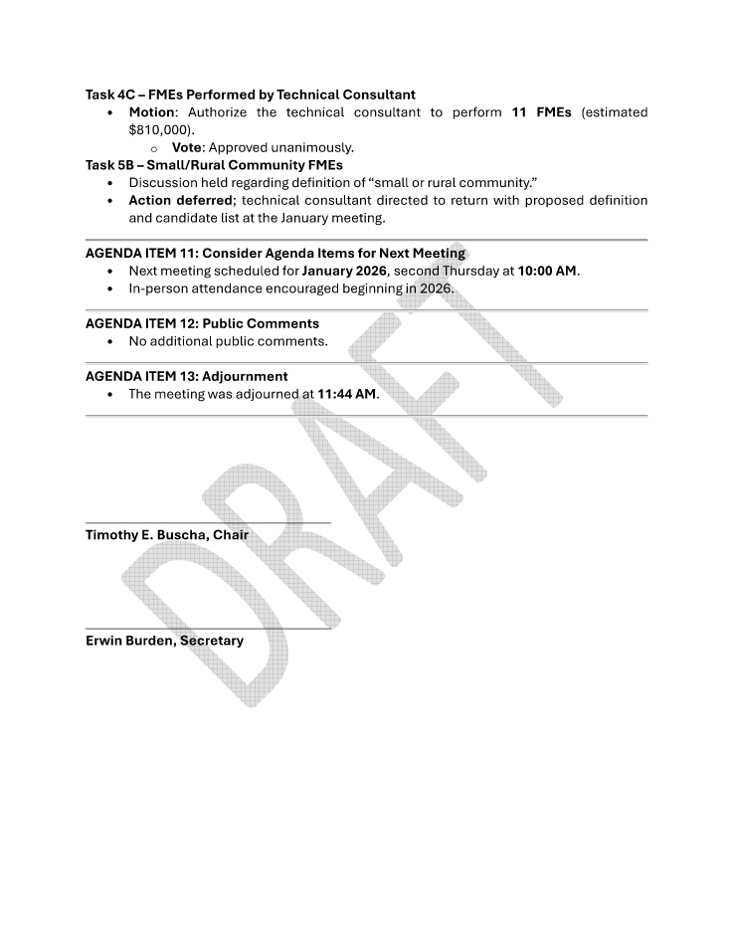
ITEM 5 Approval of Meeting Minutes

Slide 12
ITEM 6 Task 1 Discussion – RFPG Public Survey and data collection.
Liaison Reports Pertaining to Other Region(s) Progress and Status and other Related Entities:
a. Trinity Region
b. Neches Region
c. Lower Brazos Region
d. Region H Water
e. Gulf Coast Protection District (GCPD)

Slide 13
ITEM 7 SJRFPG – Technical Committee Report

Slide 14
ITEM 8 SJRFPG –Public Engagement Committee Report

Slide 15
ITEM 9
Update from the SJRFPG Technical Consultant on the 2028 Planning Cycle including discussion and possible action on the following:
a. Approval of the definition of a small or rural community that will inform the development of a prioritized list of FMEs to be submitted to the TWDB for the Board to perform under a separate program (Task 5B).

Slide 16
Technical Consultant Update
January 8, 2026
Notes:
Introduction

Slide 17

Agenda
Red icon indicates need for action from the RFPG
Task 5B – Definition of Rural Sponsor
Q1 2026 Public Meeting Series
Flyer for Regionwide Update/FMX Submittal Date
2028 Regional Flood Planning Schedule

Slide 18
Task 5B - Recommend List of FMEs to be Performed by TWDB

Slide 19
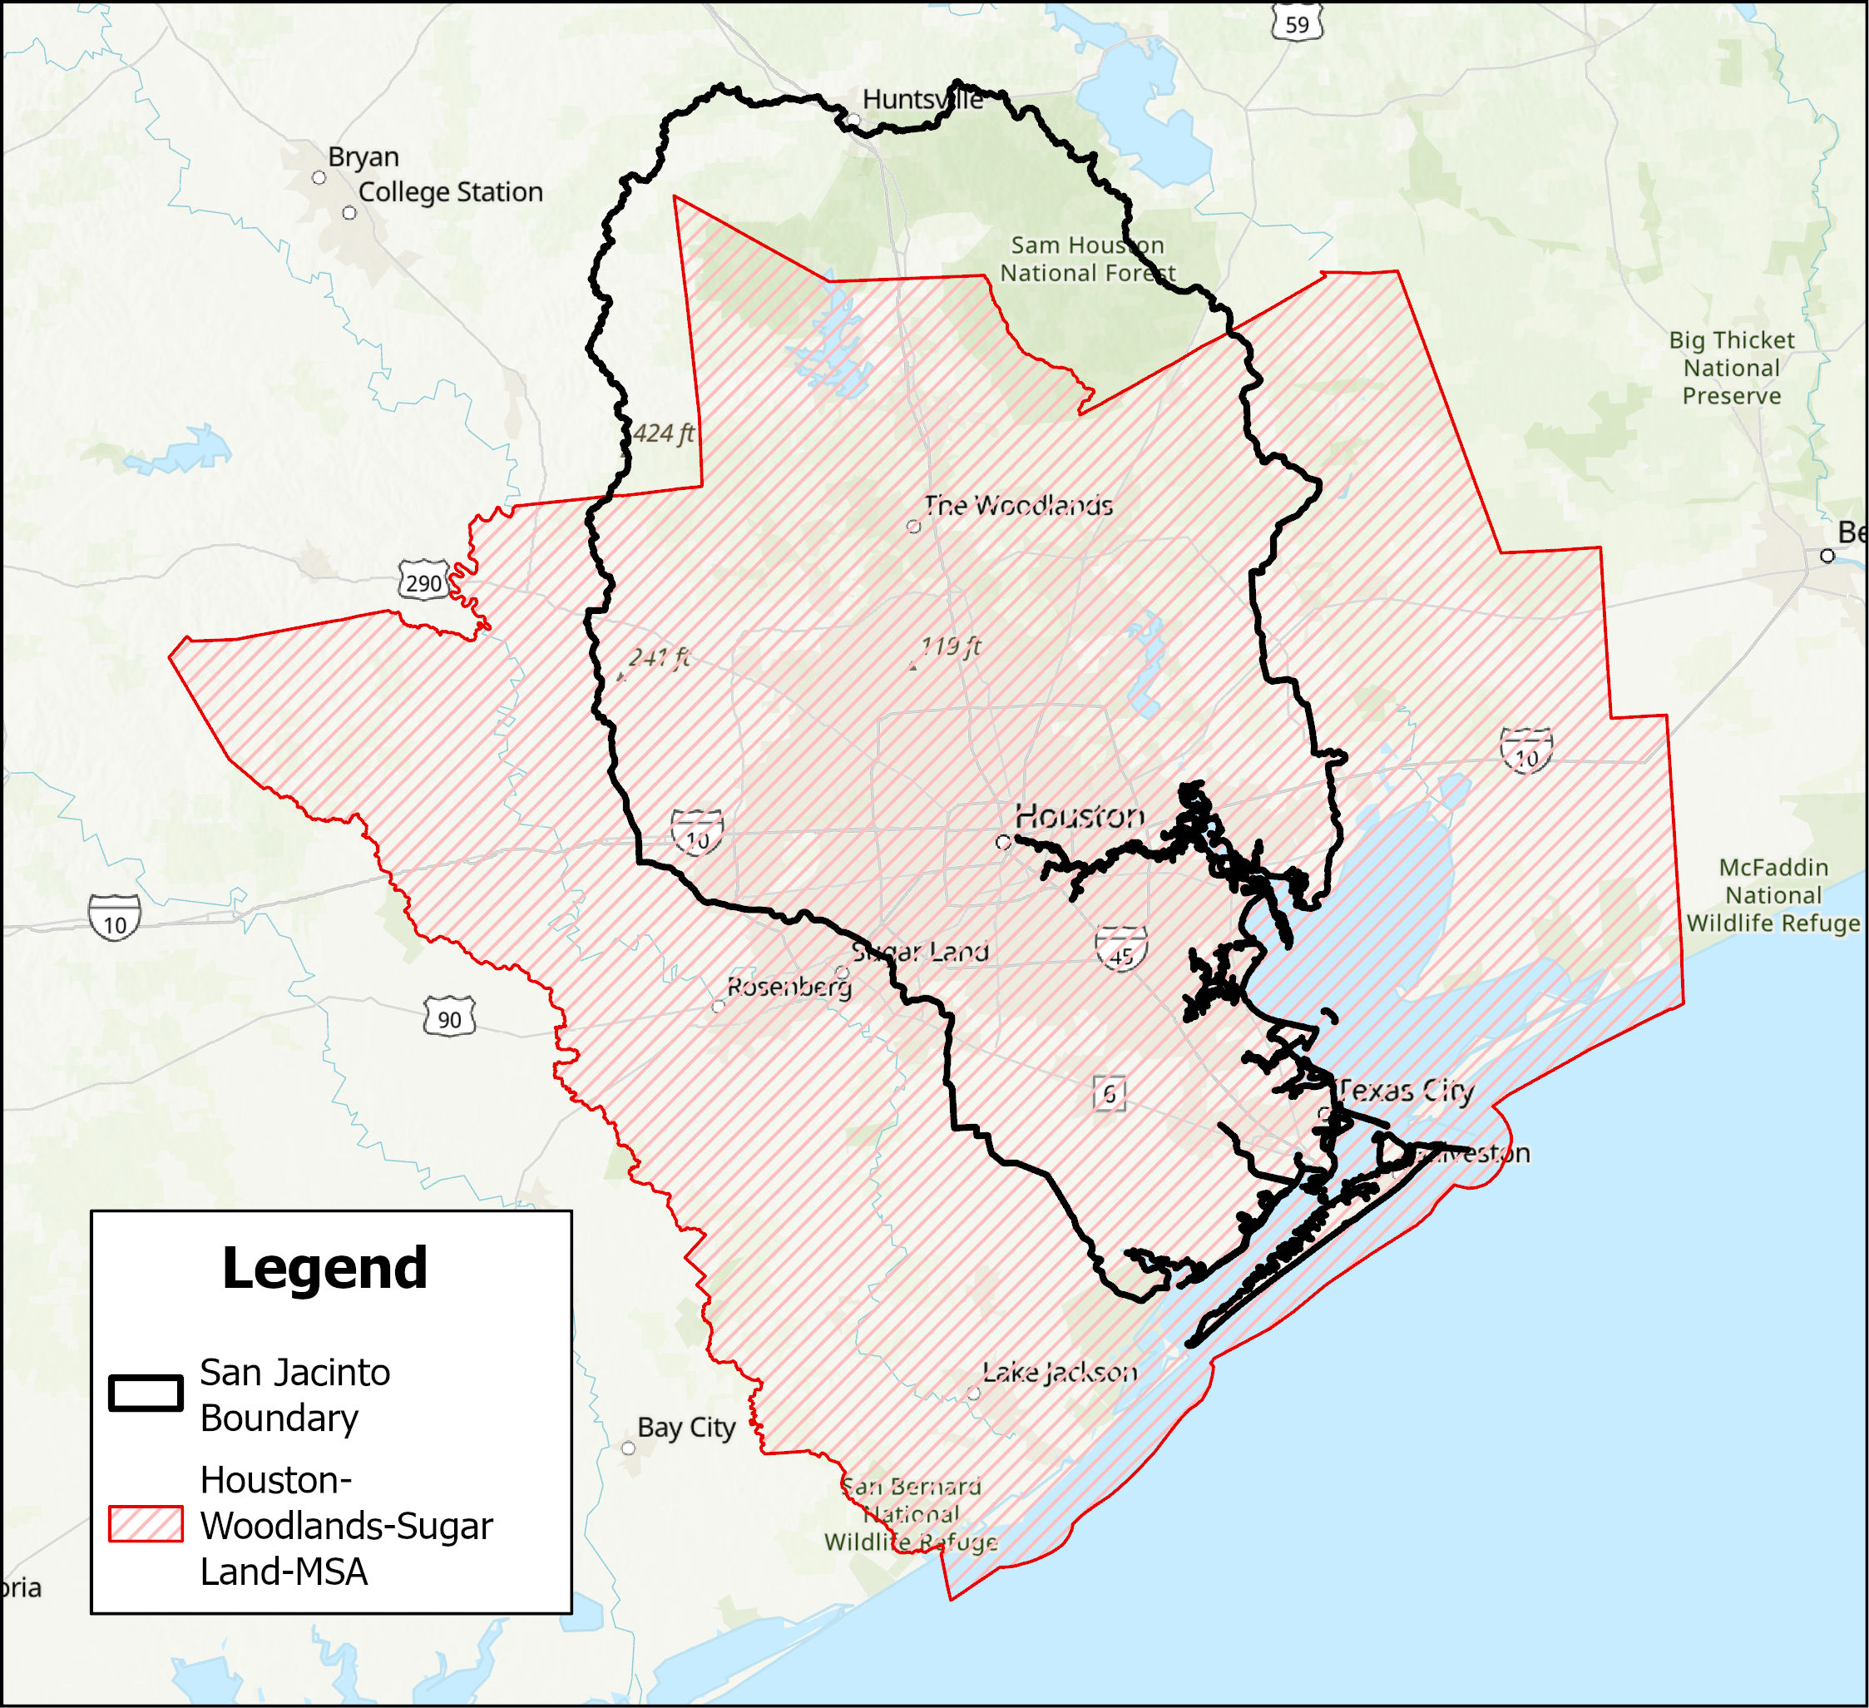
Task 5B – Small Community Sponsor Definition
Discussion and possible action to set SJRFP Rural Sponsor definition.
An Entity that is:
Within a municipality or other political subdivision with a population of 10,000 or less; OR
Located wholly in a county in which has a population of 50,000 or less
AND demonstrates in a manner satisfactory to the San Jacinto Regional Flood Planning Group that the entity is rural or the area to be served by the project is a wholly rural area despite either qualifying or not qualifying under Items (A) and (B)
- Urban area polygons developed by the US Census Bureau will be utilized to demonstrate satisfactory entities.
Notes:
Houston-Woodlands-Sugar Land-MSA takes up over 80% of the region

Slide 20
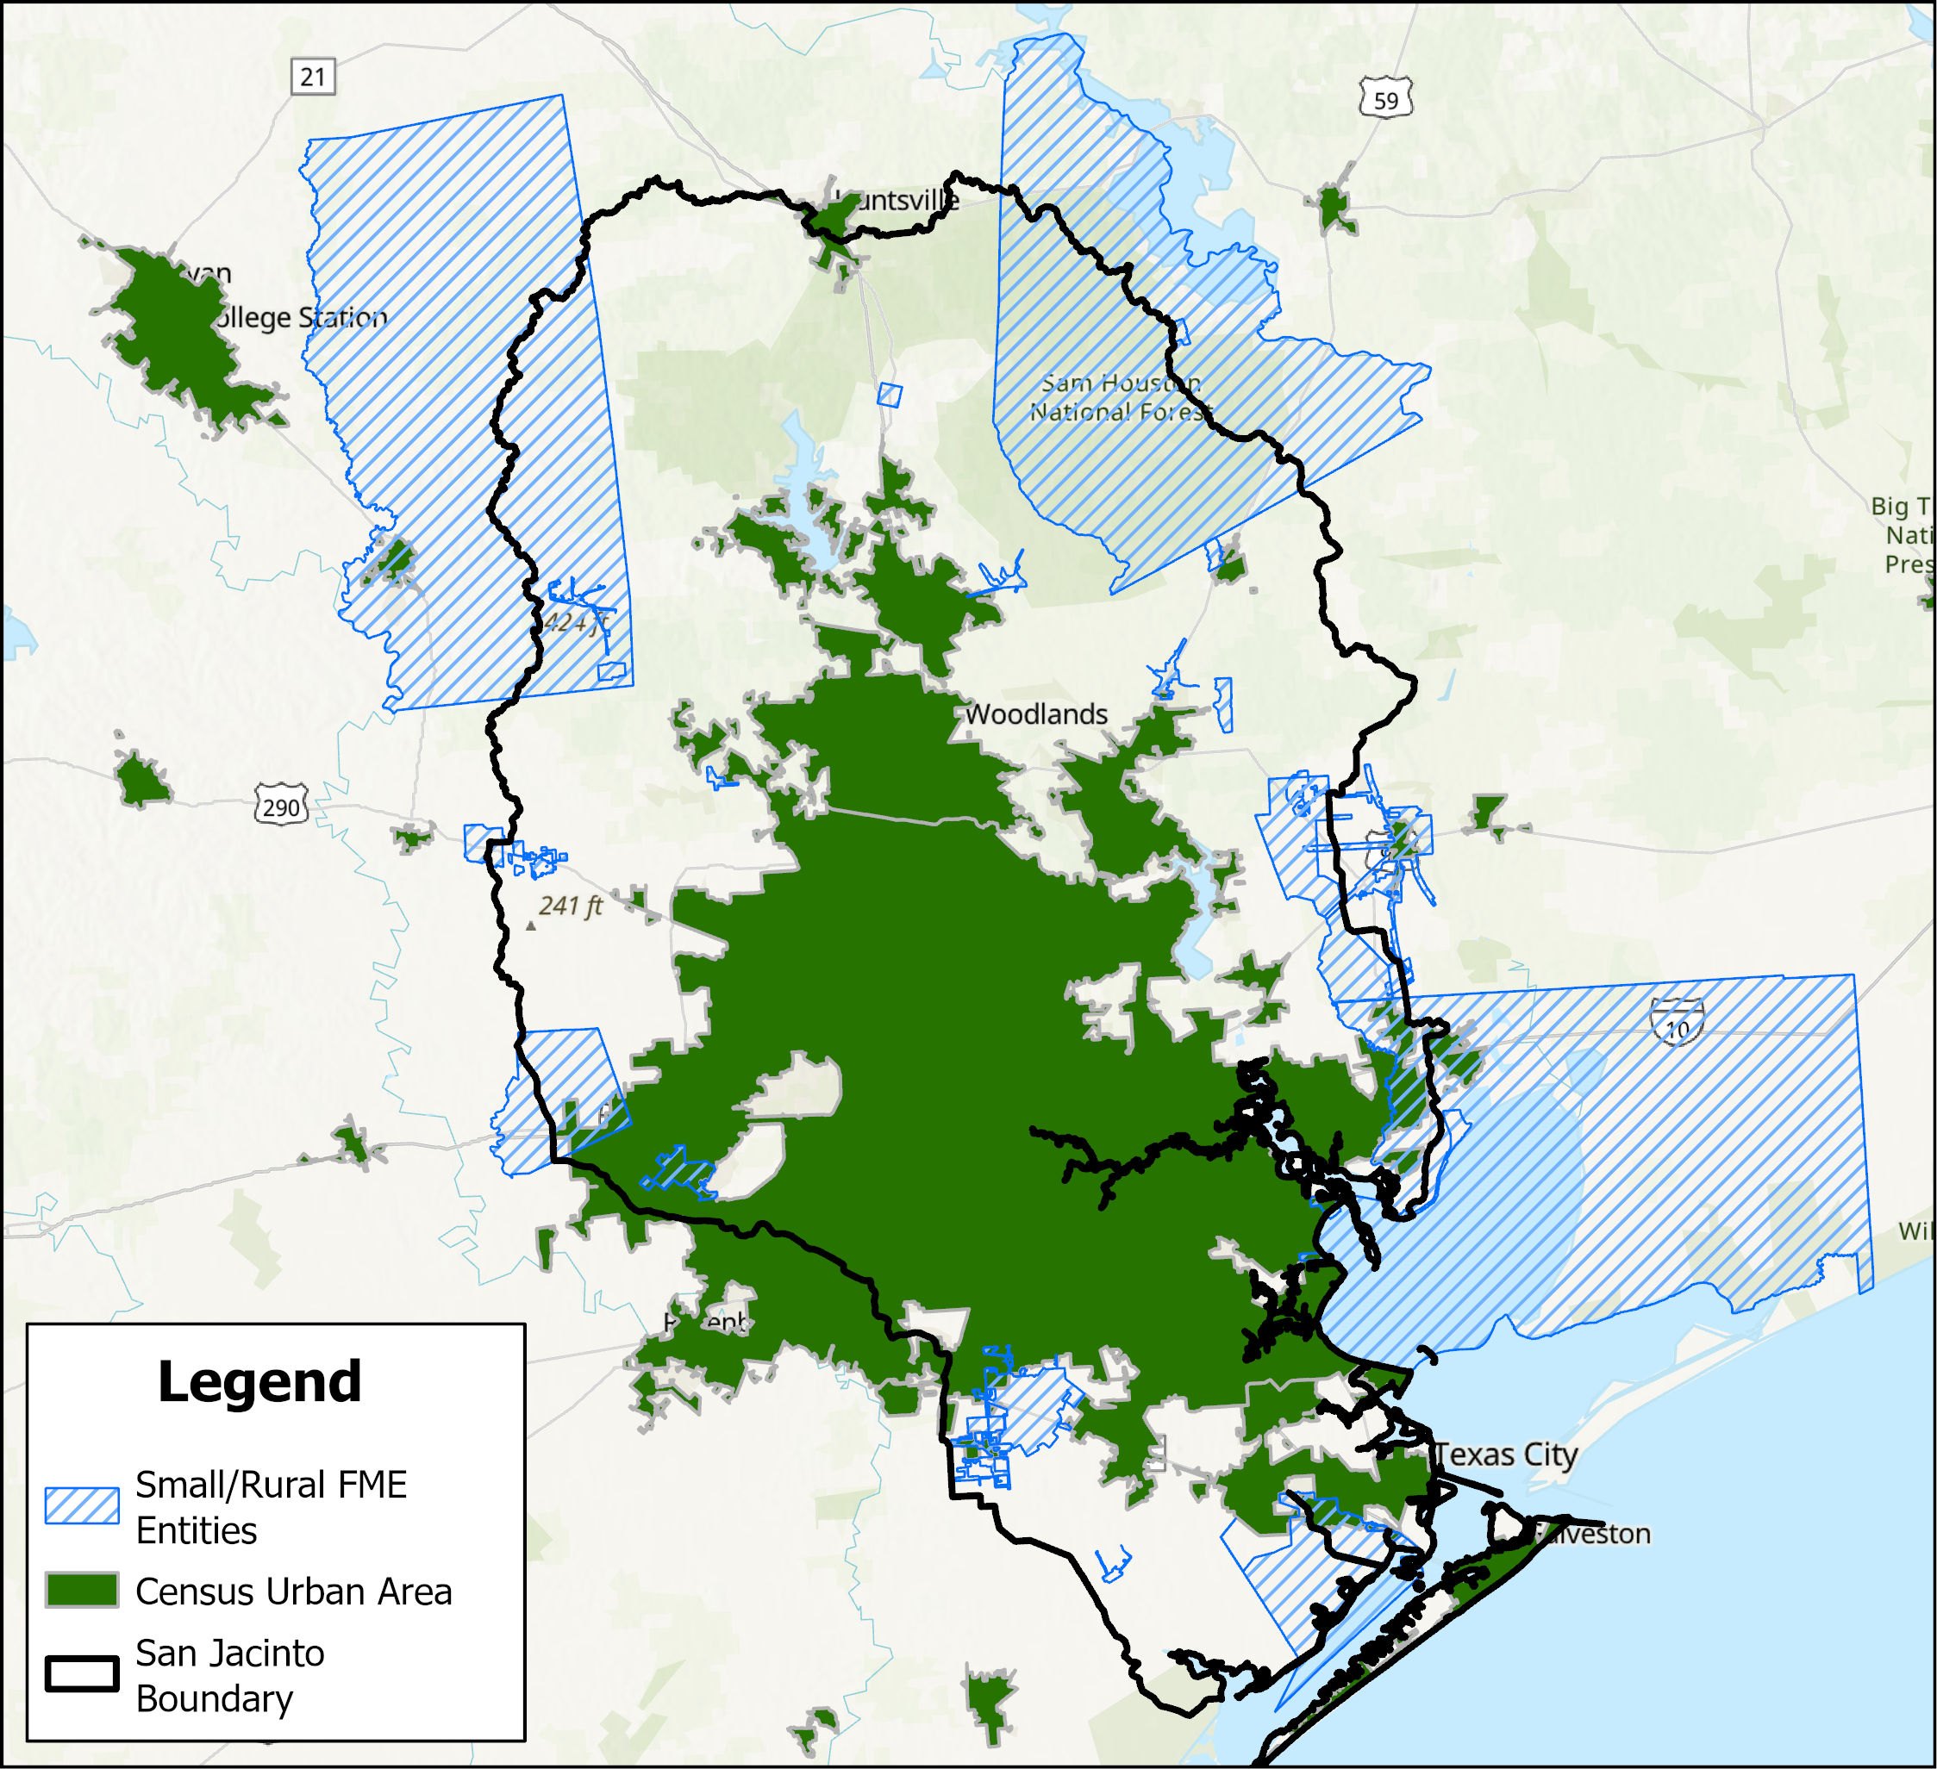
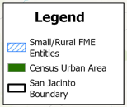
Task 5B - Small Community Sponsor Definition
$4M Budget
Notes:
Houston-Woodlands-Sugar Land-MSA takes up over 80% of the region

Slide 21
Q1 2026 Public Meeting Series

Slide 22
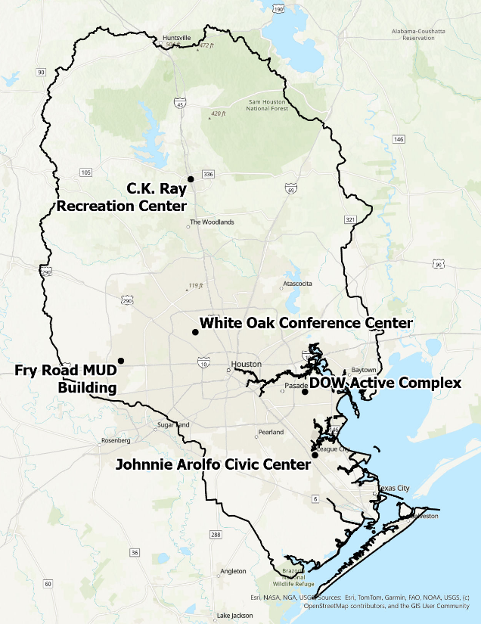
Public Meeting Series
Review and approve Q1 public meeting series.
Tuesday, January 27, 2026
Johnnie Arolfo Recreation Center (South)
Thursday, January 29, 2026
White Oak Conference Center (Central)
Tuesday, February 10, 2026
Fry Road MUD Building (West)
Tuesday, February 17, 2026
DOW Active Complex (East)
Thursday, February 19, 2026
C.K. Ray Recreation Center (North)
* All meetings scheduled from 5 PM – 7 PM

Slide 23
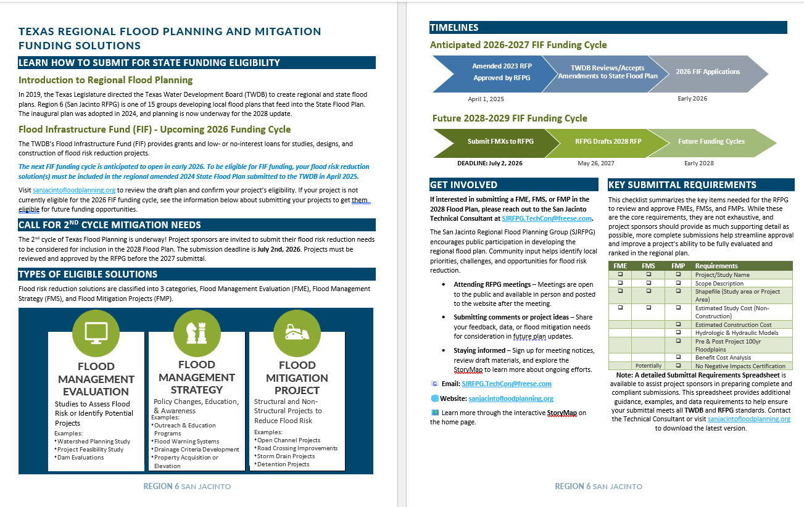
Flyer for Regionwide Update/FMX Submittal Date
Review and approve flyer and checklist posted to website.
Second cycle FMX deadline set for July 2, 2026.

Slide 24

2028 Flood Planning Cycle – FMX Schedule
FME List Due to TWDB Mar 2026
Define FME List TWDB to Perform
Draft RFP Due to TWDB May 2027
TWDB to perform top 2 FMEs through the FME Program
RFPG performs FMEs (Task 4C)
Collect Additional Data from Stakeholders
RFPG recommends FMXs (#1)
RFPG recommends FMXs (#2)
GLO RBFS Central Region Alternatives Analysis
Ongoing FIF Studies/Other sponsor-led studies
Chapter Documentation, Task 6A, 6B, Financial Assistance Survey
Call for FY26-27 FIF Abridged Apps
TWDB Abridged App Review
Call for Full Apps
TWDB Abridged App Review
March
June
September
March
June
2026
2027

Slide 25
Future Meeting Dates & Content
Meeting | Milestone/Action
Jan 2026 | RFPG Meeting – Action Needed Focus on FMEs the RFPG and TWDB to perform this cycle Vote to approve prioritized list of FMEs for the TWDB to perform (Task 5B) Planning for Q1 2026 Public Meeting Series
Mar 2026 | RFPG Meeting – Action Needed Presentation of Chapter documentation Update on potential recommended FMXs in 2028 RFP Vote to approve SOW and materials for submittal to TWDB (Task 5B)
May 2026 | RFPG Meeting Presentation of Chapter documentation GLO RBFS presentation on recommended projects Update on potential recommended FMXs in 2028 RFP

Slide 26
ITEM 10
Consider Agenda items for Next
meeting

Slide 27
ITEM 11 Public Comments – Limit 3 Minutes Per Person

Slide 28
ITEM 12 Adjournment

