Slide 1

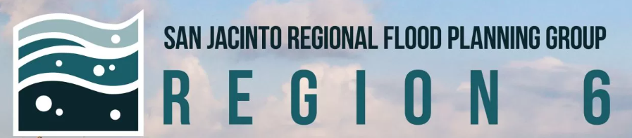
Region 6 - San Jacinto Regional Flood Planning Group
Public Engagement Meeting December 4, 2025 10:00 AM

Slide 2

ITEM 1 Call to Order

Slide 3
ITEM 2 Welcome and Roll Call

Slide 4
ITEM 3 Registered Public Comments on Agenda Items (Limit of 3 Minutes Per Person)

Slide 5
ITEM 4 Approval of Meeting Minutes

Slide 6
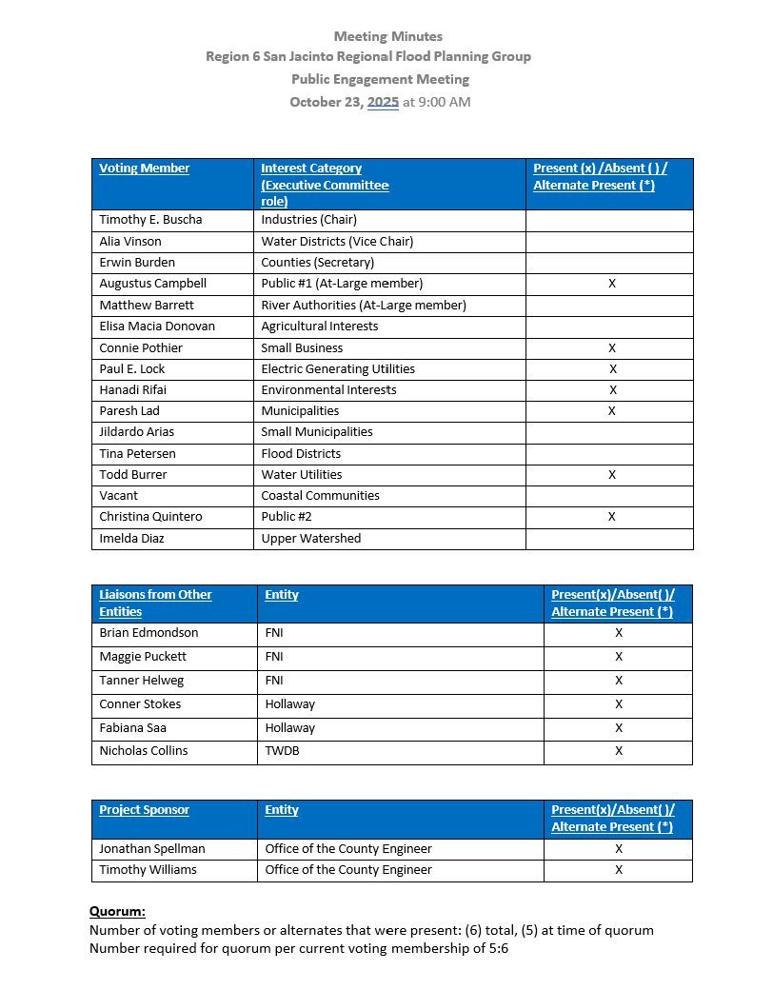
ITEM 5 Approval of Meeting Minutes

Slide 7
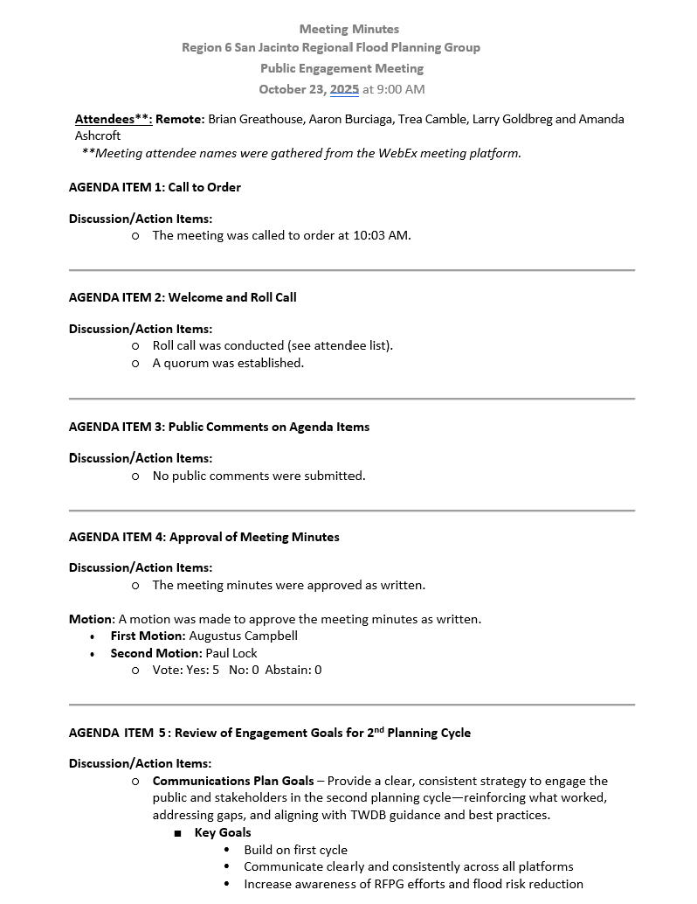
ITEM 5 Approval of Meeting Minutes

Slide 8
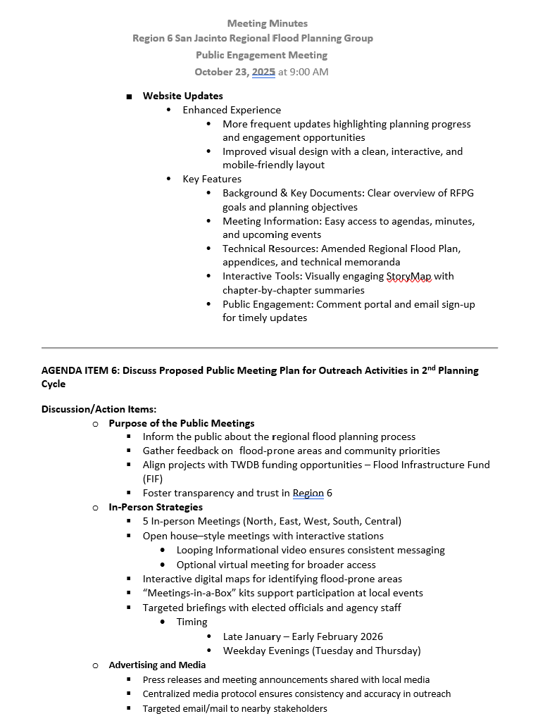
ITEM 5 Approval of Meeting Minutes

Slide 9
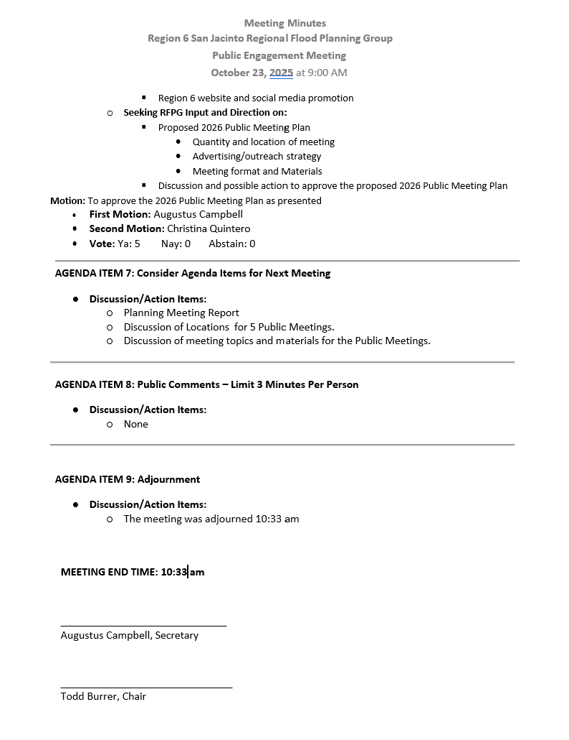
ITEM 5 Approval of Meeting Minutes

Slide 10
ITEM 6 Discussion and possible action on 2026 Public Engagement Meeting Schedule and Locations.

Slide 11
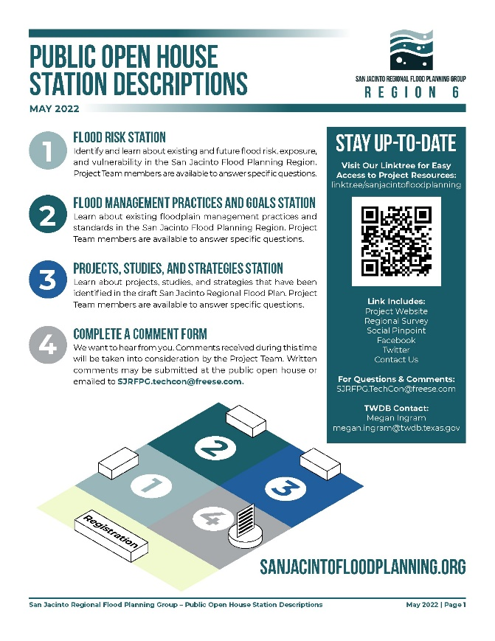
Proposed Public Meeting Materials
Proposed Topic Stations
Looping Video Presentation
About the TWDB Flood Planning Process
About Region 6
Existing Flood Risk
Identified FMXs
Proposed Meeting Materials
Informational video
Informational handout/newsletter
“How to Participate” Handout
Frequently asked questions (FAQs)
Maps/exhibits pertaining to identified topic stations
Interactive digital maps for identifying flood-prone areas

Slide 12




Purpose of the Public Meetings
Inform the public about the regional flood planning process
Gather feedback on flood-prone areas and community priorities
Align projects with TWDB funding opportunities – Flood Infrastructure Fund (FIF)
Foster transparency and trust in Region 6

Slide 13
Public Meeting Venues Considered
West
Hempstead Recreation Center
Steve Raddack Community Center
Fry Road MUD Building
South
Angleton Recreation Center
Doris Williams Lake Jackson Civic Center
Pearland Recreation and Natatorium
North
North Montgomery County Center
Kingwood Community Center
Tomball Community Center
East
Pasadena Convention Center
Felix L. Baldree Community Center
Flukinger Community Center
Central
Trini Mendenhall Community Center
White Oak Conference Center
Hiram Clarke MSC

Slide 14
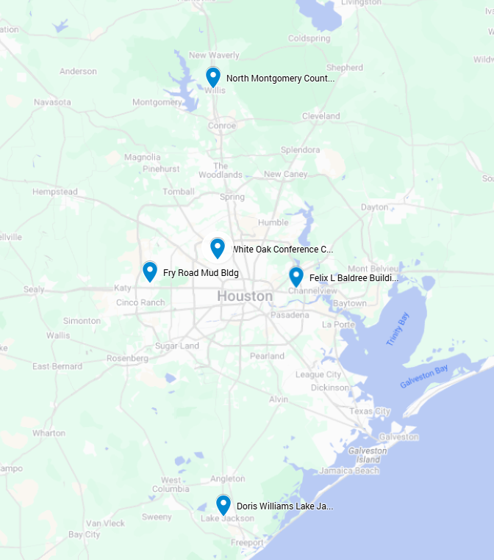
Recommended Meeting Locations & Schedule
Thursday, January 27, 2026
North Montgomery County Center (North)
Tuesday, January 29, 2026
White Oak Conference Center (Central)
Tuesday, February 10, 2026
Fry Road MUD Building (West)
Thursday, February 12, 2026
Doris Williams Lake Jackson Civic Center (South)
Tuesday, February 17, 2026
Felix L. Baldree Community Center (East)

Slide 15
Committee Action Needed
Seeking RFPG Input and Direction on:
Proposed 2026 Public Meeting Locations and Schedule
Discussion and possible action to approve the proposed 2026 Public Meeting Plan.

Slide 16
ITEM 7
Consider Agenda items for Next
meeting

Slide 17
ITEM 8 Public Comments – Limit 3 Minutes Per Person

Slide 18
ITEM 9 Adjournment

