Slide 1

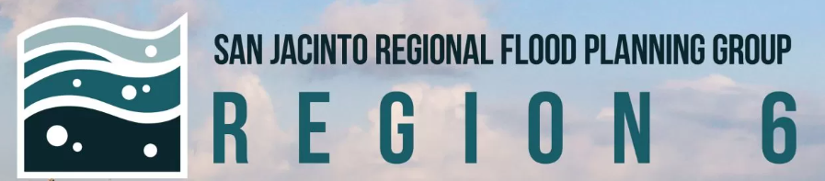
Region 6 - San Jacinto Regional Flood Planning Group
Public Engagement Meeting December 12, 2025 10:00 AM

Slide 2

ITEM 1 Call to Order

Slide 3
ITEM 2 Welcome and Roll Call

Slide 4
ITEM 3 Registered Public Comments on Agenda Items (Limit of 3 Minutes Per Person)

Slide 5
ITEM 4 Approval of Meeting Minutes

Slide 6
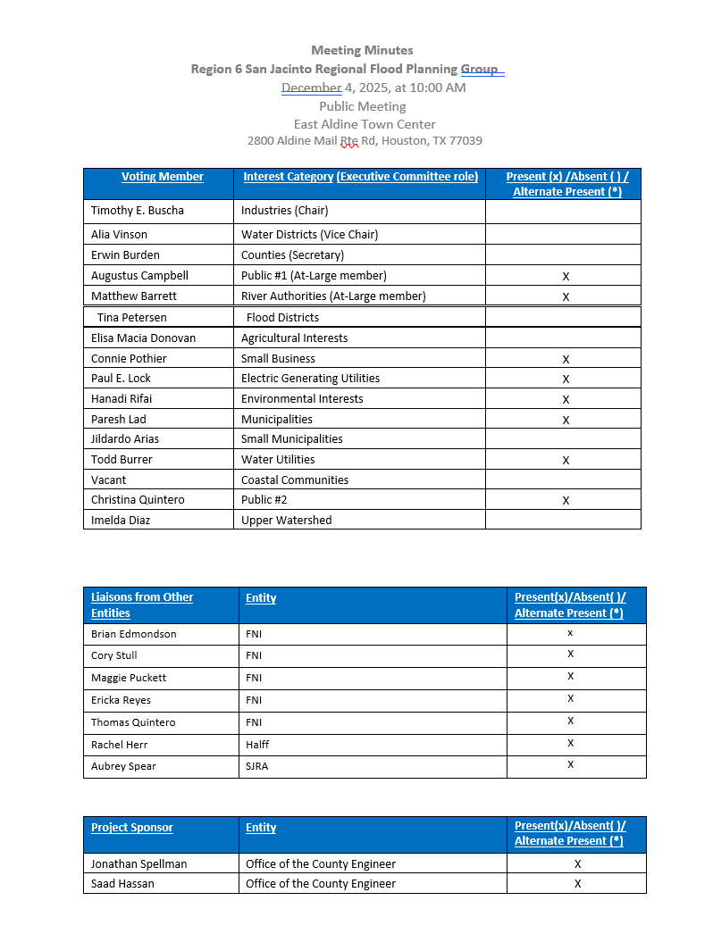
ITEM 5 Approval of Meeting Minutes

Slide 7
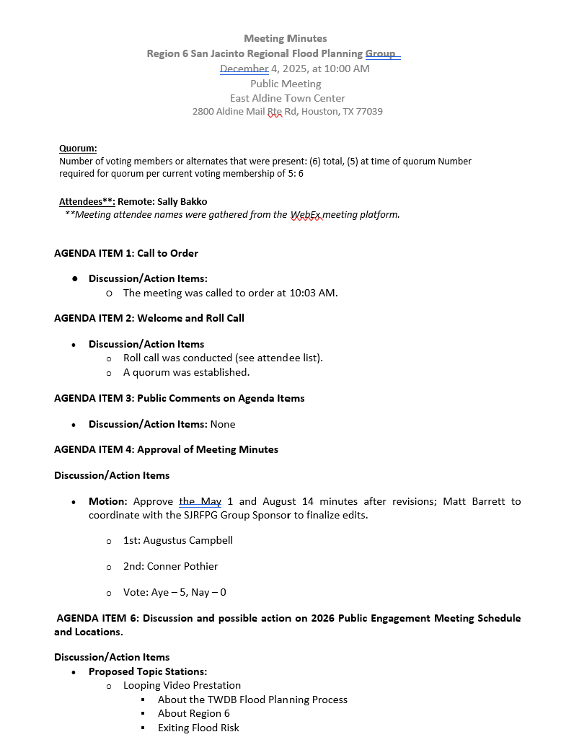
ITEM 5 Approval of Meeting Minutes

Slide 8
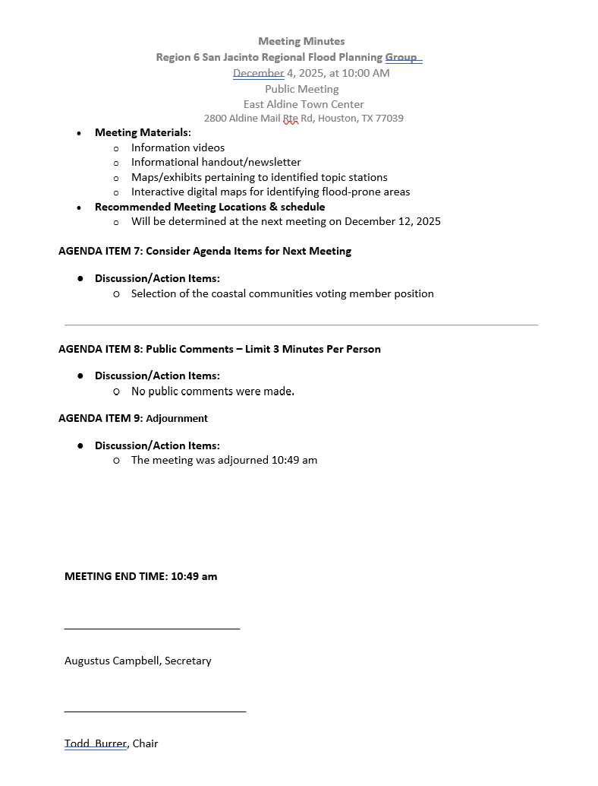
ITEM 5 Approval of Meeting Minutes

Slide 9
ITEM 6
Possible decisive action on 2026 Public Engagement Meeting Schedule and Locations.

Slide 10
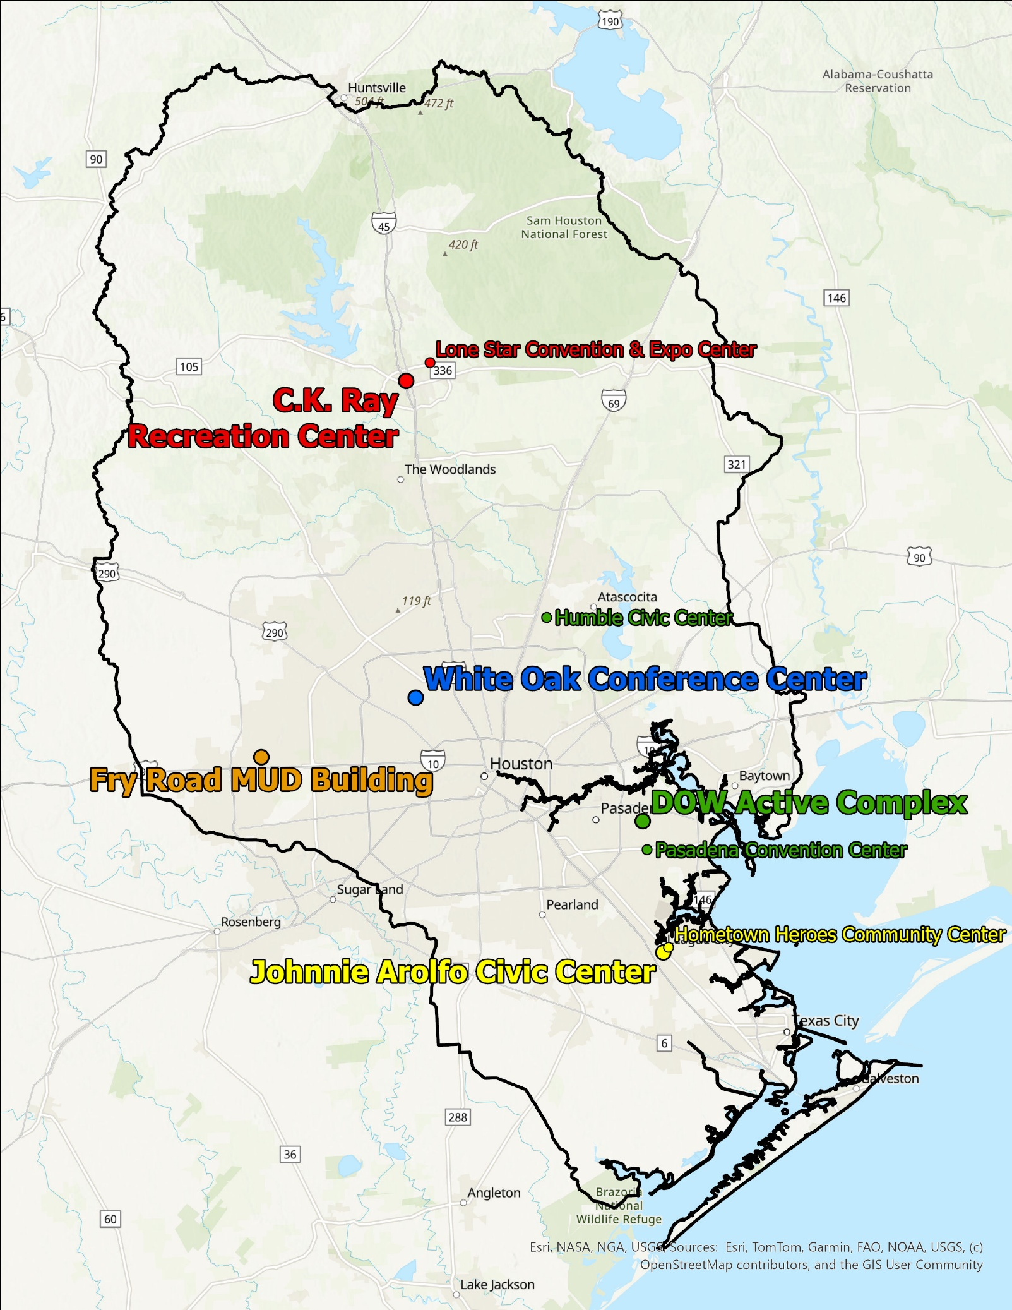
Public Meeting Venues Considered
West
Fry Road MUD Building
South
Hometown Heroes Community Center
Johnnie Arolfo Civic Center
North
C.K. Ray Recreation Center
Lone Star Convention & Expo Center
East
Pasadena Convention Center
DOW Active Complex
Humble Civic Center
Central
White Oak Conference Center

Slide 11
Recommended Meeting Locations & Schedule
Thursday, January 29, 2026
White Oak Conference Center (Central)
Alternate Dates: Open Availability
Tuesday, January 10, 2026
Fry Road MUD Building (West)
Alternate Dates: Open Availability
Thursday, February 12, 2026
Johnnie Arolfo Civic Center (South)
Alternate Dates: Open Availability
Tuesday, February 17, 2026
DOW Active Complex (East)
Alternate Dates: Open Availability
Thursday, February 19, 2026
C.K. Ray Recreation Center (North)
Alternate Dates: 2/5, 2/12

Slide 12
Committee Action Needed
Seeking RFPG Input and Direction on:
Proposed 2026 Public Meeting Locations and Schedule

Slide 13
ITEM 7
Consider Agenda items for Next
meeting

Slide 14
ITEM 8 Public Comments – Limit 3 Minutes Per Person

Slide 15
ITEM 9 Adjournment

