Slide 1


Region 6 - San Jacinto Regional Flood Planning Group
Planning Meeting November 13, 2025 10:00 AM Planning Meeting

Slide 2

ITEM 1 Call to Order

Slide 3
ITEM 2 Welcome and Roll Call

Slide 4
ITEM 3 Registered Public Comments on Agenda Items (Limit of 3 Minutes Per Person)

Slide 5
ITEM 4 Texas Water Development Board Update

Slide 6
TWDB Flood Management Evaluation (FME) for Small Communities

Slide 7
TWDB FME for Small Communities Overview
Prioritize FMEs for small and rural communities that lack resources and staff.
Consider FMEs most likely to result in potentially feasible FMPs and FMSs.
Beyond this requirement, RFPG has flexibility.
RFPGs provide list in order of timing.
RFPGs approve the FME list at regular RFPG meetings.
Notes:
From Exhibit C, pg. 81
Using the table of recommended FMEs prepared under Task 5A (but not already performed under Task 4C) the RFPGs will consider which FMEs are most likely to result in identification of potentially feasible FMPs and FMSs.
For this task, RFPGs are expected to prioritize FMEs for small and rural communities that lack the resources and staff to develop, perform, or review FMEs independently. Beyond this requirement, the RFPGs have flexibility in recommending the list of FMEs to be performed by TWDB, which may include considerations for emergency need, social vulnerability, available community resources, and scope.
The RFPGs will provide the order of timing of how they would like the FMEs to be performed by the TWDB within the list. Once a preliminary list of recommended FMEs to be performed by the TWDB is developed using the considerations listed above, the RFPG will approve the list of recommended FMEs at a regular RFPG meeting.

Slide 8
Requirements
Small and rural with limited resources
RFPGs to identify metrics to be approved at RFPG meeting and submitted to TWDB
Budget
Total estimated budget ~ approximately $59M/5 year
For the list, cap on total estimated FME-costs per RFPG per planning cycle: $3.9M
TWDB to provide the following required templates:
FMX one-pagers
Scope of work
Community affirmation form – requesting for the first two.
Notes:
RFPGs are to come up with clear criteria (example: population, AMHI, staff resources) for defining FMEs for their region to be performed by TWDB, have it approved by each region and provide it to the TWDB.
FMX one-pagers will be released soon.
Definition of Rural Applicant from FIF IUP (2024-2025)
Rural Applicant – An applicant that is: (A) a nonprofit water supply or sewer service corporation created and operating under Chapter 67 of the Texas Water Code or a district or authority created under Section 52, Article III, or Section 59, Article XVI, Texas Constitution, no part of the service area of which is located in an urban area with a population of more than 50,000; (B) a municipality: (i) with a population of 10,000 or less; or (ii) located wholly in a county in which no urban area has a population of more than 50,000; (C) a county in which no urban area has a population of more than 50,000; or (D) an entity that: (i) is a nonprofit water supply or sewer service corporation created and operating under Chapter 67 of the Texas Water Code, a district or authority created under Section 52, Article III, or Section 59, Article XVI, Texas Constitution, a municipality, county, or other political subdivision of the state, or an interstate compact commission to which the state is a party; and (ii) demonstrates in a manner satisfactory to the board that the entity is rural or the area to be served by the project is a wholly rural area despite not otherwise qualifying under Paragraph (A), (B), or (C).
Source: https://www.twdb.texas.gov/financial/programs/fif/doc/SFY2024-2025-FIF-IUP.pdf?d=8364.5

Slide 9
Considerations and Requests
The TWDB aims to complete the first two FMEs for each RFPG to align with draft 2028 RFPs due May 26, 2027
To meet an expedited timeline, TWDB requests the first two FMEs SOW be submitted with the full list on March 26, 2026.
Due on March 26, 2026:
Ordered list of FMEs: Standalone Exhibit C Table 19
Updated FME feature class
FME one-pagers
[First two FMEs only] Scope of work
[First two FMEs only] Community affirmation forms
Due on April 24, 2026:
Scope of work for all FMEs on the FME list

Slide 10
Proposed Timeline
January 7, 2026 – Tech Memo Submission Deadline
March 26, 2026 – Ordered list of FMEs due to TWDB
March 26, 2026 – SOWs for the first two FMEs due to TWDB
April 24, 2026 – SOWs for all other FMEs due to TWDB
May 2026 – Task orders executed with TWDB consultants
Sept 2026 – Midpoint update to RFPGs
February 19, 2027 – FME draft report and proposed FMPs to RFPGs
April 26, 2027 – FME final reports to RFPGs for inclusion in draft 2028 RFPs
May 26, 2027 – Draft 2028 RFP due to TWDB
Notes:
January 7, 2026 – Submission Deadline
TWDB confirms receipt
30-day review period
TWDB accepts (notice to proceed) or rejects Tech Memo
*March 26, 2026 – List of FMEs submitted to TWDB
*April 24, 2026 – SOWs for FMEs submitted to TWDB

Slide 11
Additional considerations
While RFPGs have flexibility to determine which small, rural community FMEs are included, please consider:
[First two FMEs only] Project scope: Can it be completed in less than a year?
Cost estimates: Must reasonably align with study scope and are proportionate to study size
[First two FMEs only] If TWDB determines FME cannot be completed during this cycle, FME will be skipped, and we will move to the next FME on the list
Note: TWDB consultants performing work to provide scope and fee within RFPG estimated amount (if reasonable)

Slide 12
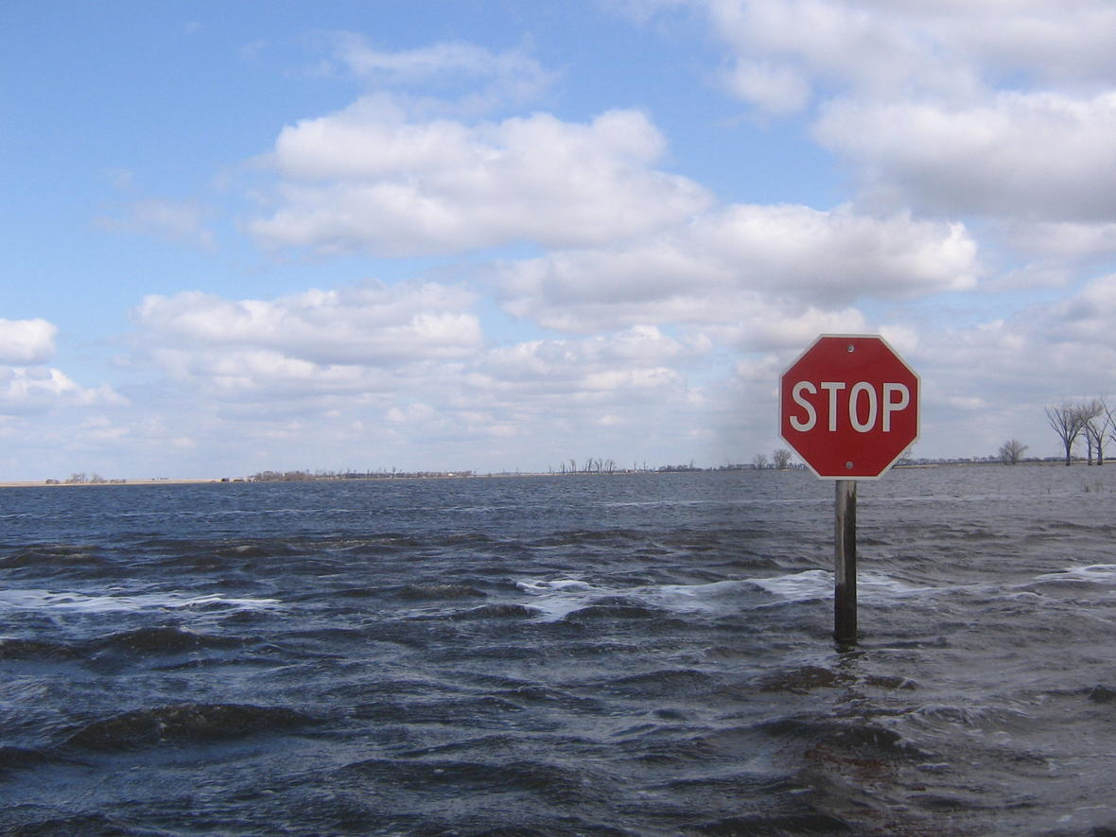
Questions?
Image: Brent Hanson, U.S. Geological Survey. Public domain.

Slide 13
ITEM 5 Approval of Meeting Minutes

Slide 14
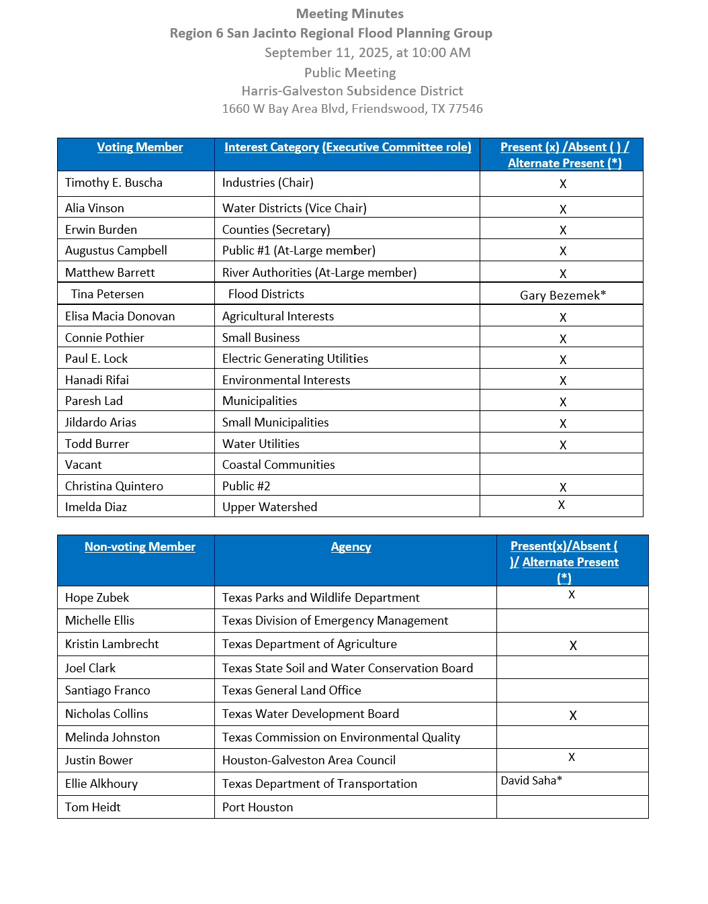
ITEM 5 Approval of Meeting Minutes

Slide 15
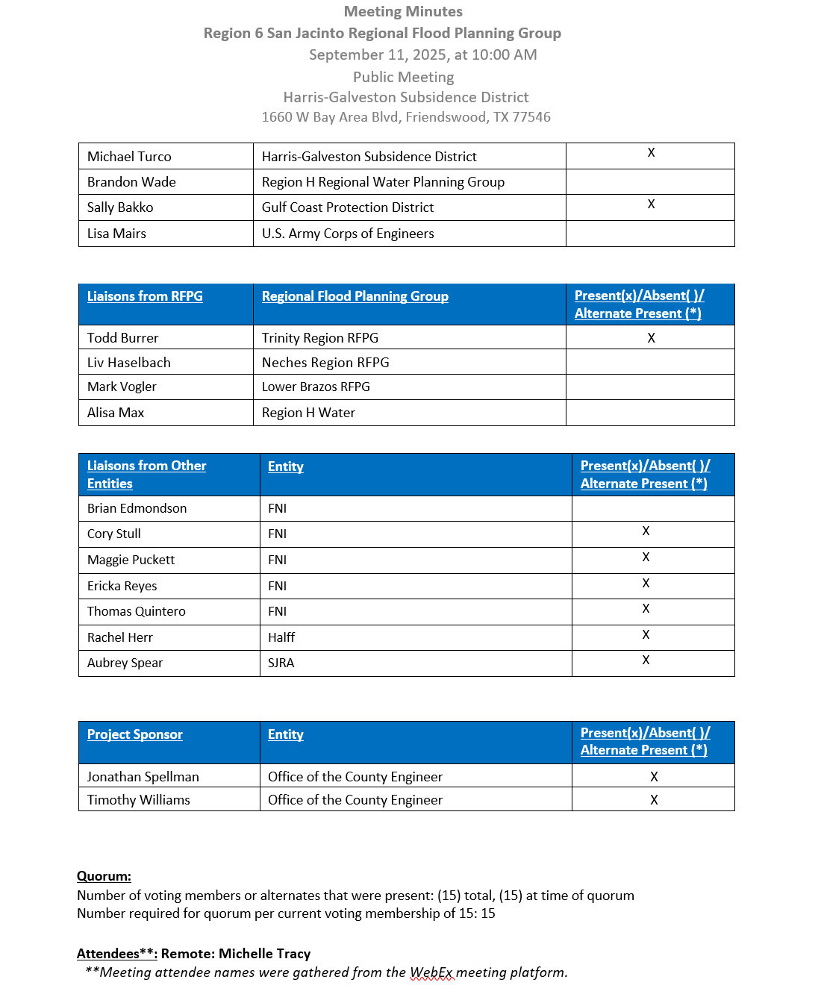
ITEM 5 Approval of Meeting Minutes

Slide 16
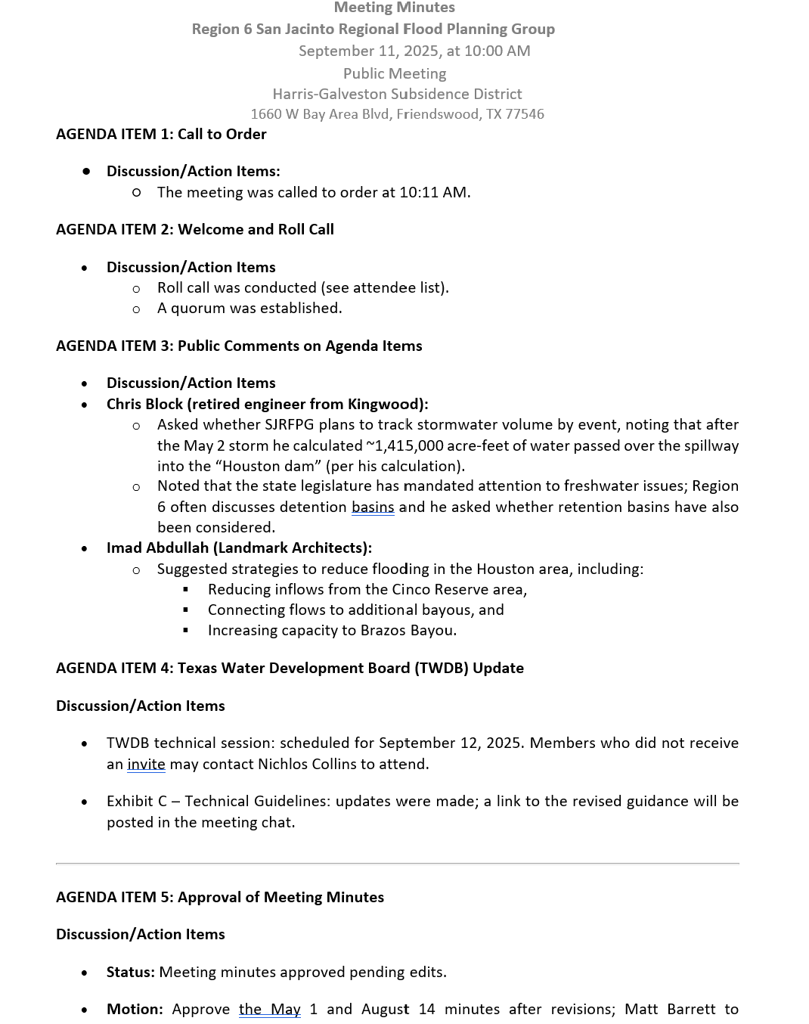
ITEM 5 Approval of Meeting Minutes

Slide 17
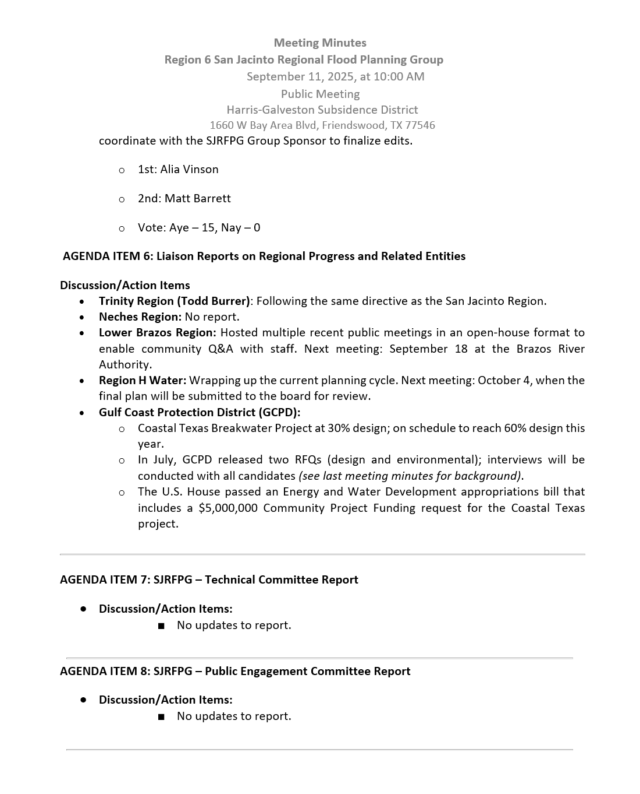
ITEM 5 Approval of Meeting Minutes

Slide 18
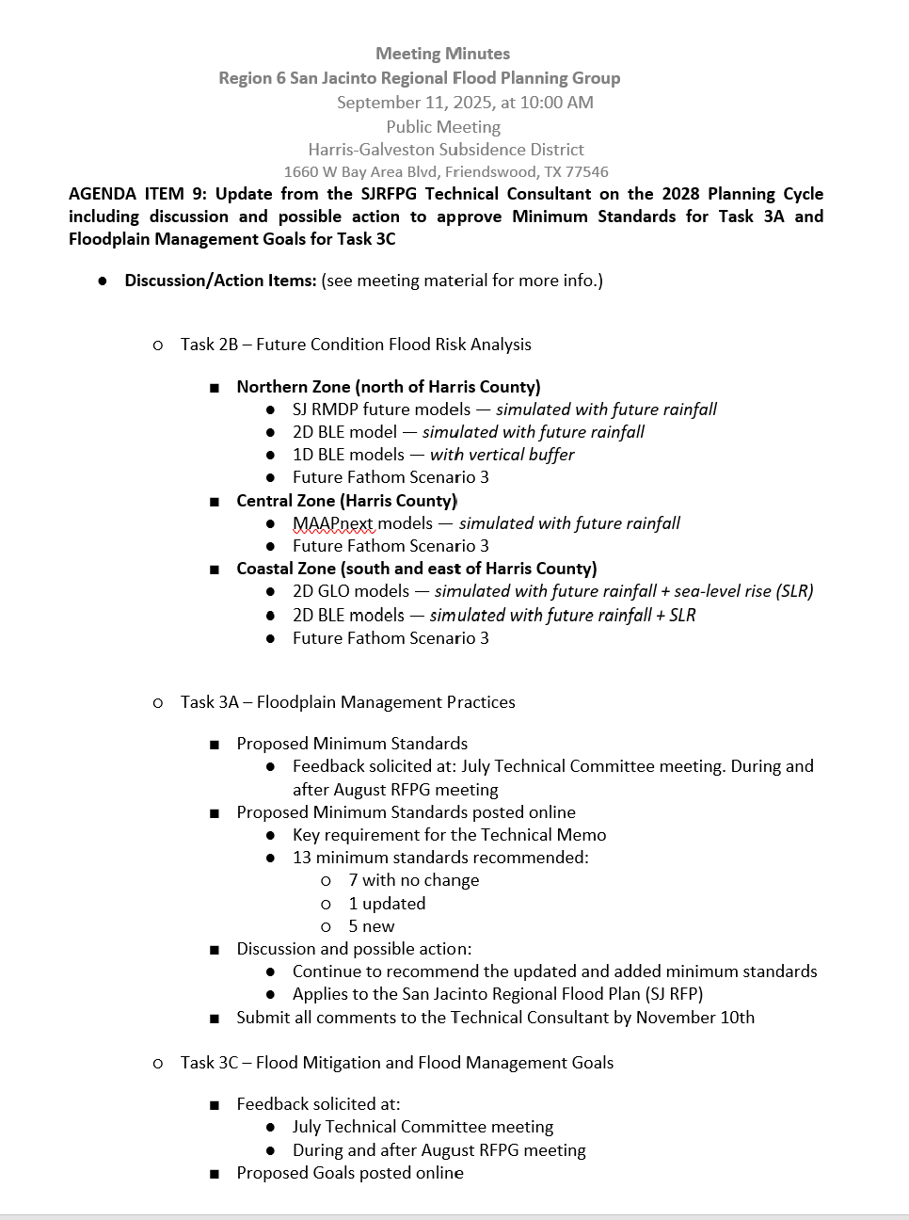
ITEM 5 Approval of Meeting Minutes

Slide 19
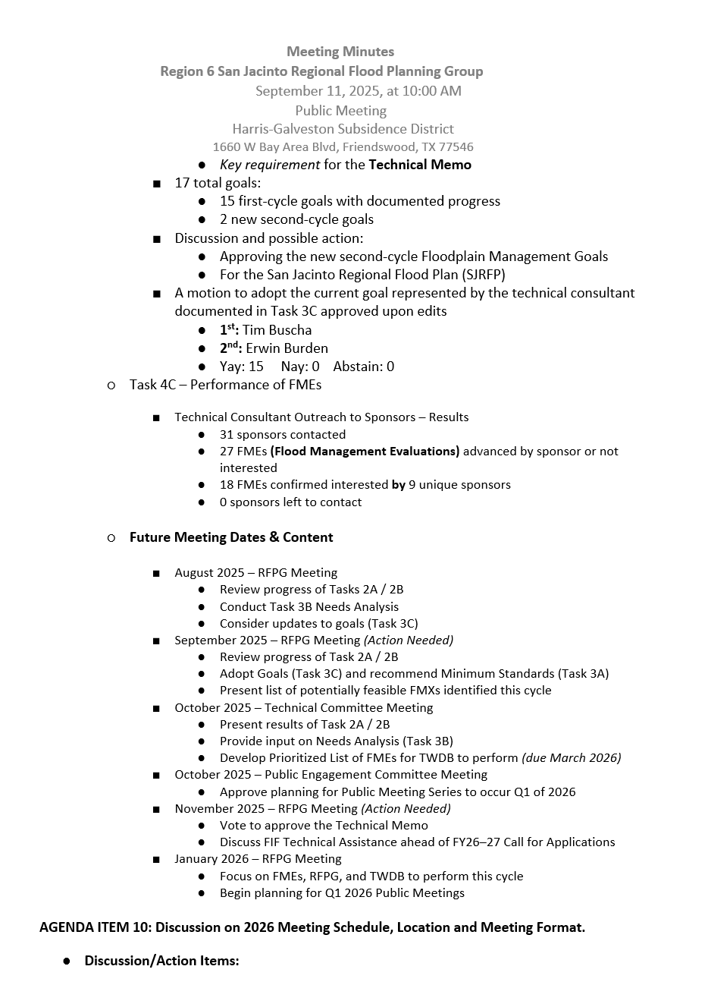
ITEM 5 Approval of Meeting Minutes

Slide 20
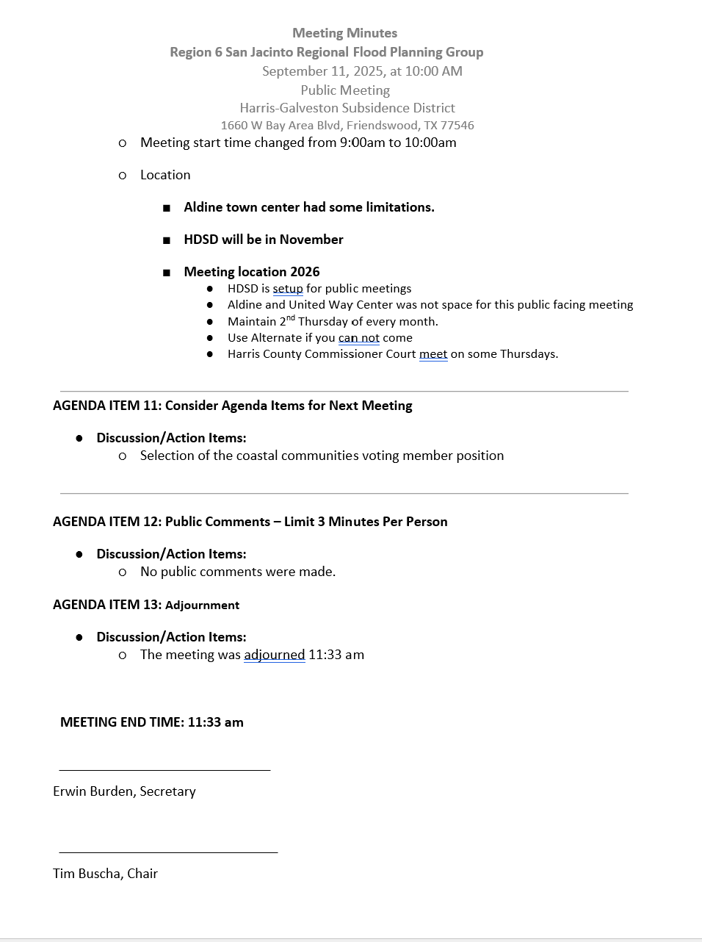
ITEM 5 Approval of Meeting Minutes

Slide 21
ITEM 6 Task 1 Discussion – RFPG Public Survey and data collection.
Liaison Reports Pertaining to Other Region(s) Progress and Status and other Related Entities:
a. Trinity Region
b. Neches Region
c. Lower Brazos Region
d. Region H Water
e. Gulf Coast Protection District (GCPD)

Slide 22
ITEM 7 Consideration of and possible action for Appointment to the Coastal Communities voting member position

Slide 23
ITEM 8 SJRFPG -Technical Committee Report

Slide 24
ITEM 9 SJRFPG –Public Engagement Committee Report

Slide 25
ITEM 10
Update from the SJRFPG Technical Consultant on the 2028 Planning Cycle including discussion and possible action on the following:
Recommendation and/or adoption of Minimum standards (Task 3A)
Adoption of goals (Task 3C)
Approval of the Technical Memorandum (Task 4B) and authorization for the Technical Consultant to submit to the TWDB on behalf of the RFPG
Selection of and authorization for the Technical Consultant Team to proceed with performing FMEs (Task 4C)
Approval of the definition of a small or rural community that will inform the development of a prioritized list of FMEs to be submitted to the TWDB for the Board to perform under a separate program (Task 5B).

Slide 26
Technical Consultant Update
November 13, 2025
Notes:
Introduction

Slide 27

Agenda
Red icon indicates need for action from the RFPG
Task 2A – Exposure Analysis Results
Task 3A – Floodplain Management Practices
Task 3C – Flood Mitigation and Flood Management Goals
Task 4B – Technical Memorandum
Task 4C – Performance of FMEs
Task 5B – Definition of Rural Sponsor
2028 Regional Flood Planning Schedule

Slide 28
Task 2A – Exposure Analysis Results

Slide 29
Task 3A - Evaluation and Recommendation of Floodplain Management Practices Review

Slide 30
Recommended Minimum Standards
Discussion and possible action to continue to recommend the updated and added minimum standards for the San Jacinto Regional Flood Plan.

Slide 31
Task 3C – Floodplain Management Goals

Slide 32
Additional Goal
Discussion and possible action to adopt one additional Floodplain Management Goal for the San Jacinto Regional Flood Plan.

Slide 33
Task 4B – Technical Memorandum
Discussion and possible action to adopt the Technical Memorandum and authorize the SJRFPG Technical Consultant to submit to the TWDB on behalf of the SJRFPG

Slide 34
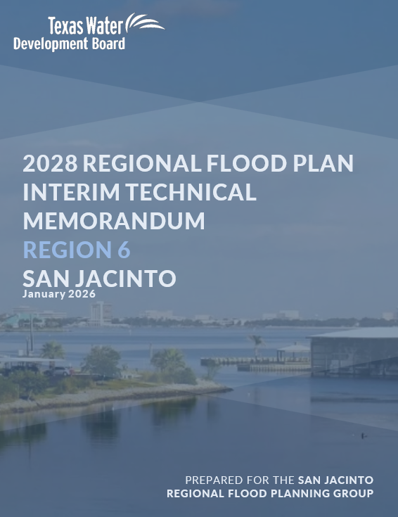
Task 4B - Supplemental Material
Draft Technical Memorandum posted to website November 6th
Technical Memorandum Documentation:
Report with appendices of required maps and tables
Due to TWDB January 7, 2026

Slide 35
Task 4C – Performance of FMEs

Slide 36
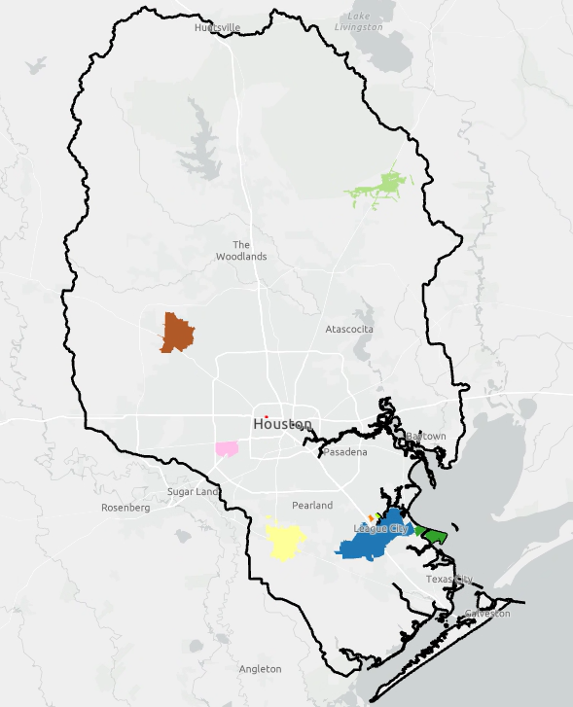
Task 4C – First Round of FMEs to Perform
Discussion and possible action to authorize the Technical Consultant team to perform the 11 FMEs.
Ongoing coordination since May RFPG meeting.
Sponsors have affirmed need and support of the RFPG performing these FMEs.
Available data has been collected from sponsors to inform scope.
Expected $810 of the total $942K for Task 4C.
Additional FMEs to be presented at January RFPG Meeting.

Slide 37
Task 4C – First Round of FMEs to Perform

Slide 38
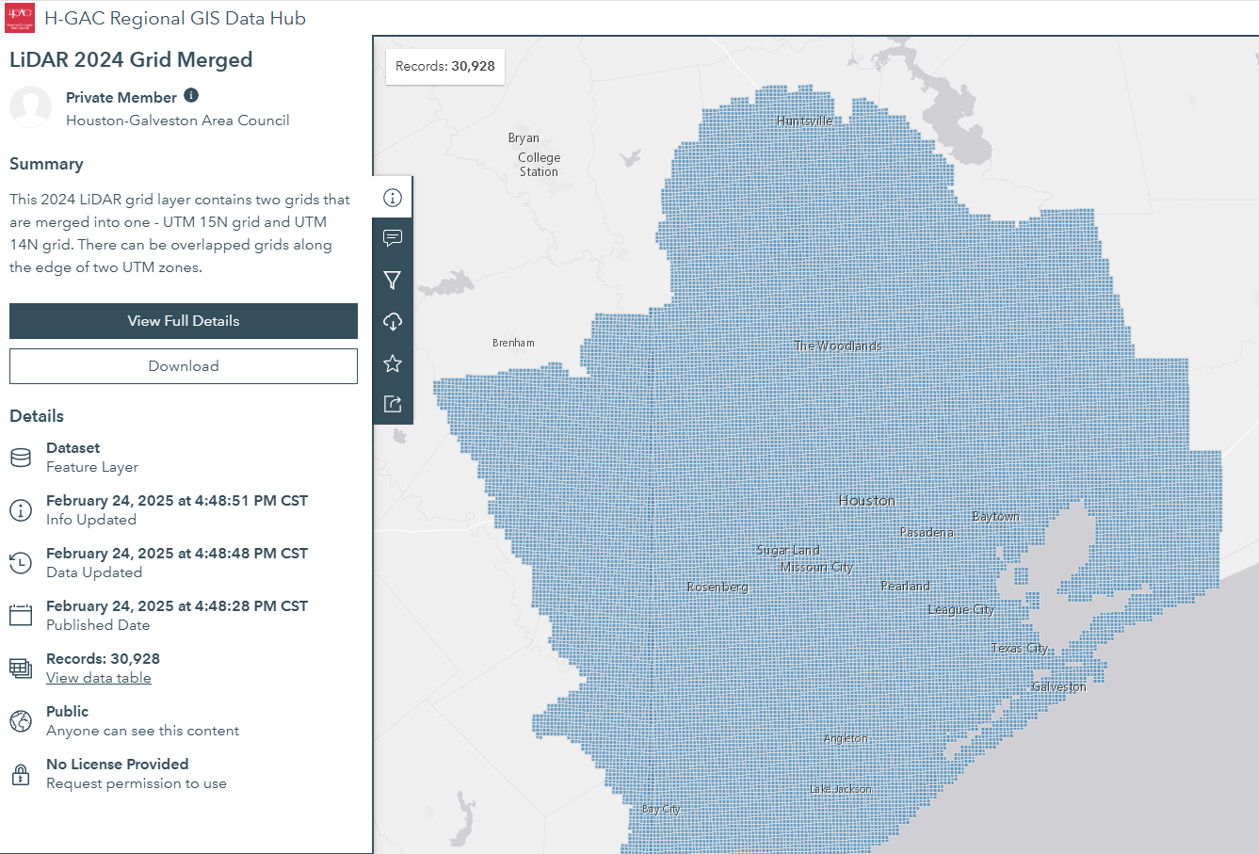
Task 4C - 2024 Preliminary LiDAR
Request to submit official request for H-GAC’s 2024 Preliminary LiDAR to supplement Task 4C FMEs.

Slide 39
Task 5B - Recommend List of FMEs to be Performed by TWDB

Slide 40
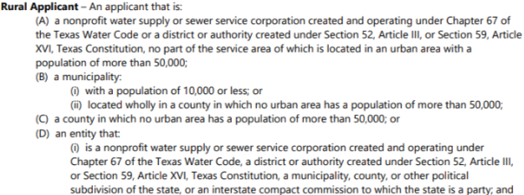
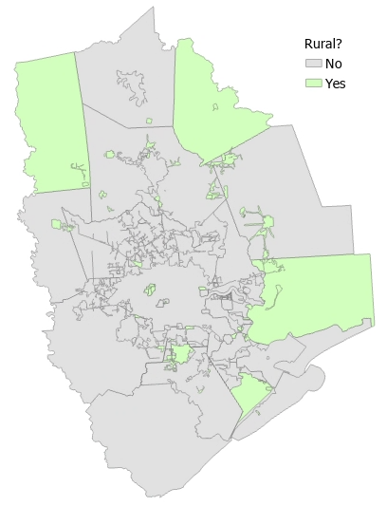
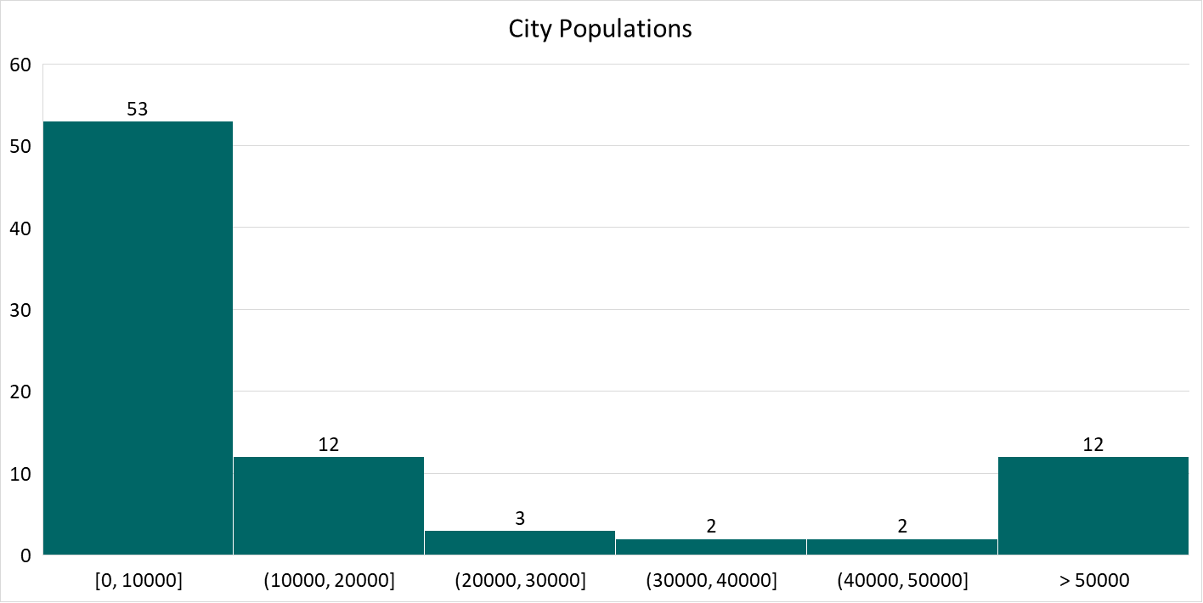
Task 5B - Rural Sponsor Definition
Discussion and possible action to set SJRFP Rural Sponsor definition.
52

Slide 41
2028 Flood Planning Cycle – Schedule
Technical Consultants under Contract Fall 2024
Tech Memo Due Jan 7, 2026
Draft 2028 RFP Due
May 26, 2027
RFP Amendments due to TWDB April 1, 2025
Submit FMEs to TWDB
Mar 26, 2026
Final 2028 RFP Due Jan 2028
2025
2026
2027
2028

Slide 42

2028 Flood Planning Cycle – FMX Schedule
FME List Due to TWDB Mar 2026
Define FME List TWDB to Perform
Draft RFP Due to TWDB May 2027
TWDB to perform top 2 FMEs through the FME Program
RFPG performs FMEs (Task 4C)
Collect Additional Data from Stakeholders
RFPG recommends FMXs (#1)
RFPG recommends FMXs (#2)
GLO RBFS Central Region Alternatives Analysis
Ongoing FIF Studies/Other sponsor-led studies
Chapter Documentation, Task 6A, 6B, Financial Assistance Survey
Call for FY26-27 FIF Abridged Apps
TWDB Abridged App Review
Call for Full Apps
TWDB Abridged App Review
March
June
September
March
June
2026
2027

Slide 43
Future Meeting Dates & Content
Meeting | Milestone/Action
Nov 2025 | RFPG Meeting – Action Needed Vote to approve key content and Tech Memo (Task 4B) Vote to authorize Tech Con to proceed with performing FMEs (Task 4C) Vote to approve definition of small/rural community (Task 5B) Discuss FIF Technical Assistance ahead of FY26-27 Call for Apps
Dec 2026 | Public Engagement Committee Meeting Approve planning for Public Meeting Series to occur ~Q1 of 2026
Jan 2026 | RFPG Meeting – Action Needed Focus on FMEs the RFPG and TWDB to perform this cycle Vote to approve prioritized list of FMEs for the TWDB to perform (Task 5B) Planning for Q1 2026 Public Meeting Series
Mar 2026 | RFPG Meeting – Action Needed Presentation of Chapter documentation Update on potential recommended FMXs in 2028 RFP Vote to approve SOW and materials for submittal to TWDB (Task 5B)
May 2026 | RFPG Meeting Presentation of Chapter documentation GLO RBFS presentation on recommended projects Update on potential recommended FMXs in 2028 RFP

Slide 44
ITEM 11
Consider Agenda items for Next
meeting

Slide 45
ITEM 12 Public Comments – Limit 3 Minutes Per Person

Slide 46
ITEM 13 Adjournment

