Slide 1
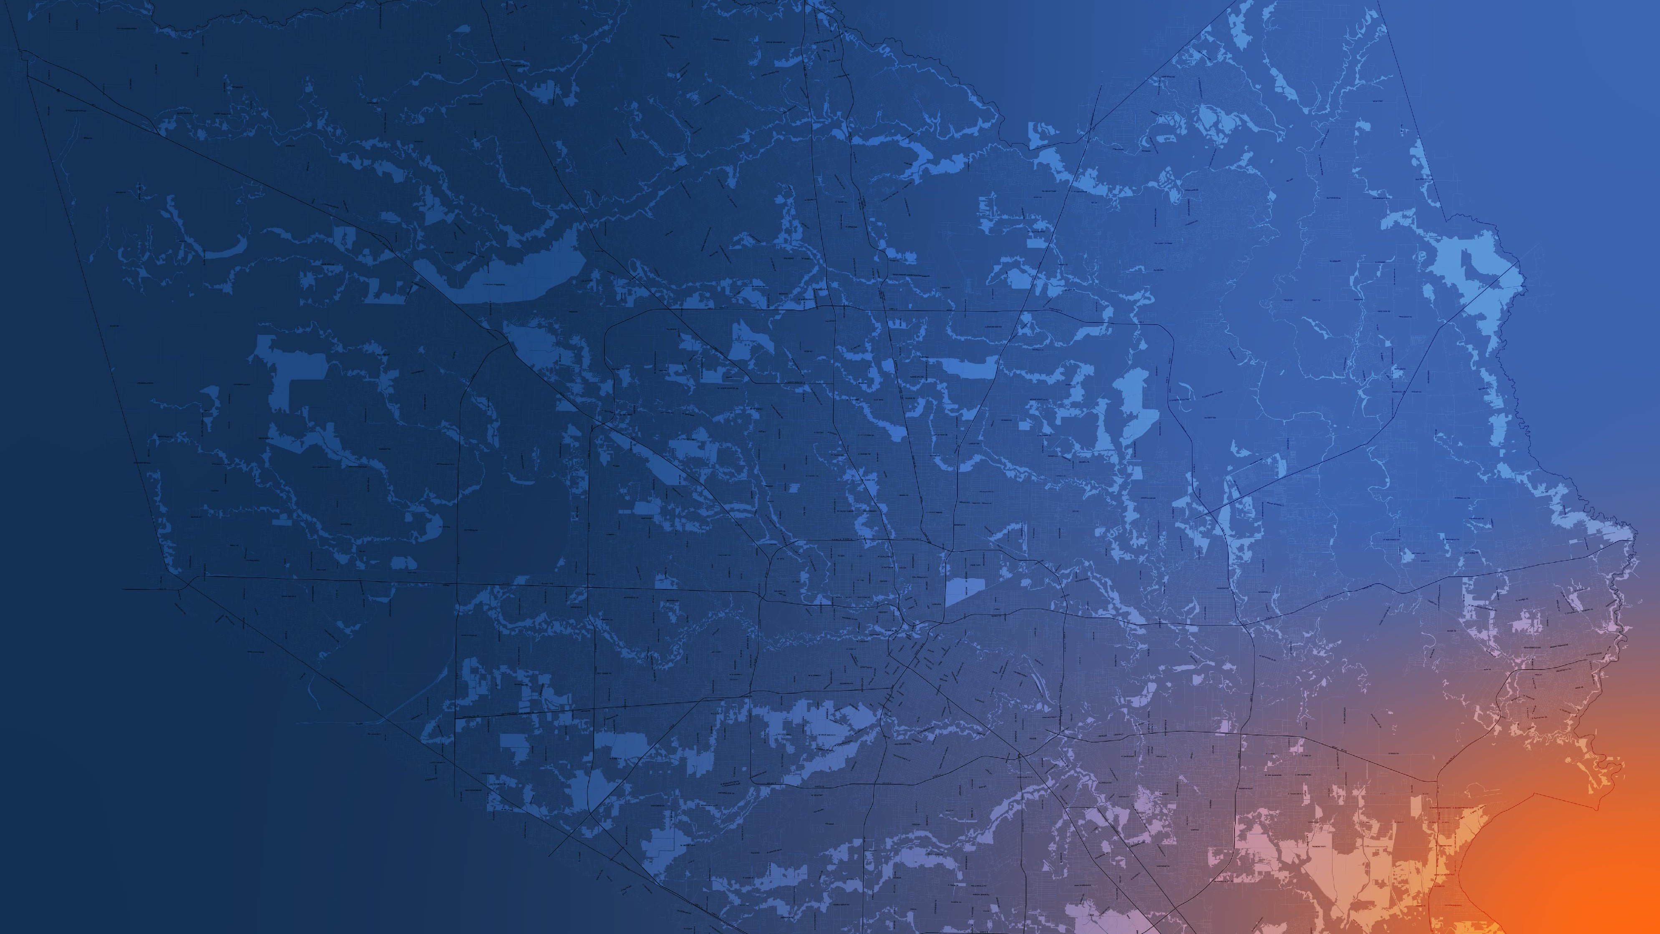
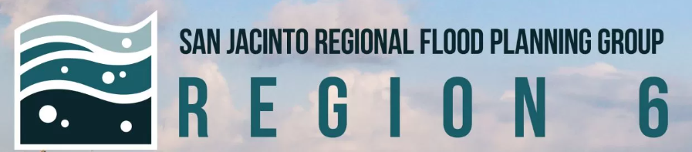
Region 6 - San Jacinto Regional Flood Planning Group
Public Engagement Meeting October 23, 2025 10:00 AM

Slide 2
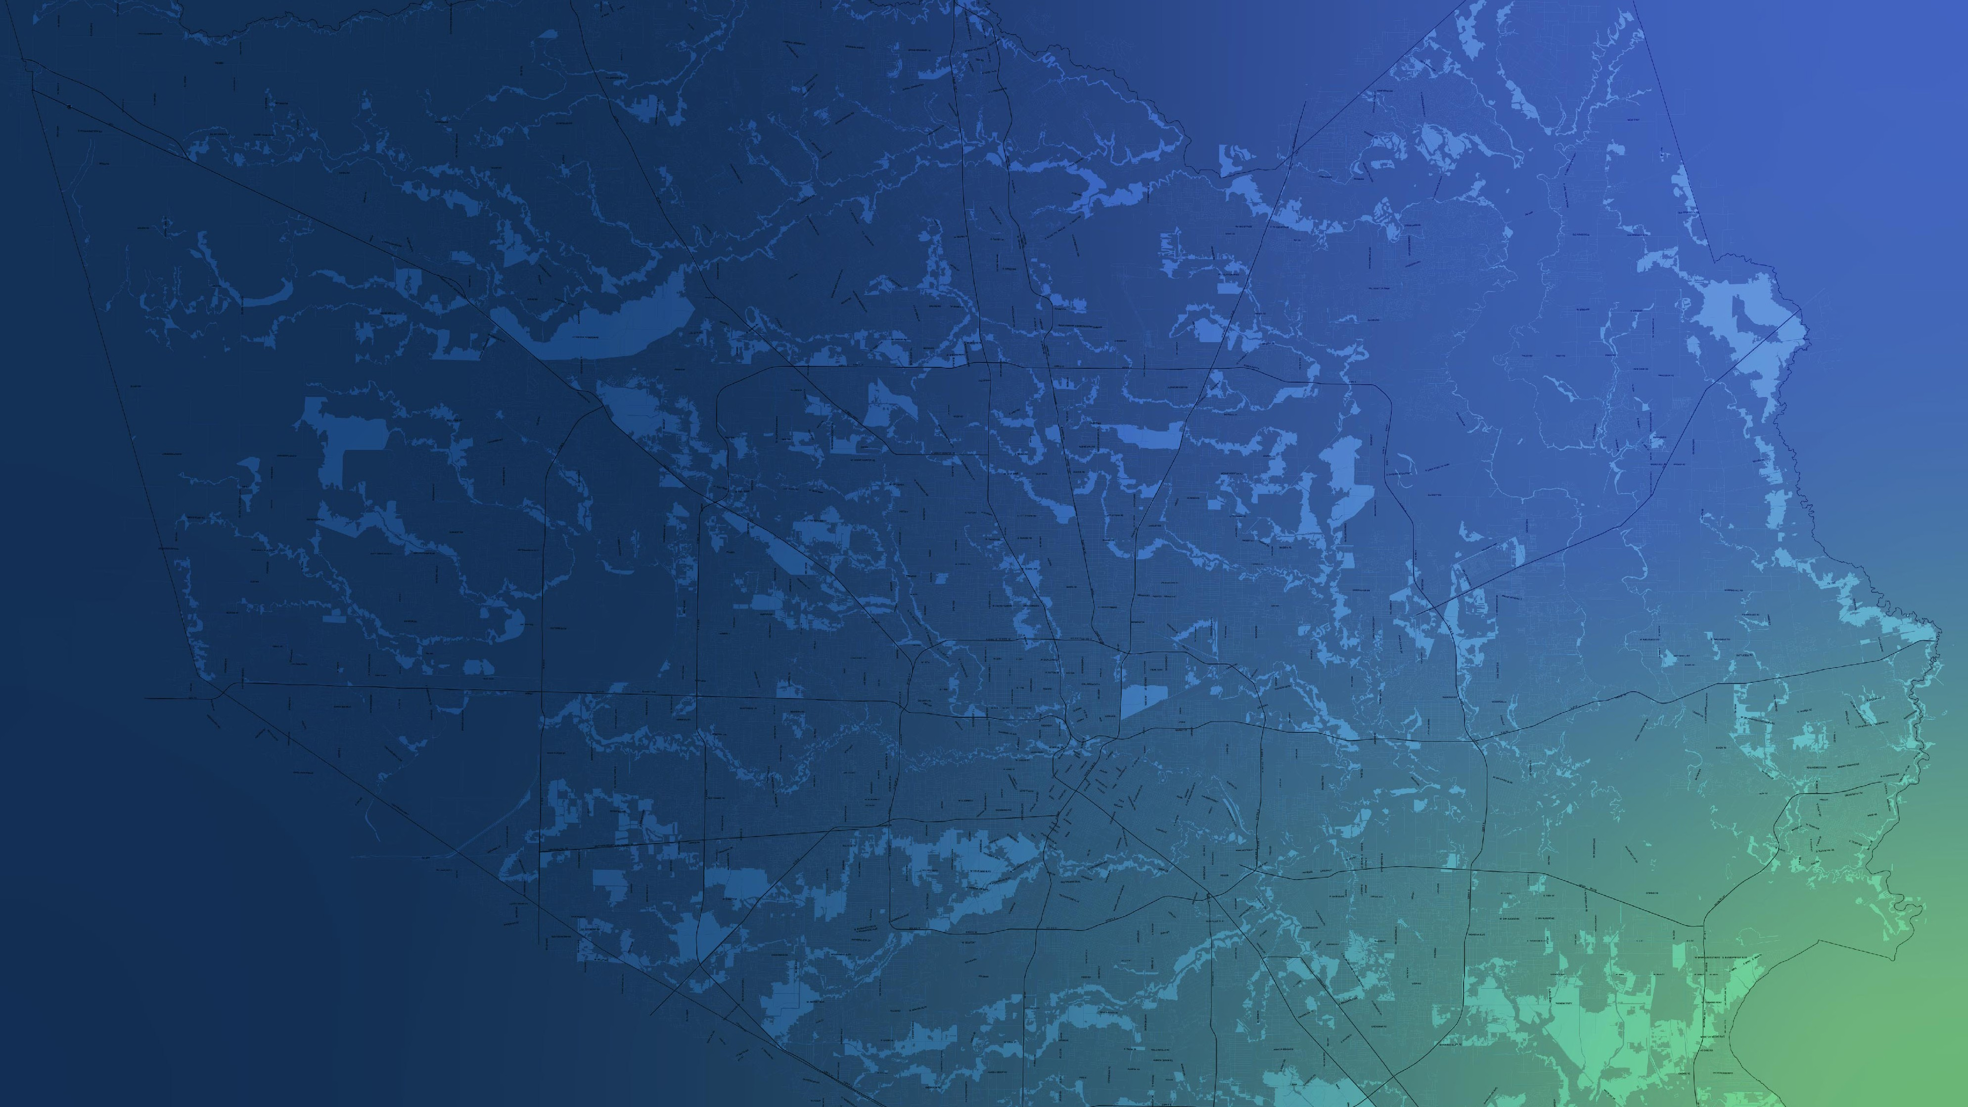
ITEM 1 Call to Order

Slide 3
ITEM 2 Welcome and Roll Call

Slide 4
ITEM 3 Registered Public Comments on Agenda Items (Limit of 3 Minutes Per Person)

Slide 5
ITEM 4 Approval of Meeting Minutes

Slide 6
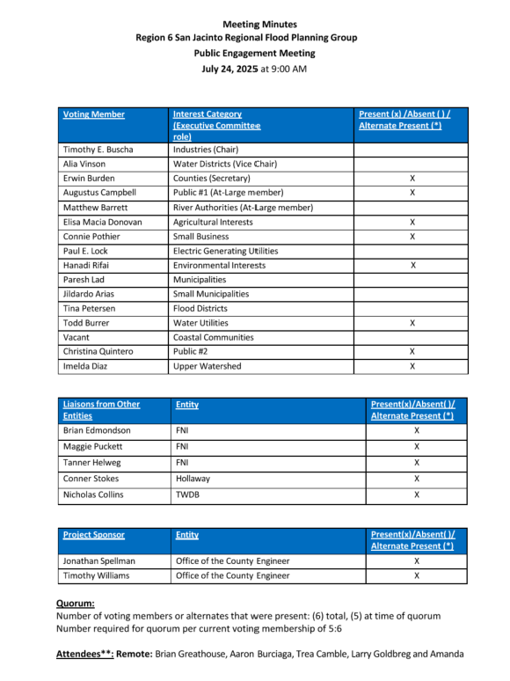

Slide 7
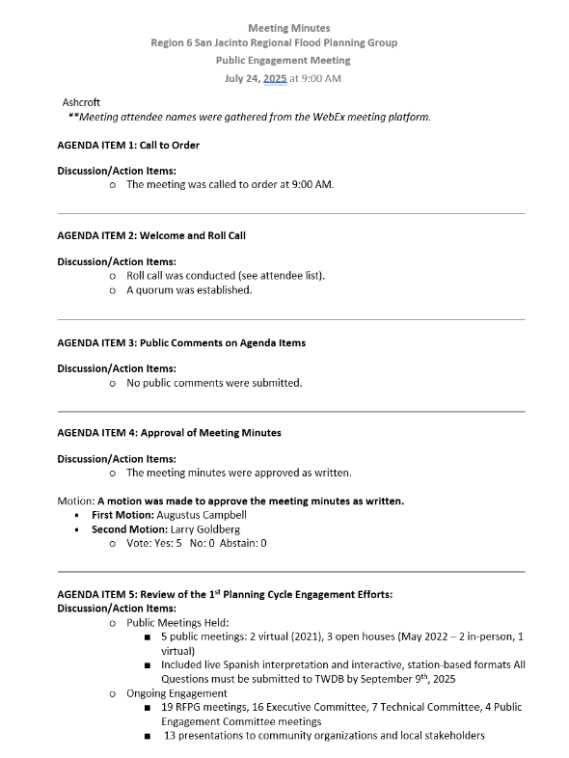

Slide 8
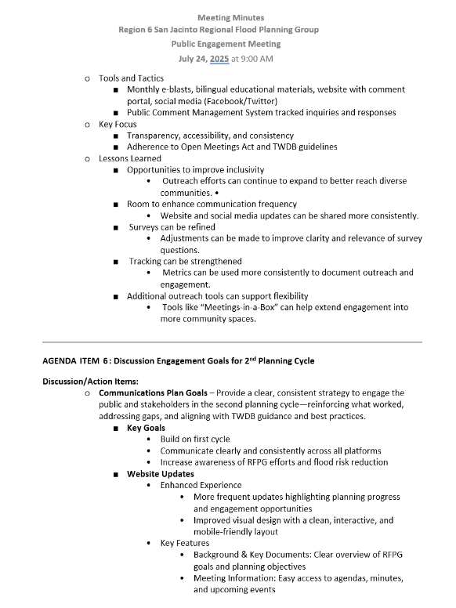

Slide 9
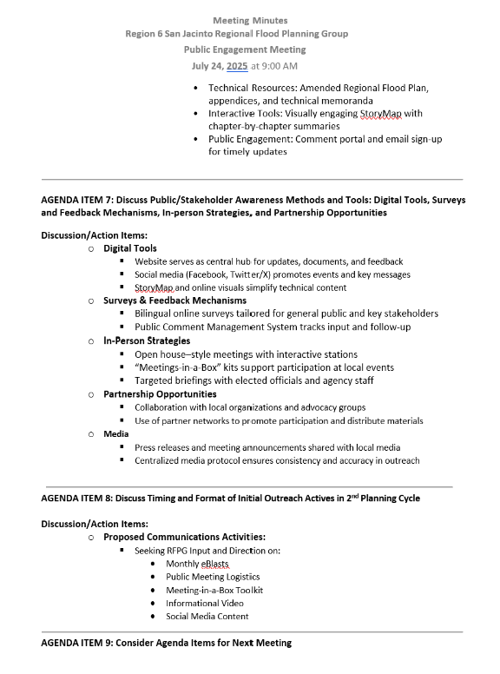

Slide 10
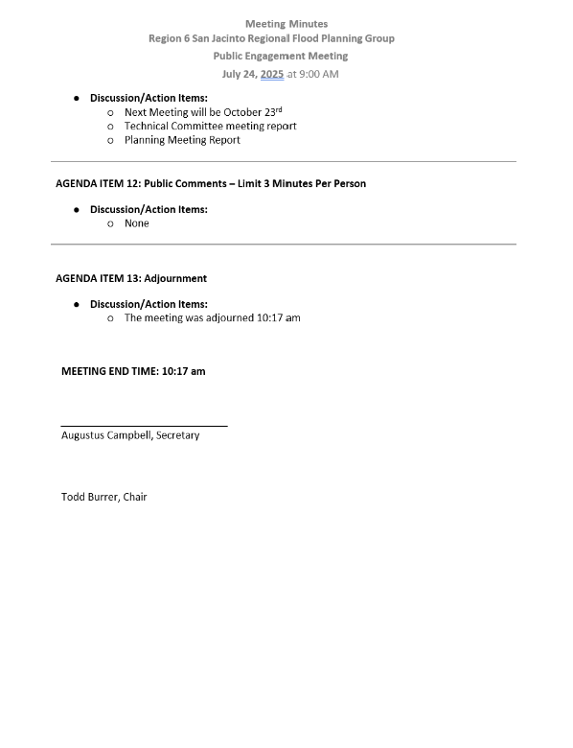

Slide 11
ITEM 5 Review of Engagement Goals for 2nd Planning Cycle

Slide 12
2nd Cycle Communications Plan Goals
Purpose
Provide a clear, consistent strategy to engage the public and stakeholders in the second planning cycle—reinforcing what worked, addressing gaps, and aligning with TWDB guidance and best practices.
Key Goals
Build on first-cycle successes while refining outreach strategies
Use varied tools to support evolving stakeholder needs
Communicate clearly and consistently across all platforms
Increase awareness of RFPG efforts and flood risk reduction
Offer inclusive, accessible opportunities for public input
Track engagement to support continuous improvement

Slide 13
ITEM 6 Discuss Proposed Public Meeting Plan for Outreach Activities in 2nd Planning Cycle

Slide 14
Overview – Proposed 2026 Public Meeting Plan
What’s Included?
Public Meeting Purpose and Goals
Proposed Meeting Locations and Timing
Advertisement and Outreach Strategy
Meeting Format
Meeting Materials and Accessibility
What’s Needed?
Discussion and possible action to approve the proposed 2026 Public Meeting Plan.

Slide 15




Purpose of the Public Meetings
Inform the public about the regional flood planning process
Gather feedback on flood-prone areas and community priorities
Align projects with TWDB funding opportunities – Flood Infrastructure Fund (FIF)
Foster transparency and trust in Region 6

Slide 16
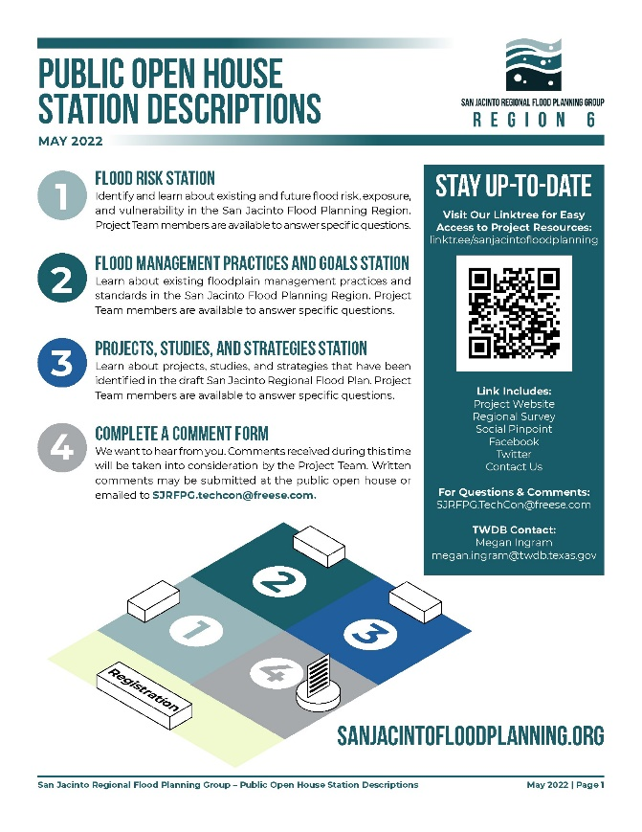
Proposed Structure
5 In-person Meetings (North, East, West, South, Central)
Informal, flexible drop-in format (no formal presentation)
Topic-specific stations with maps, handouts, and staff Q&A
Looping informational video ensures consistent messaging
Interactive digital maps for identifying flood-prone areas
ADA-compliant materials and venues
Equitable geographic coverage across the region
Optional virtual meeting for broader access
Timing:
Late January – Early February 2026
Weekday Evenings (Tuesdays and Thursdays)

Slide 17



How We’ll Reach the Public/Stakeholders
General Announcements
Regional press releases and local newspaper ads
Email blasts to full RFPG stakeholder list
Region 6 website and social media promotion
Localized Outreach
Targeted email/mail to nearby stakeholders
Coordination with local jurisdictions and community groups

Slide 18
Committee Action Needed
Seeking RFPG Input and Direction on:
Proposed 2026 Public Meeting Plan
Quantity and location of meetings
Advertising/outreach strategy
Meeting format and materials
Discussion and possible action to approve the proposed 2026 Public Meeting Plan.

Slide 19
ITEM 7 Consider Agenda Items for Next Meeting

Slide 20
ITEM 8 Public Comments – Limit 3 Minutes Per Person

Slide 21
ITEM 9 Adjournment

