Slide 1


Region 6 - San Jacinto Regional Flood Planning Group
Planning Meeting September 11, 2025 9:00 AM

Slide 2

ITEM 1 Call to Order

Slide 3
ITEM 2 Welcome and Roll Call

Slide 4
ITEM 3 Registered Public Comments on Agenda Items (Limit of 3 Minutes Per Person)

Slide 5
ITEM 4 Texas Water Development Board Update

Slide 6
ITEM 5 Approval of Meeting Minutes

Slide 7
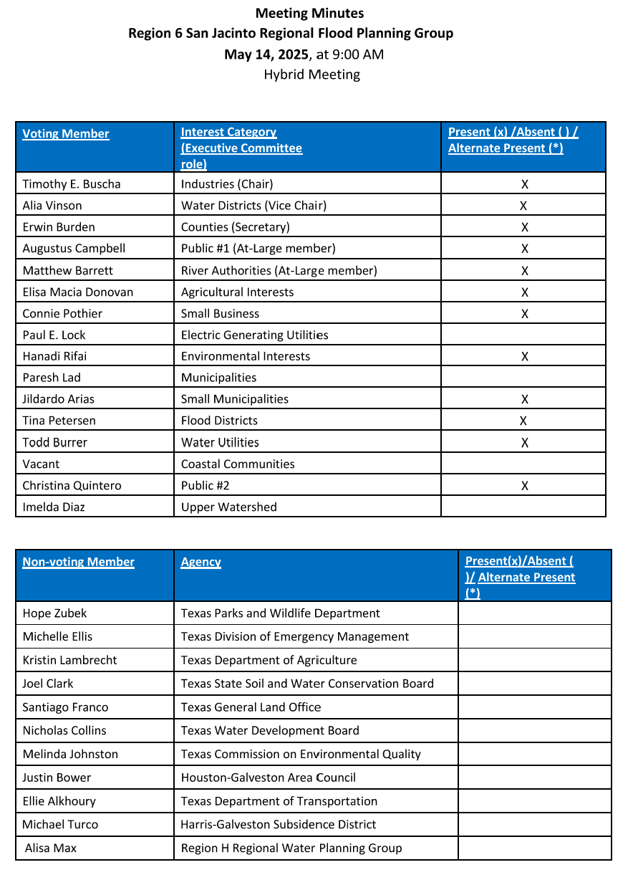
ITEM 5 Approval of Meeting Minutes

Slide 8
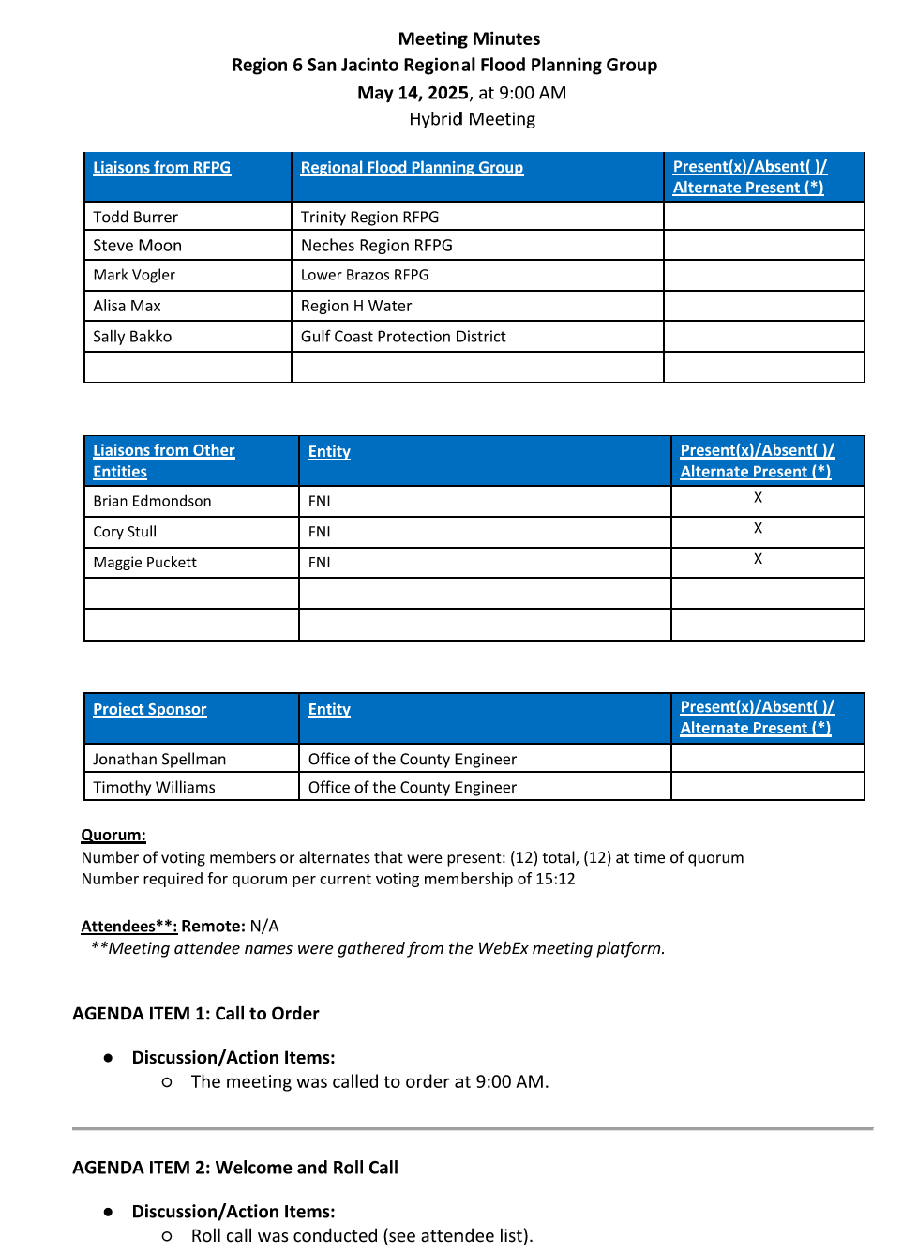
ITEM 5 Approval of Meeting Minutes

Slide 9
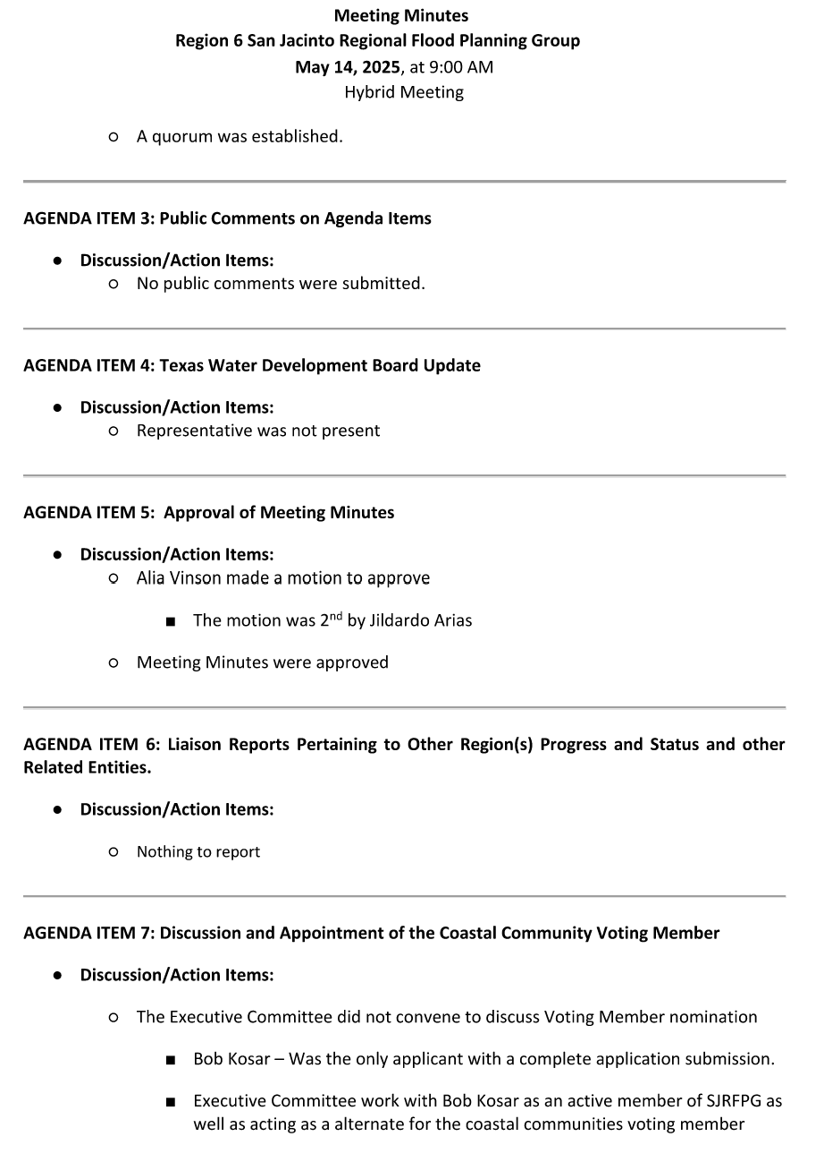
ITEM 5 Approval of Meeting Minutes

Slide 10
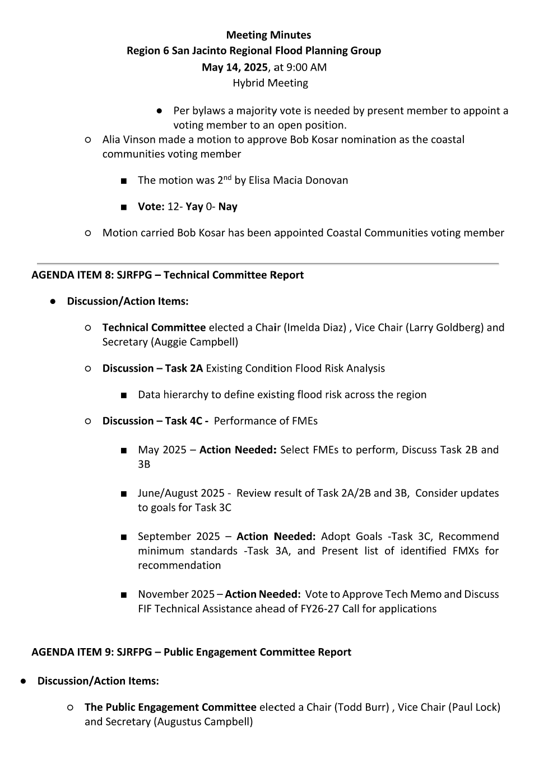
ITEM 5 Approval of Meeting Minutes

Slide 11
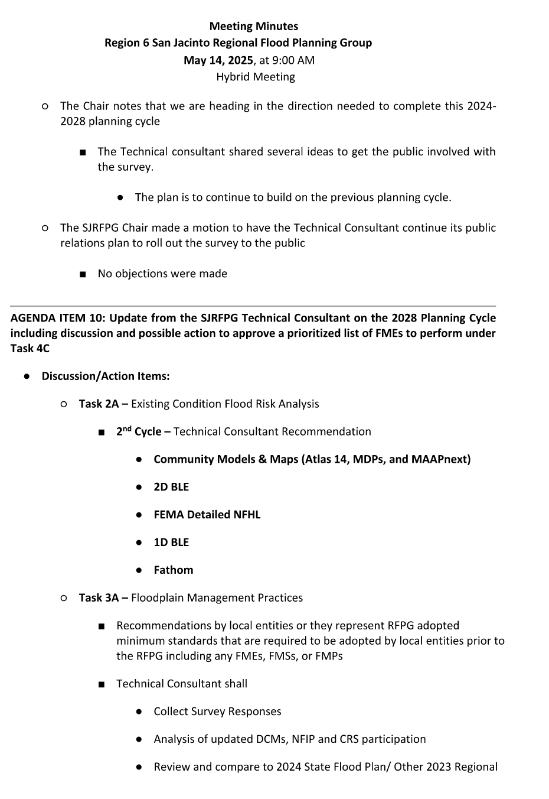
ITEM 5 Approval of Meeting Minutes

Slide 12
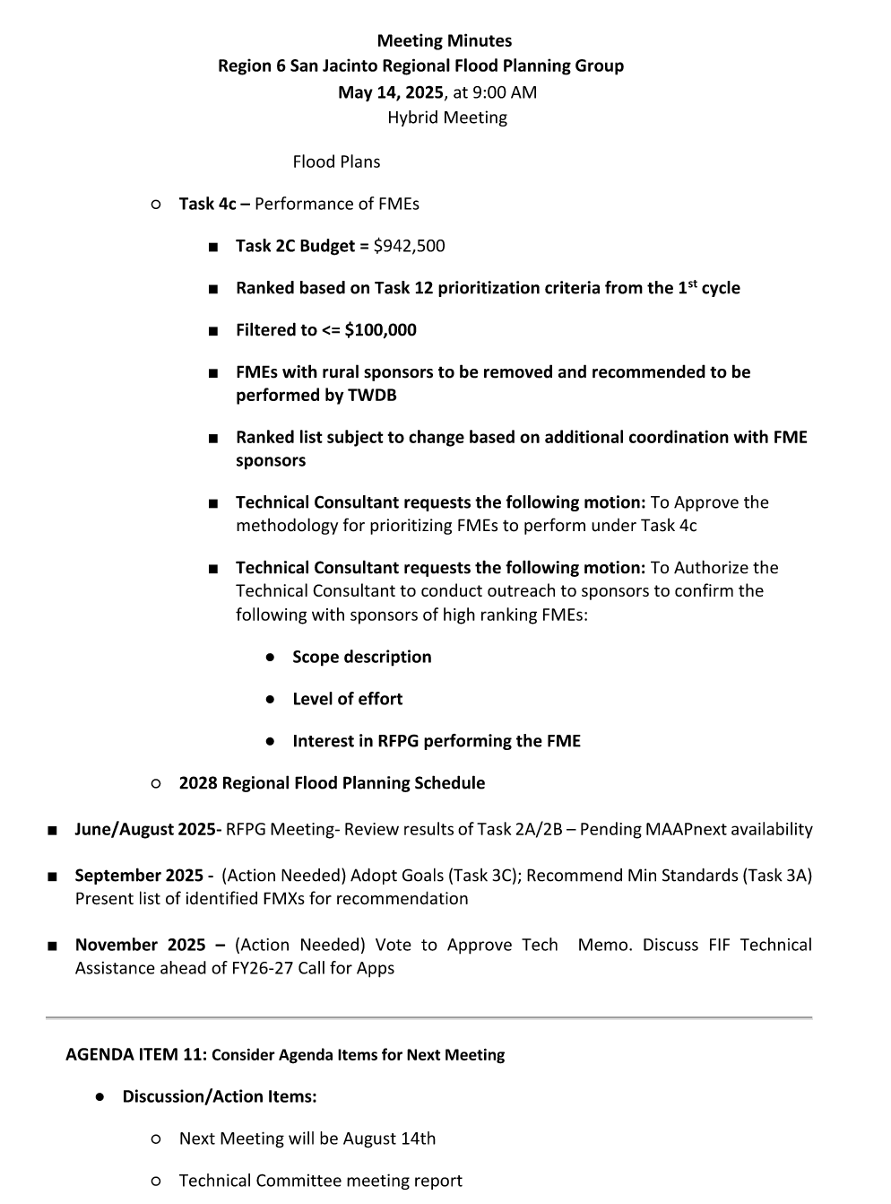
ITEM 5 Approval of Meeting Minutes

Slide 13
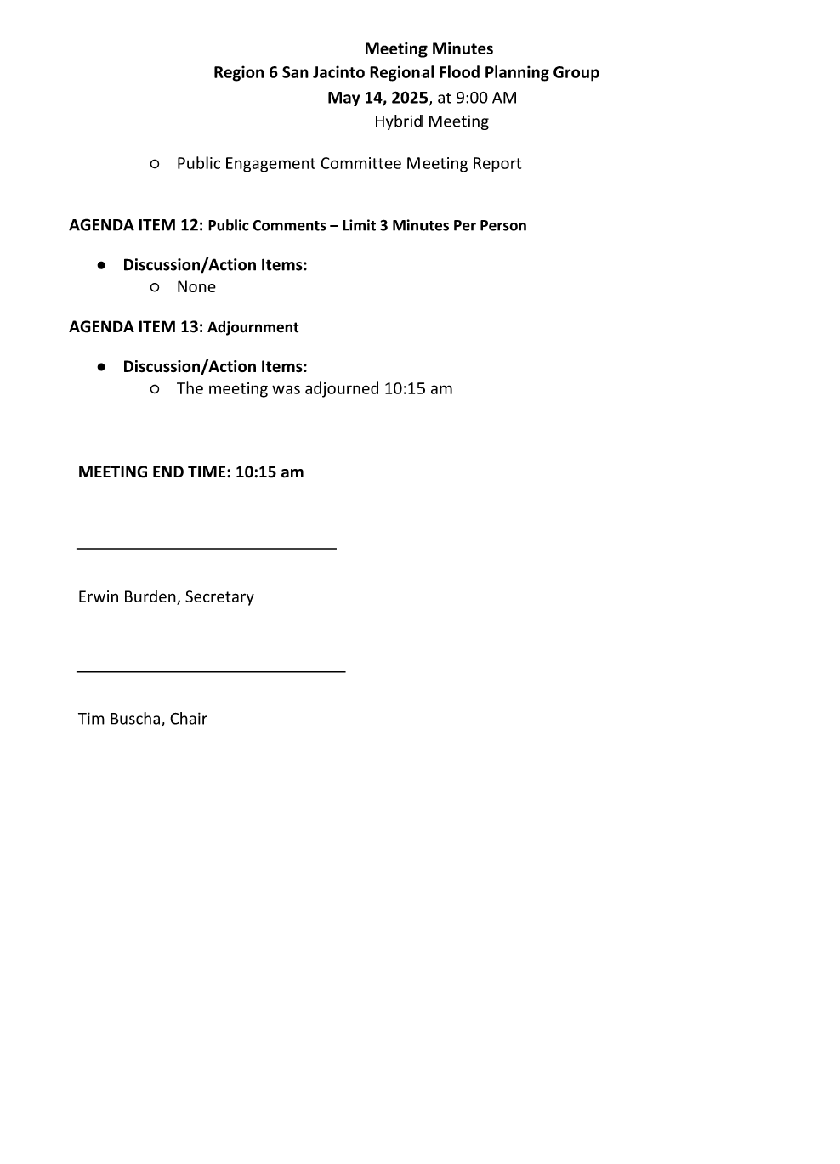
ITEM 5 Approval of Meeting Minutes

Slide 14
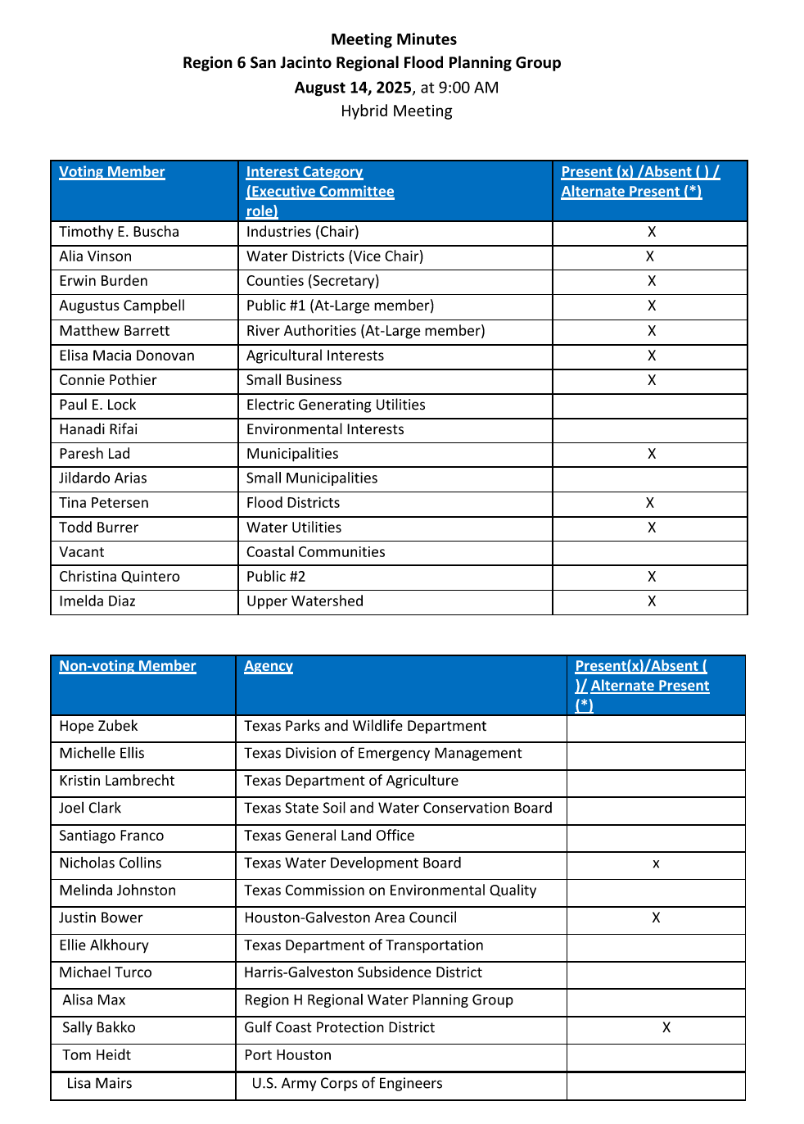
ITEM 5 Approval of Meeting Minutes

Slide 15
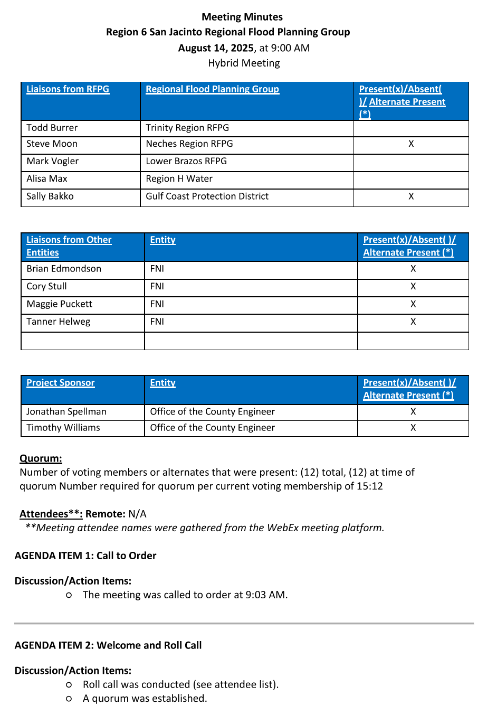
ITEM 5 Approval of Meeting Minutes

Slide 16
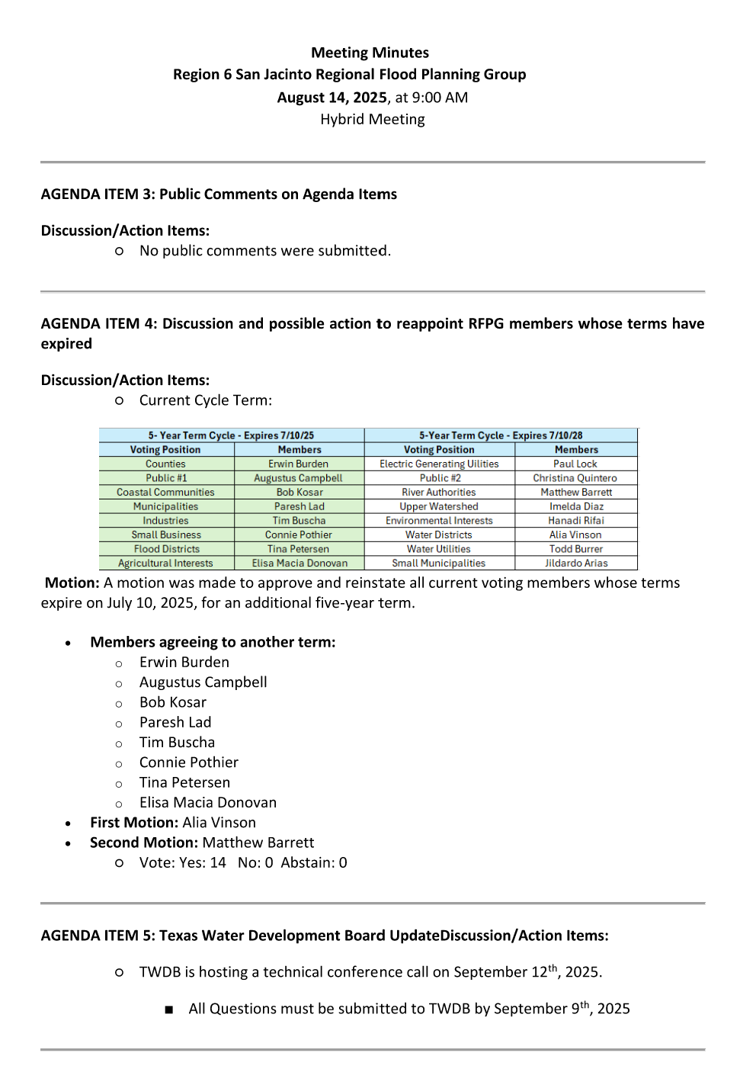
ITEM 5 Approval of Meeting Minutes

Slide 17
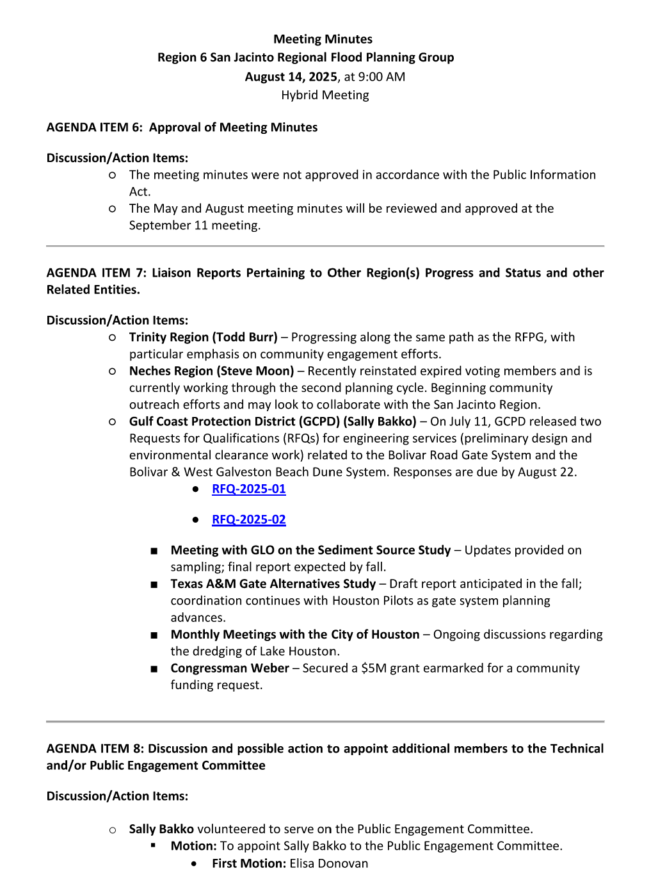
ITEM 5 Approval of Meeting Minutes

Slide 18
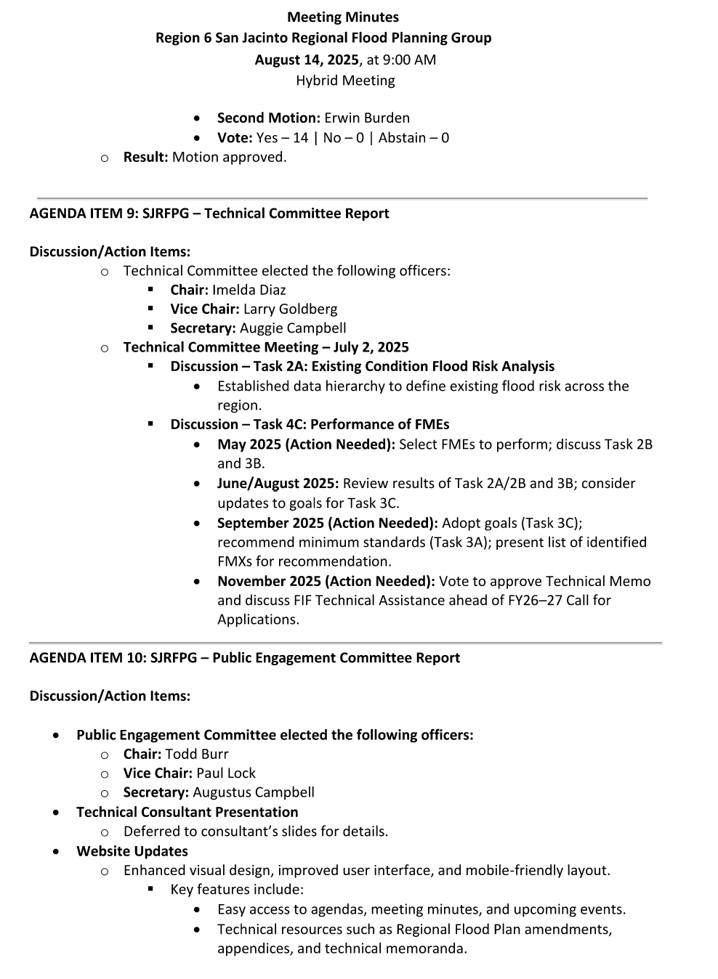
ITEM 5 Approval of Meeting Minutes

Slide 19
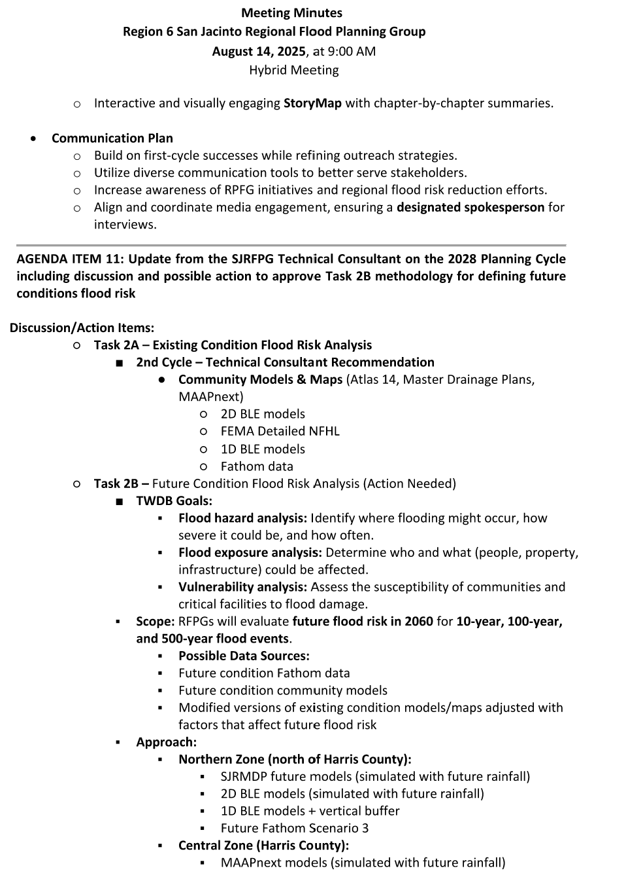
ITEM 5 Approval of Meeting Minutes

Slide 20
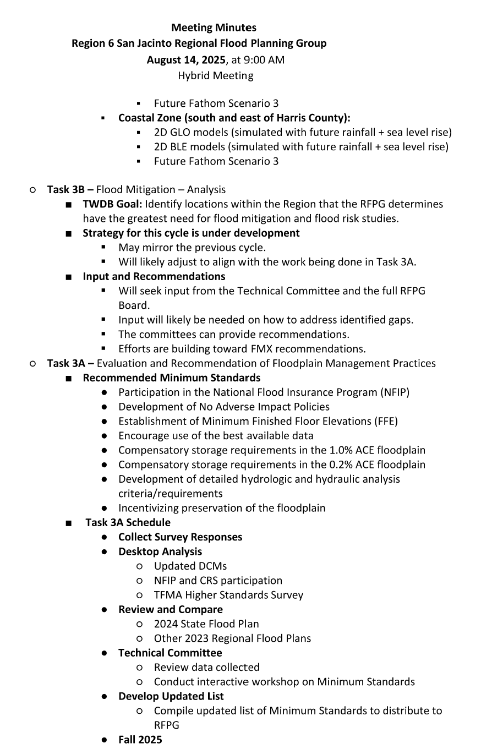
ITEM 5 Approval of Meeting Minutes

Slide 21
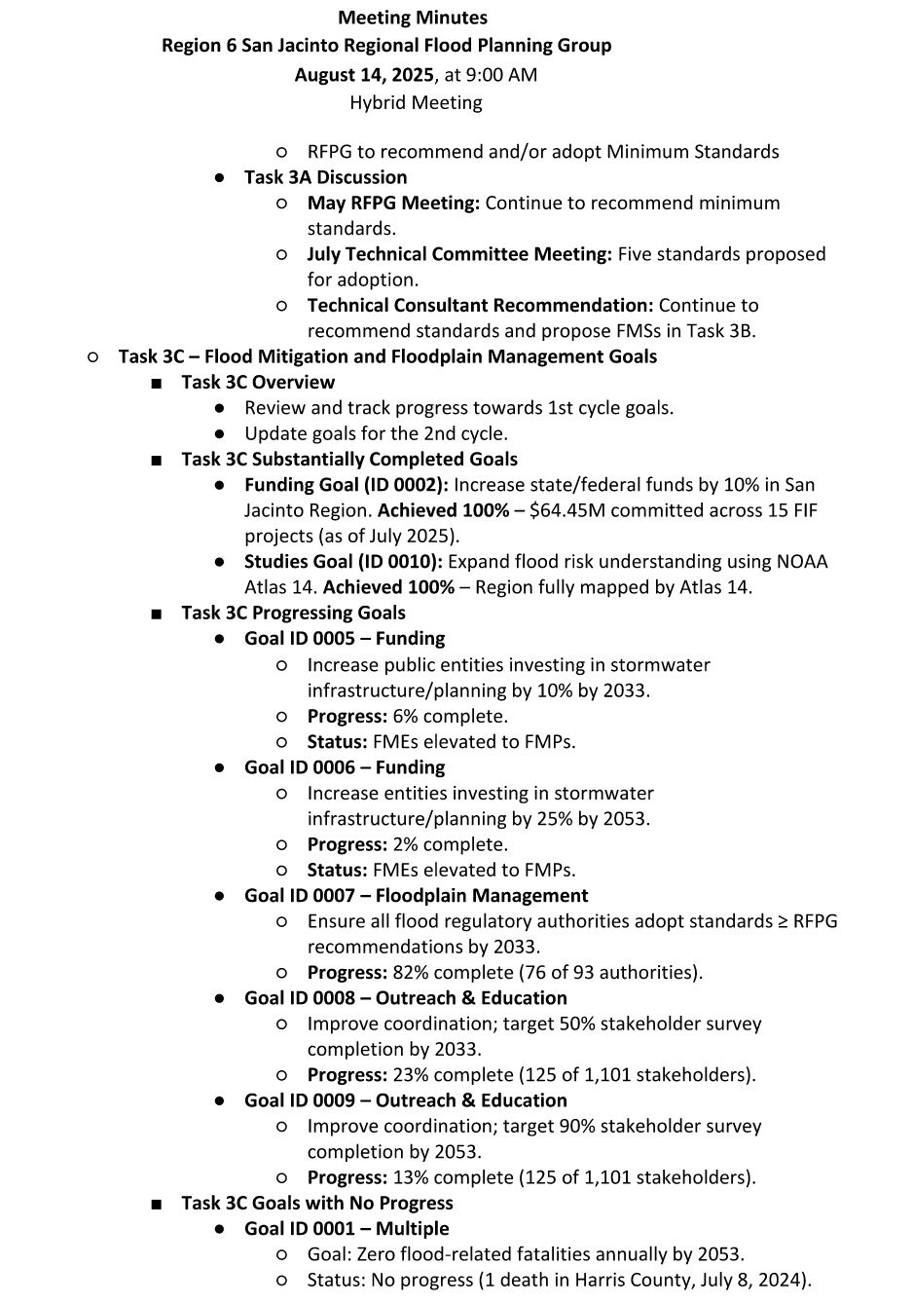
ITEM 5 Approval of Meeting Minutes

Slide 22
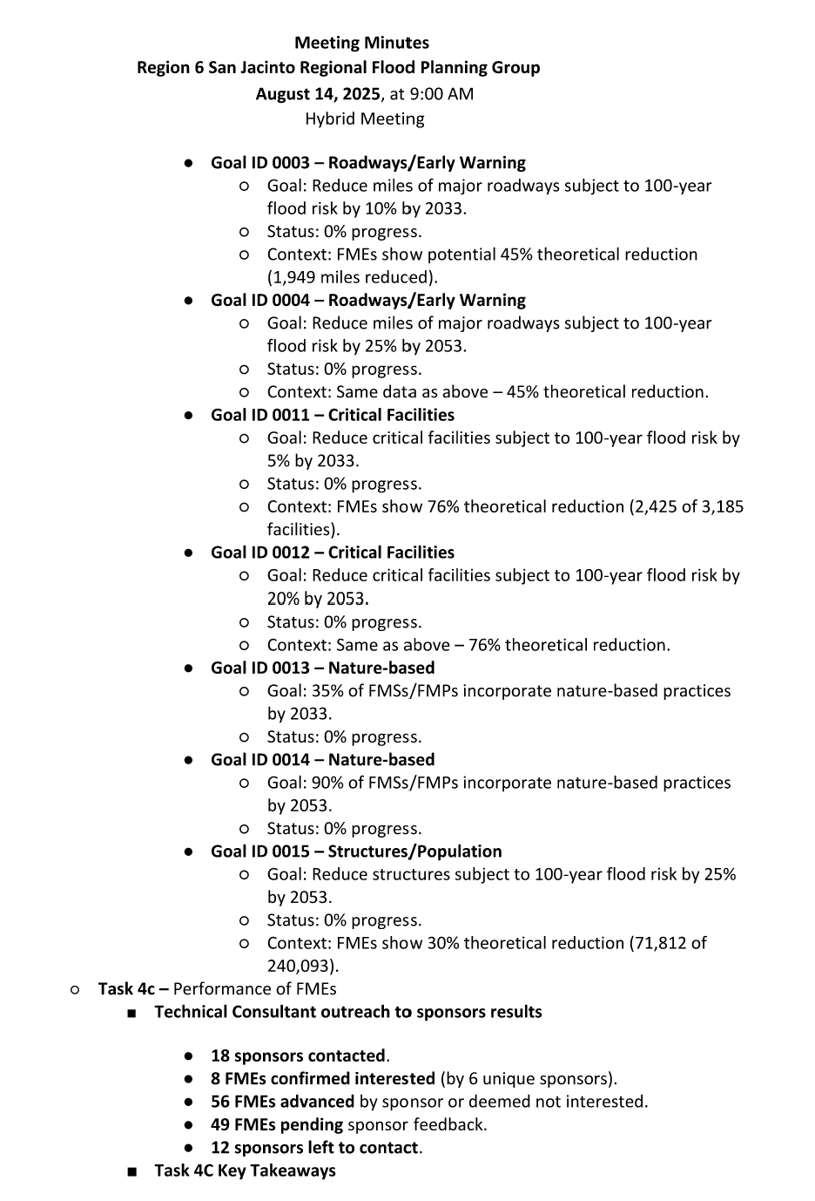
ITEM 5 Approval of Meeting Minutes

Slide 23
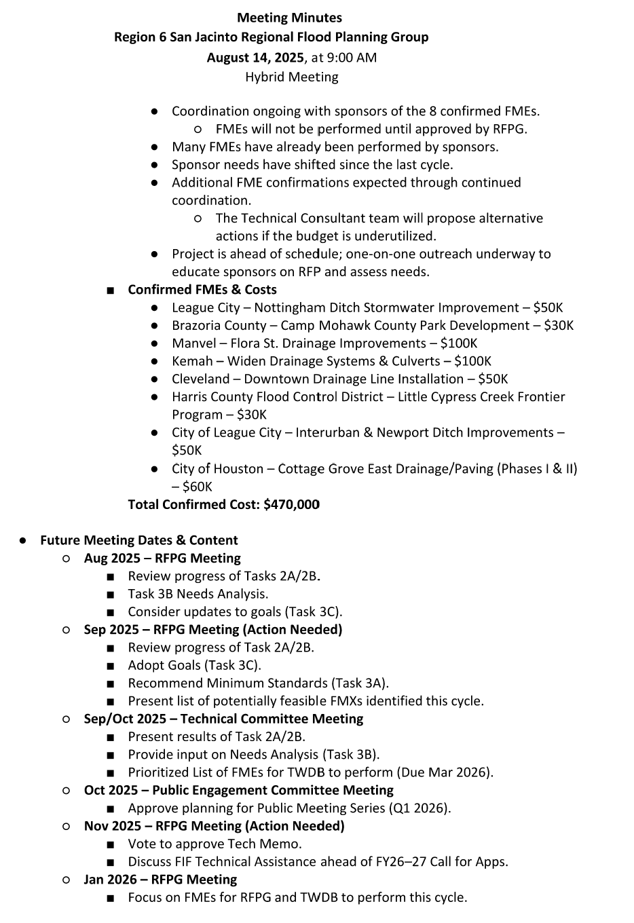
ITEM 5 Approval of Meeting Minutes

Slide 24
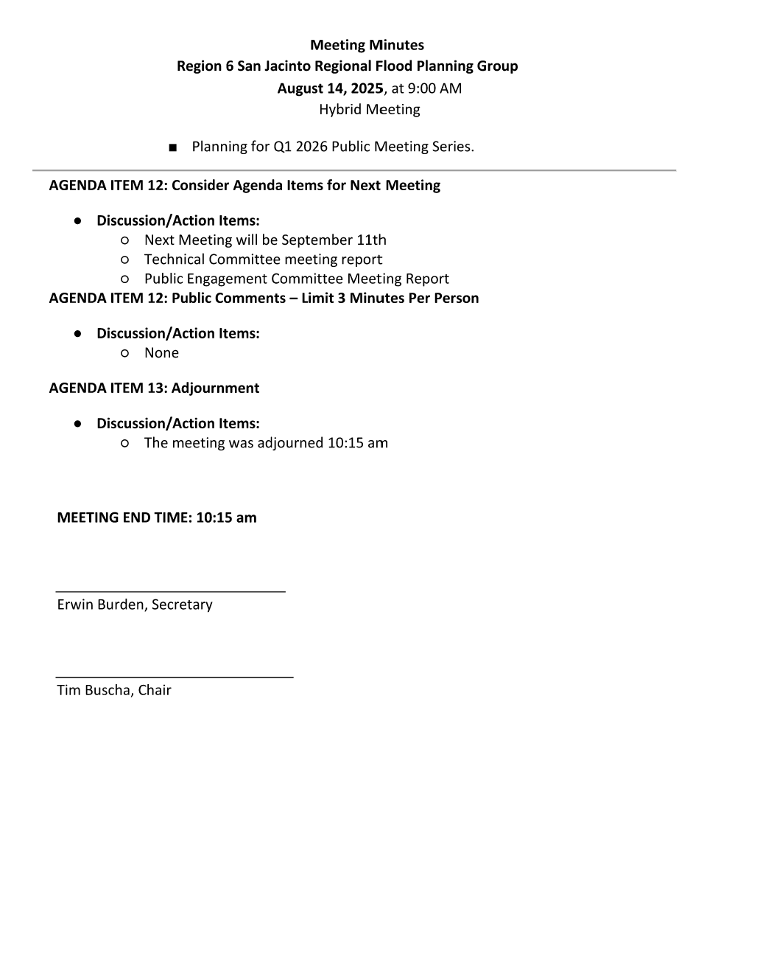
ITEM 5 Approval of Meeting Minutes

Slide 25
ITEM 6 Task 1 Discussion – RFPG Public Survey and data collection.
Liaison Reports Pertaining to Other Region(s) Progress and Status and other Related Entities:
a. Trinity Region
b. Neches Region
c. Lower Brazos Region
d. Region H Water
e. Gulf Coast Protection District (GCPD)

Slide 26
ITEM 7 SJRFPG -Technical Committee Report

Slide 27
ITEM 8 SJRFPG –Public Engagement Committee Report

Slide 28
ITEM 9 Update from the SJRFPG Technical Consultant on the 2028 Planning Cycle including discussion and possible action to approve Minimum Standards for Task 3A and Floodplain Management Goals for Task 3C

Slide 29
Technical Consultant Update
September 11, 2025
Notes:
Introduction

Slide 30

Agenda
Red icon indicates need for action from the RFPG
Task 2B – Future Condition Flood Risk Analysis
Task 3A – Floodplain Management Practices
Task 3C – Flood Mitigation and Flood Management Goals
Task 4C – Performance of FMEs
2028 Regional Flood Planning Schedule

Slide 31
Task 2B – Future Condition Flood Risk Analysis

Slide 32
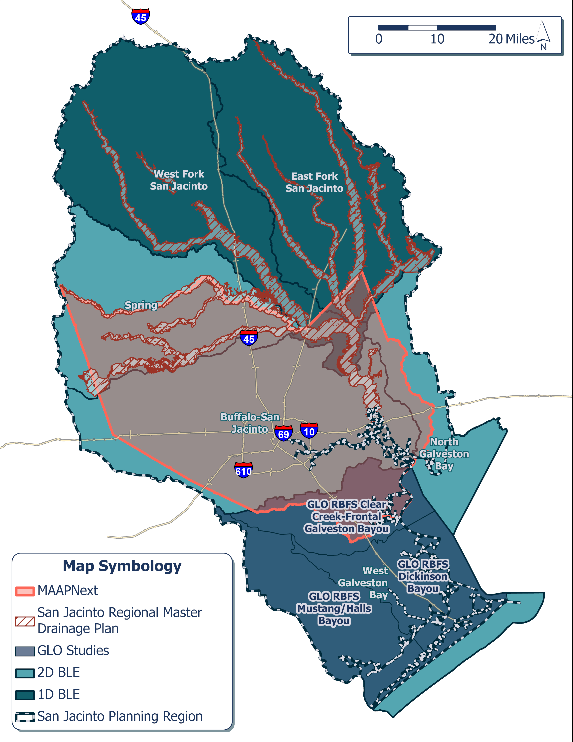
Task 2B – Approach
Northern Zone (north of Harris County):
SJRMDP future models simulated with future rainfall
2D BLE model simulated with future rainfall
1D BLE models + vertical buffer
Future Fathom Scenario 3
Central Zone (Harris County):
MAAPnext models simulated with future rainfall
Future Fathom Scenario 3
Coastal Zone (south and east of Harris County):
2D GLO models simulated with future rainfall + SLR
2D BLE models simulated with future rainfall + SLR
Future Fathom Scenario 3
Match existing extents wherever future floodplain is smaller
Approach accepted by TWDB, pending final minor comments.

Slide 33
Task 3A – Evaluation and Recommendation of Floodplain Management Practices

Slide 34
Task 3A – Proposed Minimum Standards
Feedback solicited at the July Technical Committee meeting as well as during and after August RFPG meeting.
Task 3A – Proposed Minimum Standards posted online.
Key requirement for the Technical Memo.
13 minimum standards recommended: 7 with no change, 1 updated, and 5 new.
Discussion and possible action to continue to recommend the updated and added minimum standards for the San Jacinto Regional Flood Plan.

Slide 35
Task 3C – Flood Mitigation and Floodplain Management Goals

Slide 36
Task 3C – Proposed Goals
Feedback solicited at the July Technical Committee meeting as well as during and after August RFPG meeting.
Task 3C – Proposed Goals posted online.
Key requirement for the Technical Memo.
17 total goals: 15 first cycle goals with documented progress and 2 new second cycle goals.
Discussion and possible action to approve the new second cycle Floodplain Management Goals for the San Jacinto Regional Flood Plan.

Slide 37
Task 4C – Performance of FMEs

Slide 38
Task 4C – Performance of FMEs
Technical Consultant outreach to sponsors results:
31 Sponsors Contacted
18 FMEs Confirmed Interested by 9 Unique Sponsors
27 FMEs Advanced by Sponsor or Not Interested
0 Sponsors Left to Contact

Slide 39
Task 4C – Key Takeaways
Coordination ongoing with the sponsors of the 18 confirmed FMEs.
Not performing FMEs until approved by RFPG.
FMEs to be reviewed and estimated cost to be evaluated.
Rank | FME ID | Name | Sponsor | Cost
1 | 061000404 | Halls Bayou - Planning, Right-Of-Way, Design and Construction of Halls Bayou Flood Risk Management Project | HCFCD | $ 30,000
6 | 061000115 | Stormwater Drainage Improvement- Nottingham ditch | City of League City | $ 50,000
11 | 061000440 | Brazoria County Camp Mohawk County Park Development | Brazoria County | $ 30,000
13 | 061000436 | Unincorporated Areas of Bacliff and San Leon Roadside Ditches & Driveway Culverts Improvements | Galveston County | $ 30,000
21 | 061000353 | TC Jester Detention Basin | HCFCD | $ 30,000
21 | 061000361 | G103-80-03.1B (Taylor Gully) | HCFCD | $ 30,000
31 | 061000045 | City of Manvel Flora St. Drainage Improvements | City of Manvel | $ 100,000
32 | 061000421 | Clear Creek - Hughes Stormwater Detention (SWD) Basin | HCFCD | $ 30,000
33 | 061000121 | Widen Drainage Systems and Culverts in City of Kemah | City of Kemah | $ 100,000
34 | 061000153 | Downtown Cleveland Drainage Line Installation | City of Cleveland | $ 50,000
34 | 061000358 | Little Cypress Creek - Management, Right-of-Way Acquisition, Design and Construction of the Little Cypress Creek Frontier Program | HCFCD | $ 30,000
34 | 061000405 | Hunting Bayou Wallisville Outfall (H103-00-00) - Gellhorn Drive | HCFCD | $ 30,000
71 | 061000482 | Gellhorn | City of Houston | $ 30,000
98 | 061000097 | League City - Stormwater Drainage Improvement- Interurban & Newport ditch | City of League City | $ 50,000
130 | 061000500 | Green Acres Neighborhood Drainage Improvement Study | City of Webster | $ 100,000
132 | 061000477 | Drainage and Paving Improvements for Cottage Grove East - Phase II | City of Houston | $ 30,000
132 | 061000557 | Drainage and Paving Improvements for Cottage Grove East - Phase I | City of Houston | $ 30,000
154 | 061000554 | Texas Avenue-Magnolia-MedicalCenterBlvd-Hwy3 Drainage Improvement Study | City of Webster | $ 100,000
 |  |  |  | $ 880,000

Slide 40
Future Meeting Dates & Content
Meeting | Milestone/Action
Aug 2025 | RFPG Meeting Review progress of Tasks 2A/2B Task 3B Needs Analysis Consider updates to goals (Task 3C)
Sep 2025 | RFPG Meeting – Action Needed Review progress of Task 2A/2B Adopt Goals (Task 3C); Recommend Min Standards (Task 3A) Present list of potentially feasible FMXs identified this cycle
Oct 2025 | Technical Committee Meeting Present results of Task 2A/2B Provide input on Needs Analysis (Task 3B) Prioritized List of FMEs for TWDB to Perform (Due Mar 2026)
Oct 2025 | Public Engagement Committee Meeting Approve planning for Public Meeting Series to occur Q1 of 2026
Nov 2025 | RFPG Meeting – Action Needed Vote to Approve Tech Memo Discuss FIF Technical Assistance ahead of FY26-27 Call for Apps
Jan 2026 | RFPG Meeting Focus on FMEs RFPG and TWDB to perform this cycle Planning for Q1 2026 Public Meeting Series

Slide 41
ITEM 10 Discussion on 2026 Meeting Schedule, Location and Meeting Format.

Slide 42
ITEM 11 Consider Agenda Items for Next Meeting

Slide 43
ITEM 12 Public Comments – Limit 3 Minutes Per Person

Slide 44
ITEM 13 Adjournment

