Slide 1


Region 6 - San Jacinto Regional
Flood Planning Group
Planning Meeting
August 14, 2025
9:00 AM

Slide 2

ITEM 1
Call to Order

Slide 3
ITEM 2
Welcome and Roll Call

Slide 4
ITEM 3
Registered Public Comments on Agenda Items
(Limit of 3 Minutes Per Person)

Slide 5
ITEM 4
Discussion and possible action to reappoint RFPG members whose terms have expired

Slide 6
ITEM 5
Texas Water Development Board Update

Slide 7
ITEM
Approval of Meeting Minutes

Slide 8
ITEM 7
Task 1 Discussion – RFPG Public Survey and data collection.
Liaison Reports Pertaining to Other Region(s) Progress and Status and other Related Entities:
a. Trinity Region
b. Neches Region
c. Lower Brazos Region
d. Region H Water
e. Gulf Coast Protection District (GCPD)

Slide 9
ITEM 8
Discussion and possible action to appoint additional members to the Technical and/or Public Engagement Committee

Slide 10
ITEM 9
SJRFPG -Technical Committee Report

Slide 11
ITEM 10
SJRFPG –Public Engagement Committee Report

Slide 12
Website Updates
  Enhanced Experience
    More frequent updates highlighting planning progress and engagement opportunities
    Improved visual design with a clean, interactive, and mobile-friendly layout
  Key Features
    Background & Key Documents: Clear overview of RFPG goals and planning objectives
    Meeting Information: Easy access to agendas, minutes, and upcoming events
    Technical Resources: Amended Regional Flood Plan, appendices, and technical memoranda
    Interactive Tools: Visually engaging StoryMap with chapter-by-chapter summaries
    Public Engagement: Comment portal and email sign-up for timely updates
    FAQs: Streamlined answers to common questions

Slide 13
Communications Plan Goals
  Purpose
    Provide a clear, consistent strategy to engage the public and stakeholders in the second planning cycle—reinforcing what worked, addressing gaps, and aligning with TWDB guidance and best practices.
  Key Goals
    Build on first-cycle successes while refining outreach strategies
    Use varied tools to support evolving stakeholder needs
    Communicate clearly and consistently across all platforms
    Increase awareness of RFPG efforts and flood risk reduction
    Offer inclusive, accessible opportunities for public input
    Track engagement to support continuous improvement

Slide 14
ITEM 11
Update from the SJRFPG Technical Consultant on the 2028 Planning Cycle including discussion and possible action to approve Task 2B methodology for defining future conditions flood risk

Slide 15
Technical Consultant Update
August 14, 2025
Notes:
Introduction

Slide 16

Agenda
Red icon indicates need for action from the RFPG
Task 2A – Existing Condition Flood Risk Analysis
Task 2B – Future Condition Flood Risk Analysis
Task 3B – Needs Analysis
BREAK
Task 3A – Floodplain Management Practices
Task 3C – Flood Mitigation and Flood Management Goals
Task 4C – Performance of FMEs
2028 Regional Flood Planning Schedule

Slide 17
Task 2A – Existing Condition Flood Risk Analysis

Slide 18
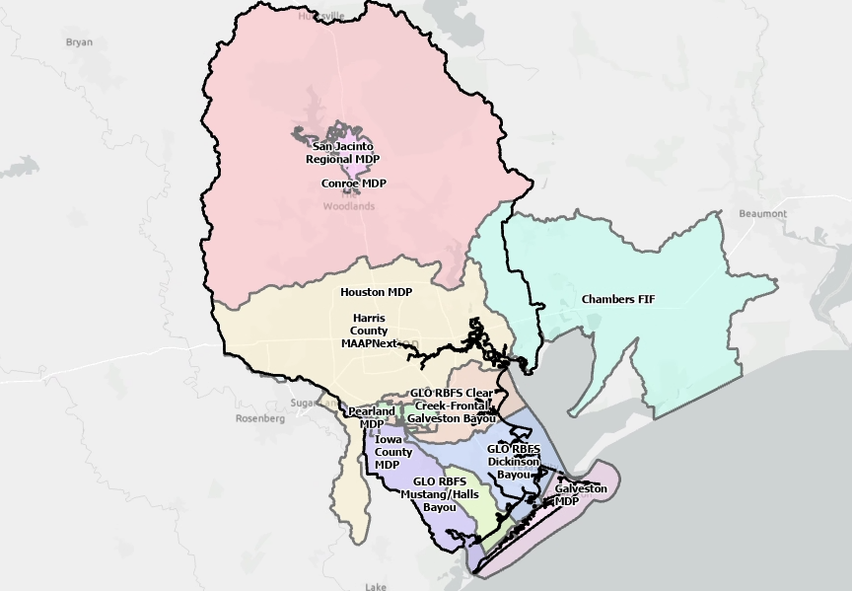
Task 2A – Existing Condition Flood Risk Analysis
Second Cycle – Technical
Consultant Recommended
Community Models & Maps
  Recent modeling with Atlas 14 rainfall (GLO, FIF Studies, MDPs, and MAAPnext*)
2D BLE
FEMA Detailed NFHL
1D BLE
Fathom
*MAAPnext Update: HCFCD has approved use of MAAPnext. Caveat that mapping is not publicly posted until official release from HCFCD.

Slide 19
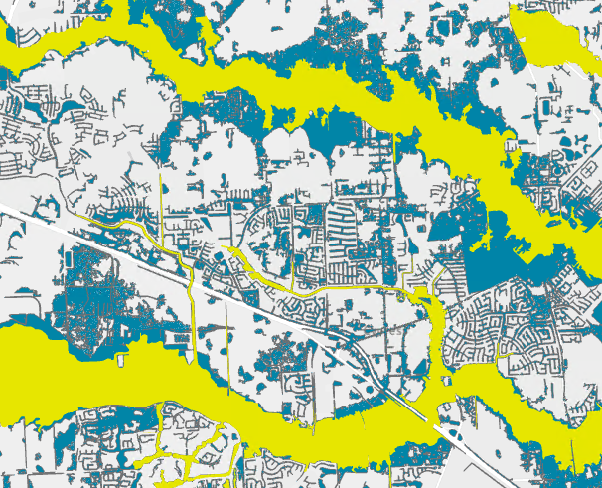
Task 2A – Upper Watershed Analysis
Preliminary 100-year Existing Flood Hazard Comparison

Slide 20


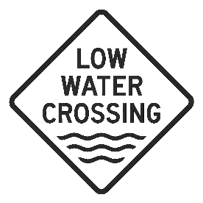


Task 2A – Exposure Analysis
Structures
  Updated within Harris County using the HCFCD dataset.
Critical facilities
  Reviewed and updated regionwide.
Low water crossings
  Defined as overtopped by the 2-year by TWBD.
  Identified using model results from the Hazard Analysis layer.
  For model results lacking the 2-year frequency event, extrapolation from other frequency events available.
Roadways
Agricultural Parcels

Slide 21
Task 2B – Future Condition Flood Risk Analysis

Slide 22
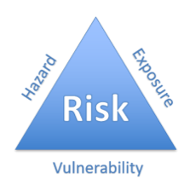
Task 2B – Future Condition Flood Risk Analysis
TWDB Goals: Perform future condition flood risk analyses for the region comprising:
Flood hazard analyses (location, magnitude, and frequency of flooding)
Flood exposure analyses (who and what might be harmed)
Vulnerability analyses (communities and critical facilities)
Obtain a general understanding of future flood risk for planning purposes
Not a regulatory product

Slide 23
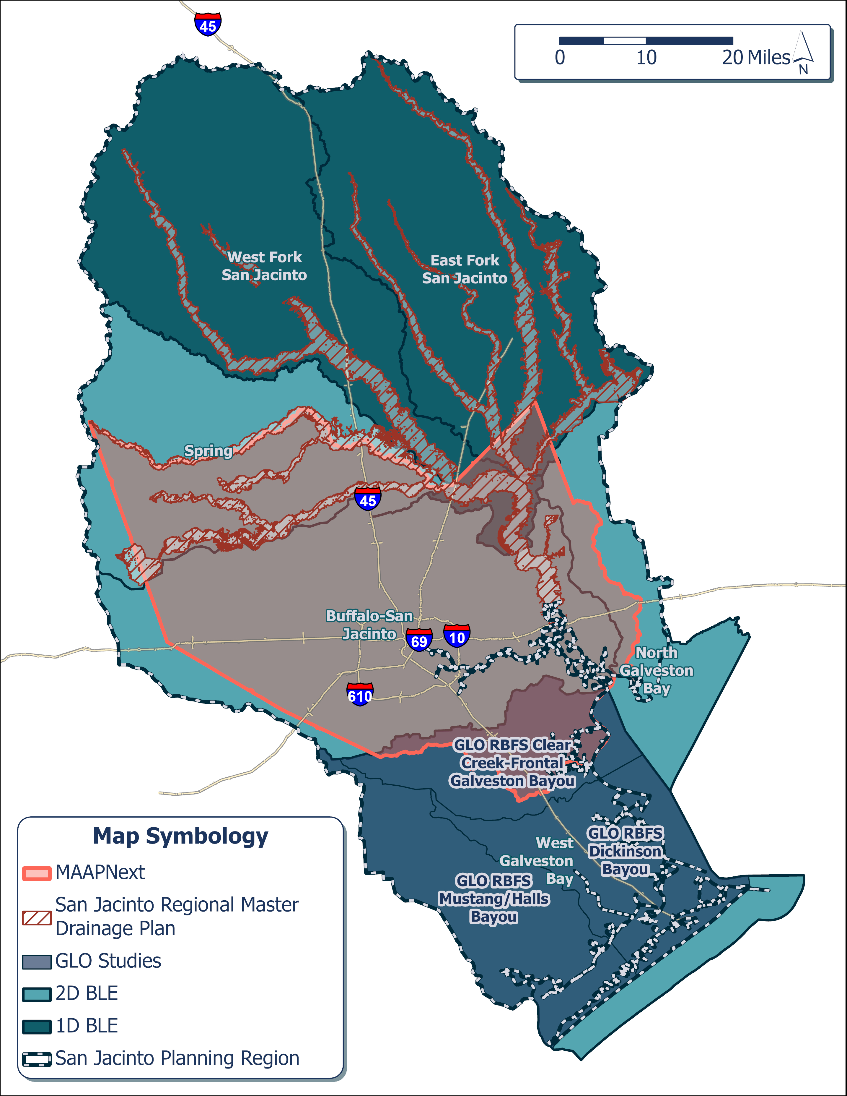
Task 2B – Scope
Scope: RFPGs will analyze future flood risk (year 2060) for 10-year, 100-year, and 500-year events
Possible Data Sources
Future condition Fathom data
Future condition community models
Modified forms of existing condition models/maps using factors that affect future flood risk

Slide 24
Task 2B – Approach
Northern Zone (north of Harris County):
  SJRMDP future models simulated with future rainfall
  2D BLE model simulated with future rainfall
  1D BLE models + vertical buffer
  Future Fathom Scenario 3
Central Zone (Harris County):
  MAAPnext models simulated with future rainfall
  Future Fathom Scenario 3
Coastal Zone (south and east of Harris County):
  2D GLO models simulated with future rainfall + SLR
  2D BLE models simulated with future rainfall + SLR
  Future Fathom Scenario 3
  Match existing extents wherever future floodplain is smaller

Slide 25
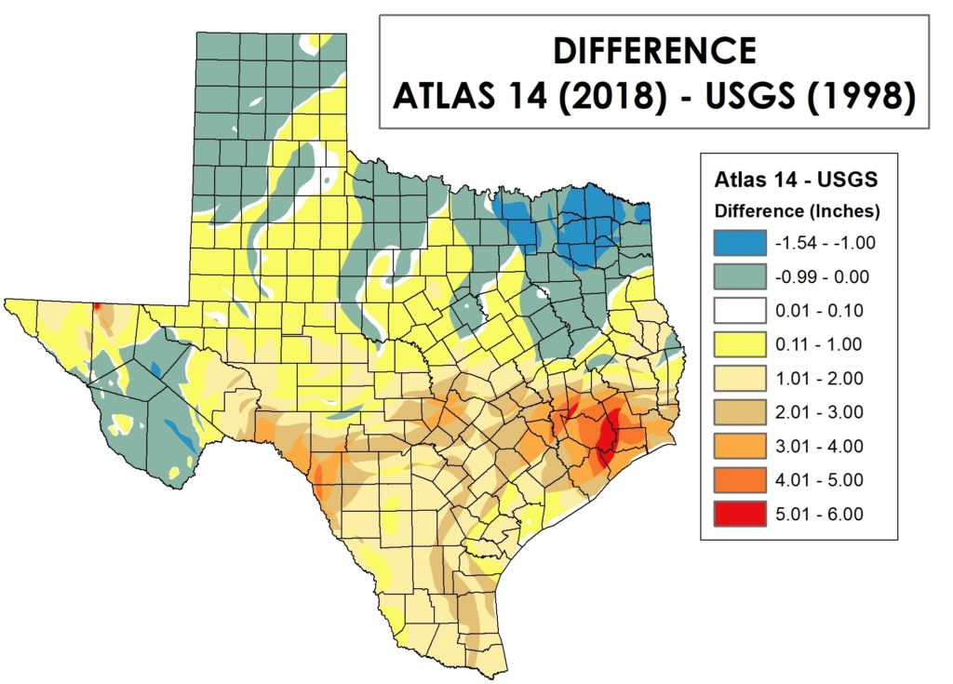
Task 2B – Future Condition Fathom Data
Future condition Fathom models incorporate:
Future climate variability rainfall patterns
Sea level rise
Subsidence
Land use change
Future Scenarios | Future Climate Forcing | Future Subsidence & Land Use
Scenario 1 | Minimal | Yes
Scenario 2 | Moderate | Yes
Scenario 3 | Significant | Yes
Scenario 4 | Moderate | No
Scenario 3 represents “worst case” and is suitable for the San Jacinto region

Slide 26
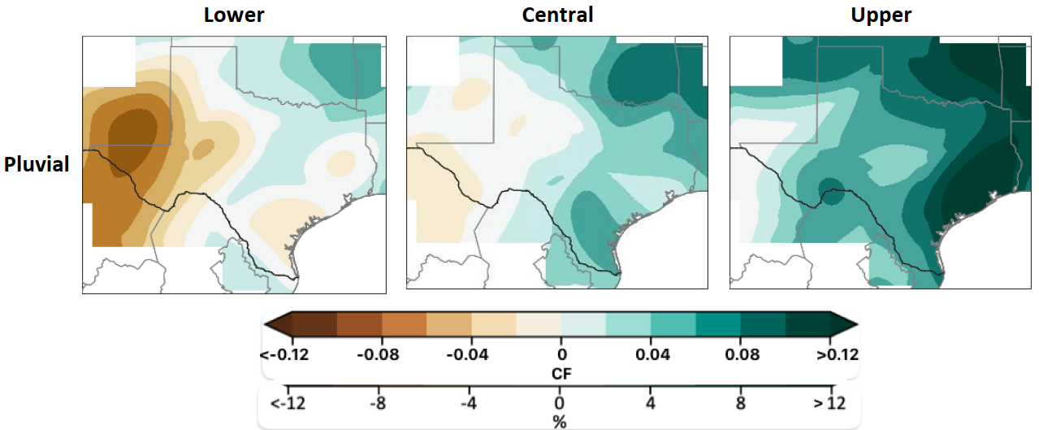
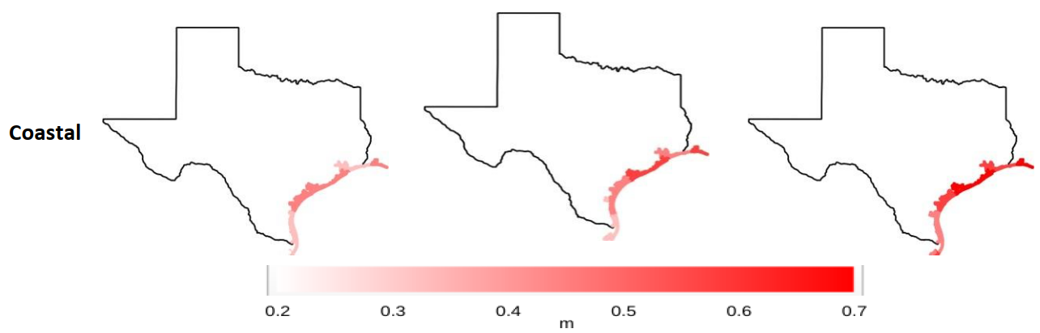
Task 2B – Future Condition Fathom Data
Future Change Factors
Pluvial: Existing rainfall is multiplied by a percentage
Fluvial: Existing river discharges are multiplied by a percentage
Coastal: Absolute changes in sea level
Source: “Year 2060 Floodplain Maps for Texas – Final Report”, TWDB, April 2025.

Slide 27
Task 2B – Future Condition Fathom Data
Conclusions from Fathom report
For fluvial/pluvial scenarios: When future land use and subsidence are introduced (no changes in climate), median change in WSEL is zero.
For coastal scenarios: When future land use and subsidence are introduced, median increase in WSEL is 2 inches.
For all scenarios: Future climate forcing is the biggest driver in WSEL increases
  Fluvial: Almost 2-foot increase from minimal to significant climate forcing
Source: “Year 2060 Floodplain Maps for Texas – Final Report”, TWDB, April 2025.

Slide 28
Task 2B – Future Condition Fathom Data
How does future condition Fathom compare to existing floodplains in the region?
Expectation: Future floodplain should be wider than existing floodplain.

Slide 29
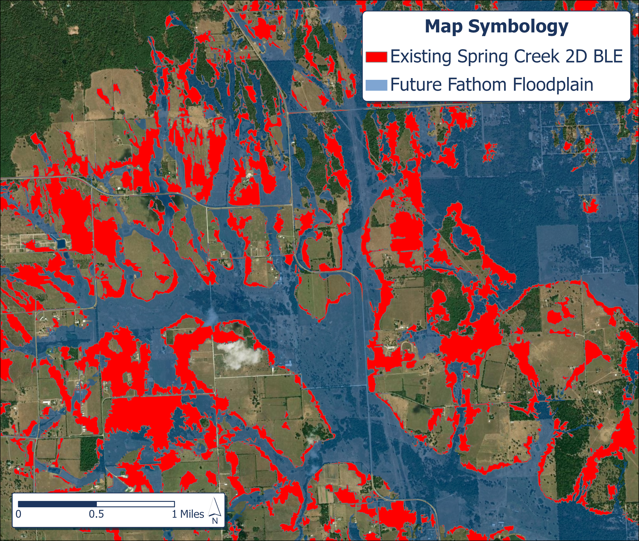
Task 2B – Future Fathom vs. 2D BLE
Future Fathom floodplain is commonly smaller than existing flood extents from detailed modeling for all storm events.
100-year Spring Creek 2D BLE
Therefore, existing models will be leveraged/modified to produce future flood risk maps.
Future Fathom will be utilized where pluvial flood risk is not already defined.

Slide 30
Task 2B – Approach
Northern Zone (north of Harris County):
  SJRMDP future models simulated with future rainfall
  2D BLE model simulated with future rainfall
  1D BLE models + vertical buffer
  Future Fathom Scenario 3
Central Zone (Harris County):
  MAAPnext models simulated with future rainfall
  Future Fathom Scenario 3
Coastal Zone (south and east of Harris County):
  2D GLO models simulated with future rainfall + SLR
  2D BLE models simulated with future rainfall + SLR
  Future Fathom Scenario 3
  Match existing extents wherever future floodplain is smaller

Slide 31
Task 2B – Approach
Northern Zone (north of Harris County):
  SJRMDP future models simulated with future rainfall
Update rainfall using pluvial change factor
Rerun 1D models
Remap
Source: “Year 2060 Floodplain Maps for Texas – Final Report”, TWDB, April 2025.

Slide 32
Task 2B – Approach
Northern Zone (north of Harris County):
  SJRMDP future models simulated with future rainfall
  2D BLE model simulated with future rainfall
Update rainfall using pluvial change factor
Rerun 2D model
Remap

Slide 33
Task 2B – Approach
Northern Zone (north of Harris County):
  SJRMDP future models simulated with future rainfall
  2D BLE model simulated with future rainfall
  1D BLE models + vertical buffer
Determine average WSEL increase using Fathom analysis
Apply vertical buffer using GIS tools
Remap
Future (Scen. 3)
Future
Existing
Existing
Fathom
1D BLE

Slide 34
Task 2B – Approach
Northern Zone (north of Harris County):
  SJRMDP future models simulated with future rainfall
  2D BLE model simulated with future rainfall
  1D BLE models + vertical buffer
  Future Fathom Scenario 3

Slide 35
Task 2B – Approach
Central Zone (Harris County):
  MAAPnext models simulated with future rainfall
Update rainfall using pluvial change factor
Rerun 1D/2D models
Remap
Source: “Year 2060 Floodplain Maps for Texas – Final Report”, TWDB, April 2025.

Slide 36
Task 2B – Approach
Northern Zone (north of Harris County):
  SJRMDP future models simulated with future rainfall
  2D BLE model simulated with future rainfall
  1D BLE models + vertical buffer
  Future Fathom Scenario 3
Central Zone (Harris County):
  MAAPnext models (pending approval) + vertical buffer
  OR Detailed NFHL models + vertical buffer
  Future Fathom Scenario 3
Coastal Zone (south and east of Harris County):
  2D GLO models simulated with future rainfall + SLR
  2D BLE models simulated with future rainfall + SLR
Update rainfall using pluvial change factor
Rerun 2D model
Remap
Apply SLR to boundary condition

Slide 37
Task 2B – Approach
Northern Zone (north of Harris County):
  SJRMDP future models simulated with future rainfall
  2D BLE model simulated with future rainfall
  1D BLE models + vertical buffer
  Future Fathom Scenario 3
Central Zone (Harris County):
  MAAPnext models simulated with future rainfall
  Future Fathom Scenario 3
Coastal Zone (south and east of Harris County):
  2D GLO models simulated with future rainfall + SLR
  2D BLE models simulated with future rainfall + SLR
  Future Fathom Scenario 3
  Match existing extents wherever future floodplain is smaller
Notes:
Propose break for RFPG after this slide

Slide 38
Task 3B – Needs Analysis

Slide 39
Task 3B – Flood Mitigation Needs Analysis
TWDB Goal: Identify locations within the Region that the RFPG considers to have the greatest flood mitigation and flood risk study needs.
Areas with Highest Flood Risk
Areas prone to flooding
Flood management practices
Areas with emergency need
Existing modeling analysis
Identified and evaluated plans
Historic flood events
Other factors deemed relevant
Availability of H&H Models
Availability of Flood Risk Maps
Areas with Map Gaps
Notes:
Meet the goal of this task by considering several factors, which are shown as components of the larger tasks on this graphic

Slide 40
Task 3B – Previous Cycle
Split region by HUC boundaries into 115 watersheds.
Evaluated watersheds based on the categories to create a score.
Utilized the results to create knowledge gap and flood risk need maps.
Determined nine data categories with 20 subcategories

Slide 41
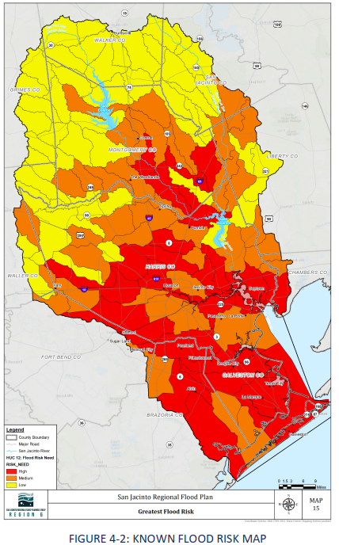
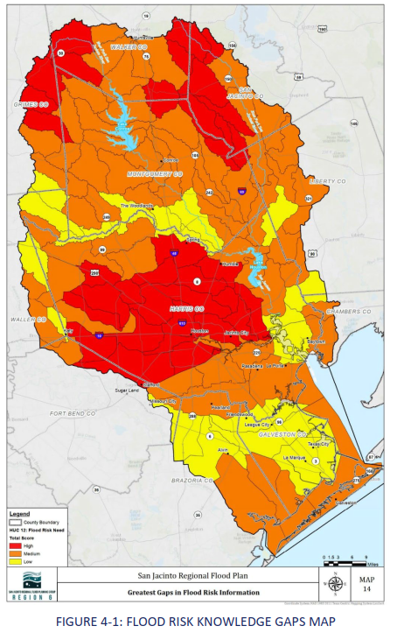
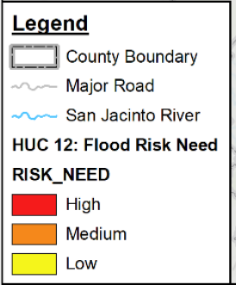
Task 3B – Previous Cycle

Slide 42
Task 3B – Previous Cycle
Areas with Highest Flood Risk
Exposure Analysis (Task 2A)
Flood Management Practices (Task 3A)
Project Evaluation (Task 1)
Known Flood Risk
Notes:
Pulled from data calculated in Task 2A (exposure analysis)
Identified and evaluated projects was not included in previous cycle because the purpose of this scoring category was to identify plans and studies that are not implemented or funded within the region. Upon evaluation, the RFPG determined that the proposed projects do not reflect the knowledge gaps nor the area of greatest needs.
Criteria Evaluated
Areas Prone to Flooding
Areas within the floodplain
Number of structures in the floodplain
Agricultural areas
Quantity of roadway miles
Number of roadway crossings
Critical facilities
Flood Management Practices
Participation in NFIP
Communities with a DCM
Communities with Higher Floodplain Standards
Communities CRS Score
Areas with Emergency Need
FEMA RL/SRL
Critical Facilities
Miles of Hurricane Evacuation Routes
Identified and Evaluated Projects
Not evaluated
Historic Flooding Events
FEMA Claims
Damage Amounts
Already Implemented Projects
Active Construction Projects
Other Factors
Social Vulnerability Index (SVI)
Nighttime population density

Slide 43
Task 3B – Previous Cycle
Flood Risk Gaps
Availability of maps (Task 1)
Availability of models (Task 1)
Flood Risk Knowledge Gaps
Notes:
Criteria Evaluated
Availability of H&H Models
Map types and age
Existing Modeling Analysis
Detailed Studies

Slide 44
Task 3B – Current Cycle
Strategy for this cycle is under development
  May mirror previous cycle
  Will likely adjust to align with the effort being done in Task 3A
Will seek input from the Technical Committee and the Full RFPG Board
  Input will likely be needed on how to address gaps
  Can make recommendations
  Building towards FMX recommendations
Notes:
Will likely align with the effort in Task 3A and be a more targeted effort.

Slide 45
Task 3B – Current Cycle
Deliverables:
  Chapter 3
  Revised/updated figures
  Associated GIS files
Results of this effort will help to inform where FMXs should be targeted to reduce flood risk to life and property
Notes:
Will likely align with the effort in Task 3A and be a more targeted effort.

Slide 46
Task 3A – Evaluation and Recommendation of Floodplain Management Practices

Slide 47



Task 3A – 2023 SJRFP Minimum Standards
Recommended Minimum Standards
Participation in the National Flood Insurance Program (NFIP)
Development of No Adverse Impact Policies
Establish Minimum Finished Floor Elevations (FFE)
Encourage Use of Best Available Data
Compensatory Storage Requirements in the 1.0% ACE Floodplain
Compensatory Storage Requirements in the 0.2% ACE Floodplain
Development of Detailed Hydrologic and Hydraulic Analysis Criteria/Requirements
Incentivizing the Preservation of the Floodplain
Add specification to previously recommended standards
Expand the list of minimum standards
Consider adopting standards

Slide 48
Task 3A Schedule
Collect Survey Responses
Technical Committee
Review data collected with Tech Comm
Interactive Workshop on Minimum Standards
Desktop Analysis of updated DCMs, NFIP and CRS participation, TFMA Higher Standards Survey
Develop Updated List of Minimum Standards to distribute to the RFPG
Fall 2025
RFPG to Recommend and/or Adopt Minimum Standards
Review and Compare to 2024 State Flood Plan/ Other 2023 Regional Flood Plans

Slide 49
Task 3A City/County Overview
Participation in the NFIP
97%
82%
Entities with Higher Standards
Entities with
Strong Standards
46%
27%
Entities with CRS Participation
Notes:
90/93 NFIP
77/93 Higher Standards
44/93 Strong

Slide 50
Quick Summary of Survey Responses
Public Responses
Stakeholder Responses
46%
Offline feedback to be solicited from RFPG between August and September meetings

Slide 51
Task 3A – Discussion
May RFPG Meeting: Continue to recommend minimum standards
Technical Consultant Recommendation: continue to recommend standards and propose FMSs in Task 3B
July Technical Committee Meeting: Five standards proposed for adoption
*Review of Pre-Meeting Materials

Slide 52
Task 3C – Flood Mitigation and Floodplain Management Goals

Slide 53
Task 3C - Overview
Review and track progress towards 1st cycle goals
Updates to goals for 2nd cycle

Slide 54
Task 3C – Substantially Completed Goals

Slide 55
Task 3C – Progressing Goals

Slide 56
Task 3C – Goals with No Progress

Slide 57
Quick Summary of Survey Responses
Public Responses
Stakeholder Responses
46%
Offline feedback to be solicited from RFPG between August and September meetings

Slide 58
Task 4C – Performance of FMEs

Slide 59
Task 4C – Performance of FMEs
Technical Consultant outreach to sponsors results:
18 Sponsors Contacted
8 FMEs Confirmed Interested by 6 Unique Sponsors
56 FMEs Advanced by Sponsor or Not Interested
49 FMEs Pending Sponsor Feedback
12 Sponsors Left to Contact

Slide 60
Task 4C – Key Takeaways
Coordination ongoing with the sponsors of the 8 confirmed FMEs.
  Not performing FMEs until approved by RFPG.
Sponsors have already performed many FMEs.
Sponsors needs have changed since last cycle.
Anticipating additional FME confirmations with ongoing coordination.
  Technical Consultant team will present alternative course of action if allocated budget is not fully utilized.
Ahead of schedule. Opportunity for one-on-one outreach to educate sponsors on RFP and understand needs.

Slide 61
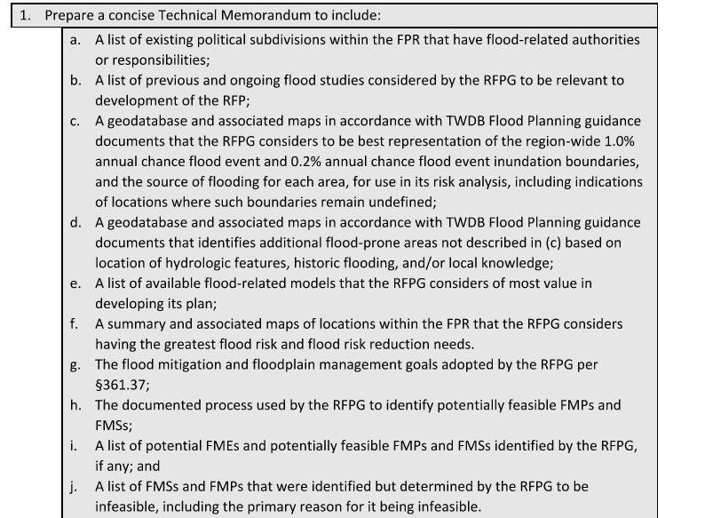
Task 4B – Technical Memorandum
Task 4B, Interim Deliverable, Due January 7, 2026
  Select items from Tasks 1 through 4
  Checklist to be provided by TWDB
Approval for Tech Memo at November RFPG meeting

Slide 62
Future Meeting Dates & Content
Meeting | Milestone/Action
Aug 2025 | RFPG Meeting Review progress of Tasks 2A/2B Task 3B Needs Analysis Consider updates to goals (Task 3C)
Sep 2025 | RFPG Meeting – Action Needed Review progress of Task 2A/2B Adopt Goals (Task 3C); Recommend Min Standards (Task 3A) Present list of potentially feasible FMXs identified this cycle
Sep/Oct 2025 | Technical Committee Meeting Present results of Task 2A/2B Provide input on Needs Analysis (Task 3B) Prioritized List of FMEs for TWDB to Perform (Due Mar 2026)
Oct 2025 | Public Engagement Committee Meeting Approve planning for Public Meeting Series to occur Q1 of 2026
Nov 2025 | RFPG Meeting – Action Needed Vote to Approve Tech Memo Discuss FIF Technical Assistance ahead of FY26-27 Call for Apps
Jan 2026 | RFPG Meeting Focus on FMEs RFPG and TWDB to perform this cycle Planning for Q1 2026 Public Meeting Series

Slide 63
ITEM 12
Consider Agenda Items for Next Meeting

Slide 64
ITEM 13
Public Comments – Limit 3 Minutes Per Person

Slide 65
ITEM 14
Adjournment

