Slide 1


Region 6 - San Jacinto Regional
Flood Planning Group
Planning Meeting
May 1, 2025
9:00 AM
Planning Meeting

Slide 2

ITEM 1
Call to Order

Slide 3
ITEM 2
Welcome and Roll Call

Slide 4
ITEM 3
Registered Public Comments on Agenda Items
(Limit of 3 Minutes Per Person)

Slide 5
ITEM 4
Texas Water Development Board Update

Slide 6
ITEM 5
Approval of Meeting Minutes

Slide 7
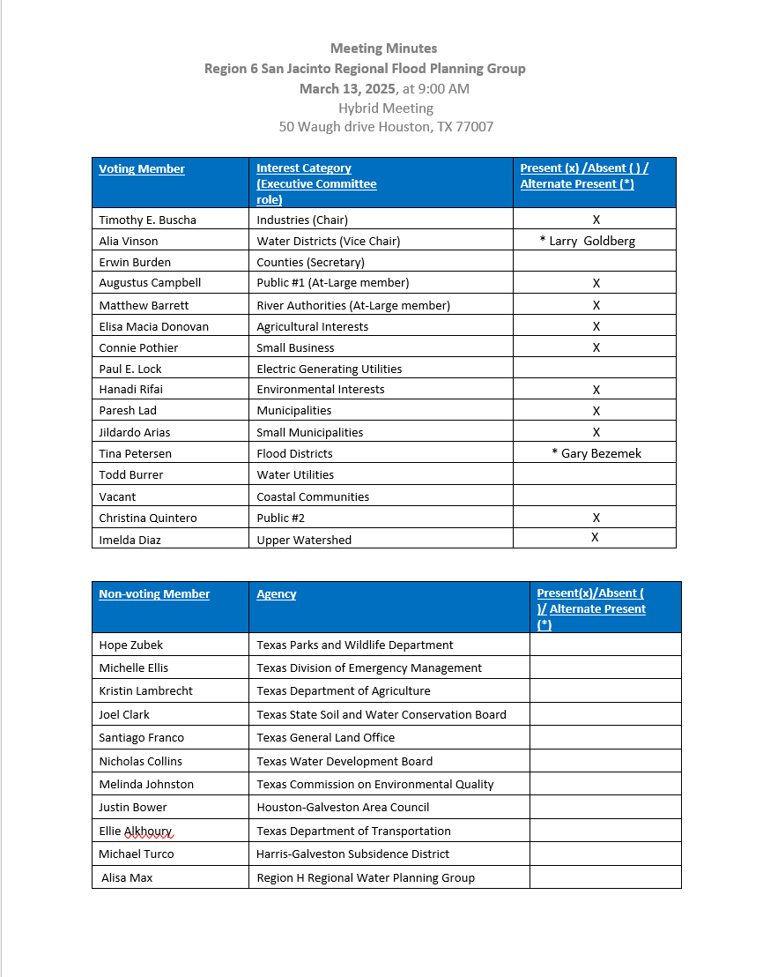
ITEM 5
Approval of Meeting Minutes

Slide 8
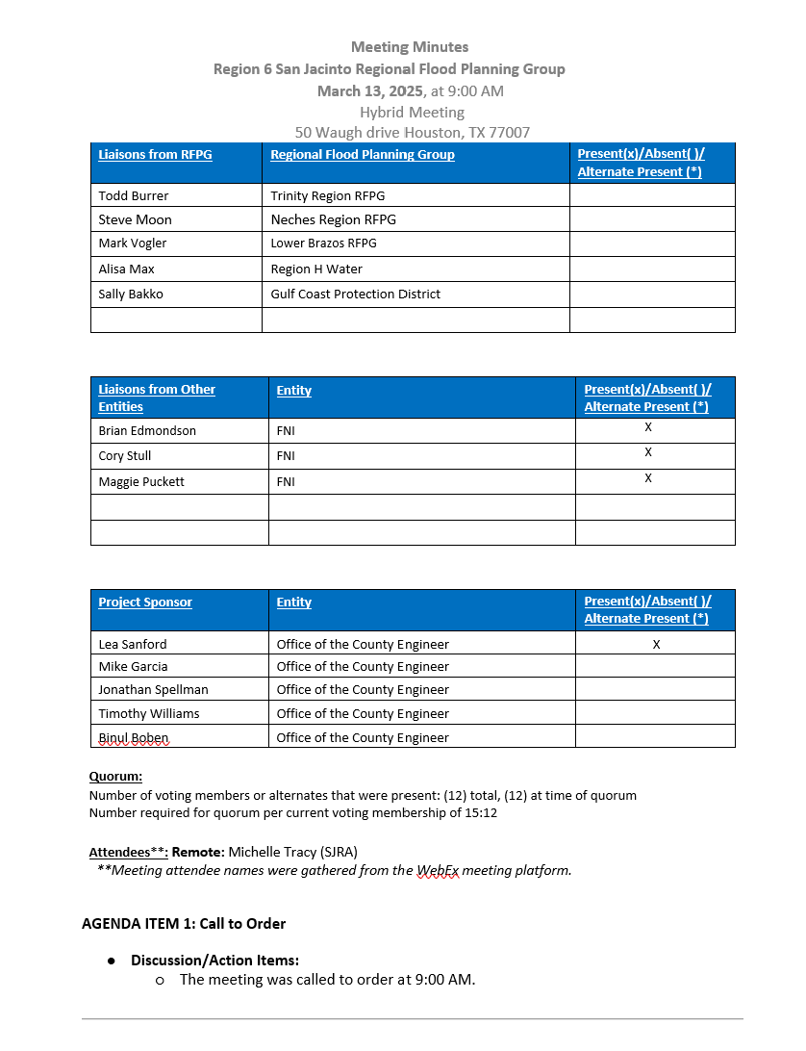
ITEM 5
Approval of Meeting Minutes

Slide 9
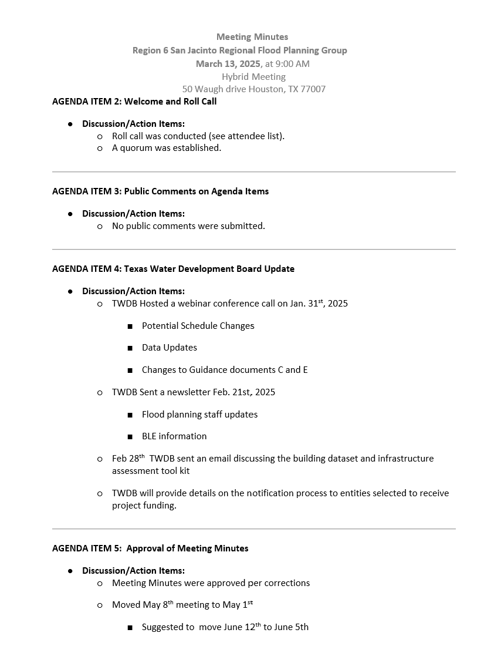
ITEM 5
Approval of Meeting Minutes

Slide 10
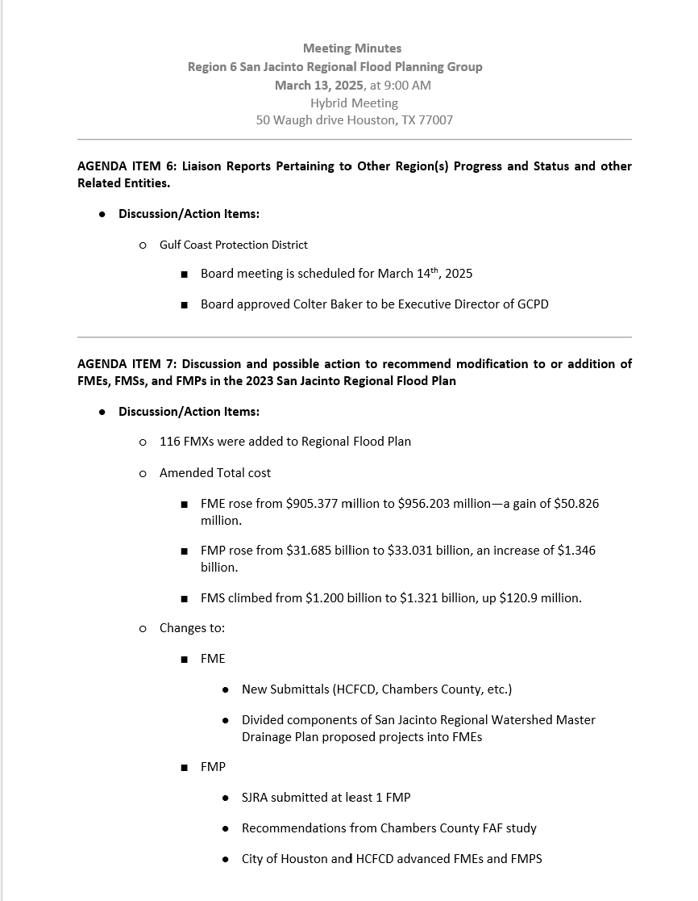
ITEM 5
Approval of Meeting Minutes

Slide 11
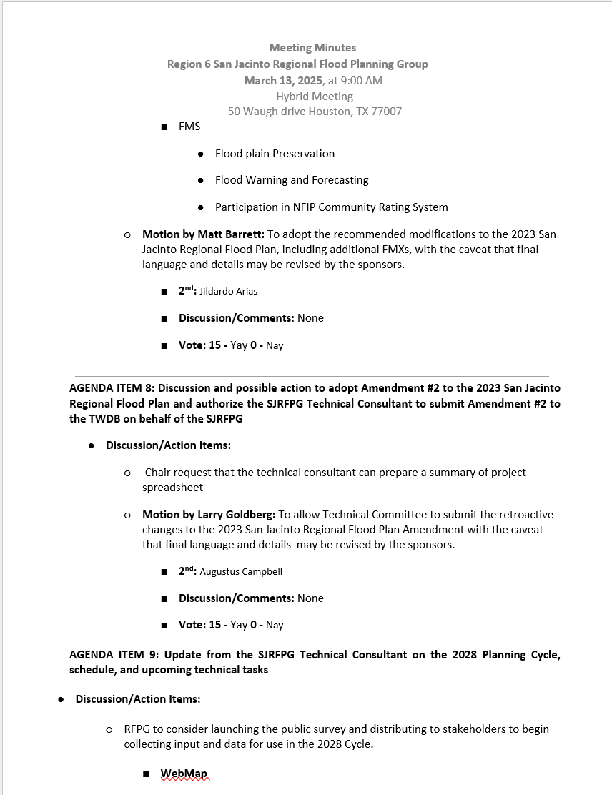
ITEM 5
Approval of Meeting Minutes

Slide 12
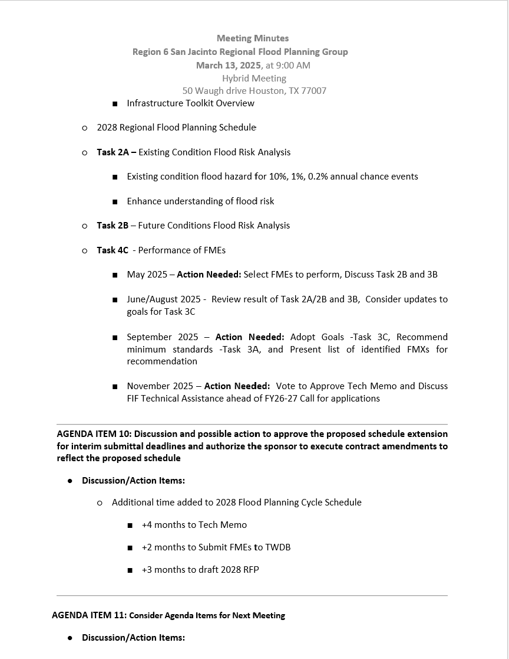
ITEM 5
Approval of Meeting Minutes

Slide 13
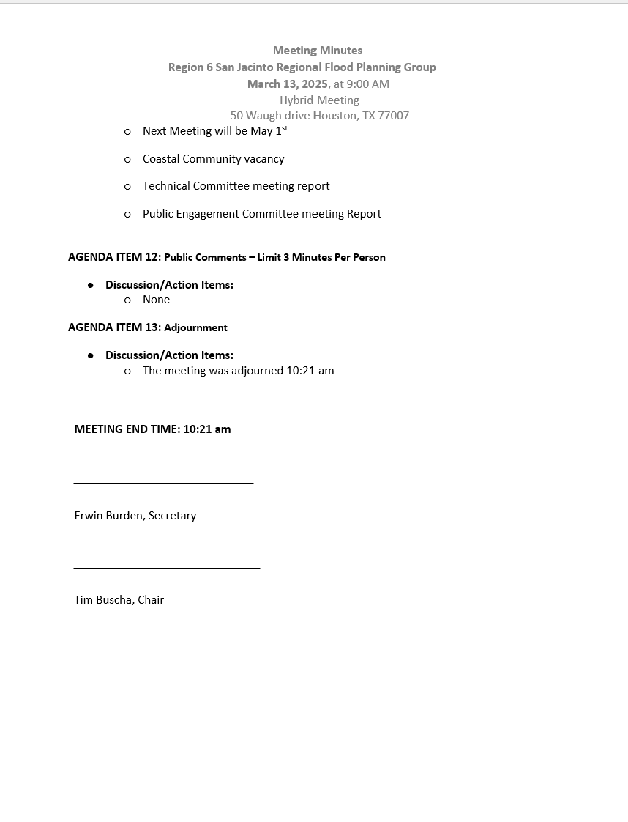
ITEM 5
Approval of Meeting Minutes

Slide 14
ITEM 6
Task 1 Discussion – RFPG Public Survey and data collection.
Liaison Reports Pertaining to Other Region(s) Progress and Status and other Related Entities:
a. Trinity Region
b. Neches Region
c. Lower Brazos Region
d. Region H Water
e. Gulf Coast Protection District (GCPD)

Slide 15
ITEM 7
Discussion and Appointment of the Coastal Community Voting Member

Slide 16
ITEM 8
SJRFPG -Technical Committee Report

Slide 17
ITEM 9
SJRFPG –Public Engagement Committee Report

Slide 18
ITEM 10
Update from the SJRFPG Technical Consultant on the 2028 Planning Cycle including discussion and possible action to approve a prioritized list of FMEs to perform under Task 4C

Slide 19
Technical Consultant Update
May 1, 2025
Notes:
Introduction

Slide 20

Agenda
Red icon indicates need for action from the RFPG
Task 2A – Existing Condition Flood Risk Analysis
Task 3A – Floodplain Management Practices
Task 4C – Performance of FMEs
2028 Regional Flood Planning Schedule

Slide 21
Task 2A – Existing Condition Flood Risk Analysis

Slide 22
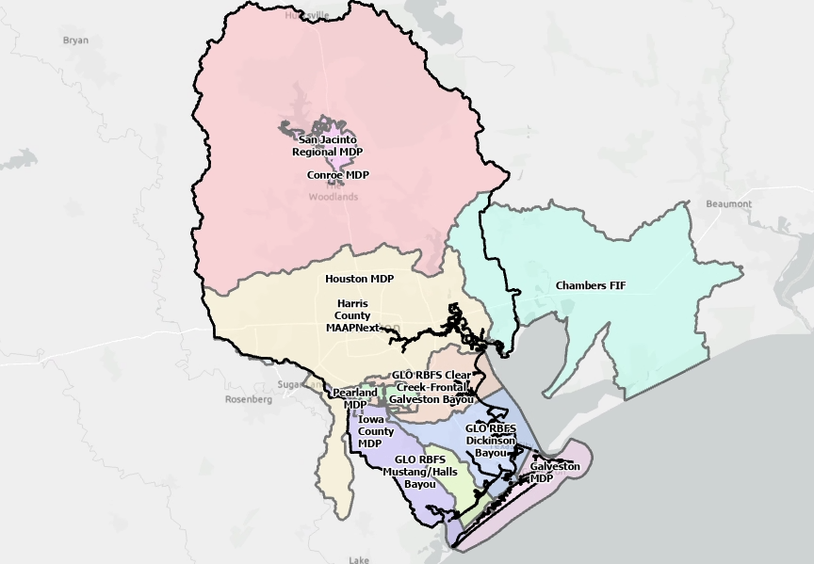
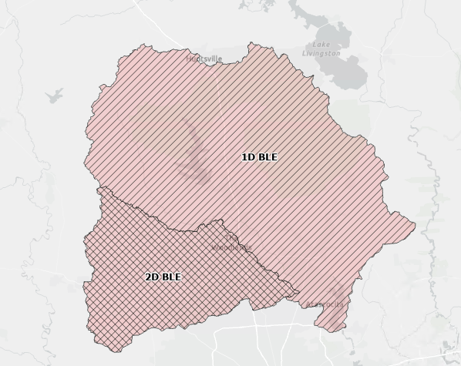
Task 2A – Existing Condition Flood Risk Analysis
Second Cycle – Technical
Consultant Recommended
Community Models & Maps
  Recent modeling with Atlas 14 rainfall (GLO, FIF Studies, MDPs, and MAAPnext pending availability)
2D BLE
FEMA Detailed NFHL
1D BLE
Fathom

Slide 23
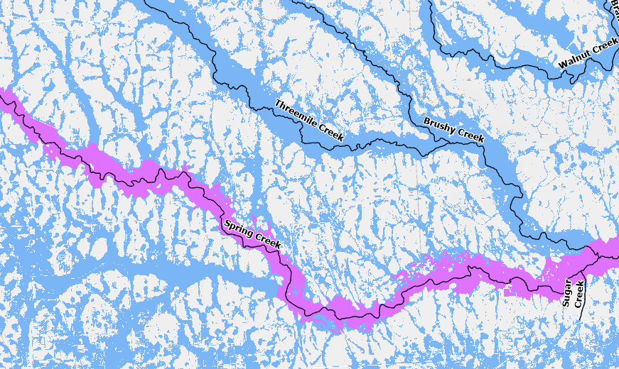
Task 2A – Existing Condition Flood Risk Analysis
Community Model (SJMDP) vs 2D BLE
SJMDP provides a more accurate depiction of flood risk along major rivers.
2D BLE to be used for urban and small tributary flood risk.
Legend
SJMDP
2D BLE

Slide 24
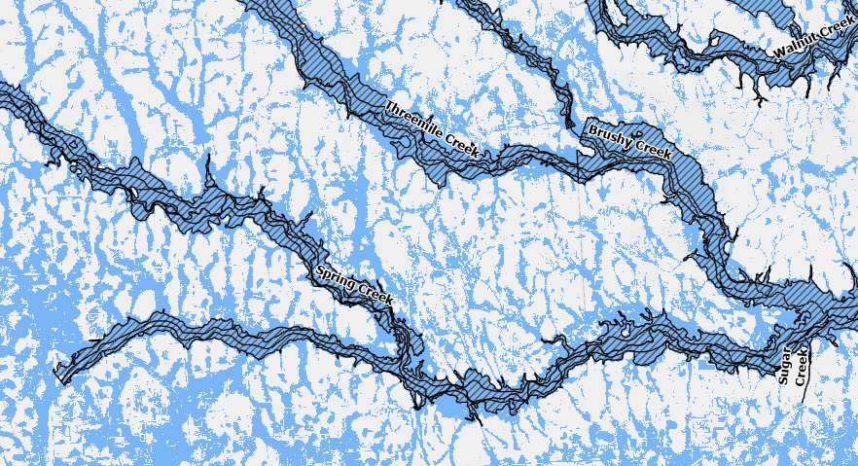
Task 2A – Existing Condition Flood Risk Analysis
2D BLE vs FEMA Detailed NFHL
More detailed risk captured by 2D BLE, which utilizes Atlas 14 rainfall and updated terrain.
Urban and minor tributary flood risk not captured by FEMA Detailed NFHL.
2D BLE to be used instead of NFHL.
Legend
FEMA Detailed NFHL
2D BLE

Slide 25
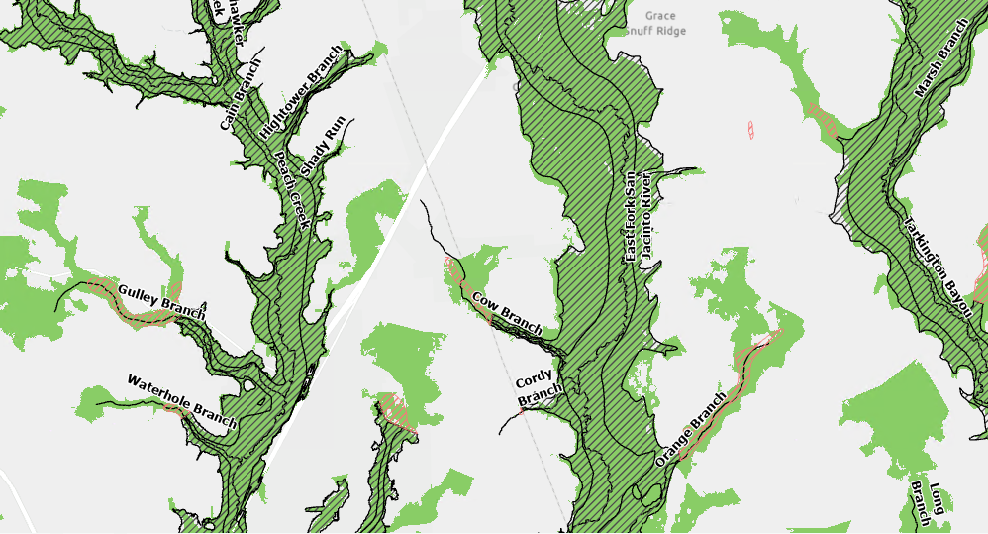
Task 2A – Existing Condition Flood Risk Analysis
1D BLE vs FEMA Detailed NFHL vs FEMA Approximate NFHL
Similar flood risk footprints along major rivers.
Minor tributary flood risk best captured by 1D BLE.
FEMA Approx NFHL will not be used.
Legend
FEMA Detailed NFHL
FEMA Approx NFHL
1D BLE

Slide 26
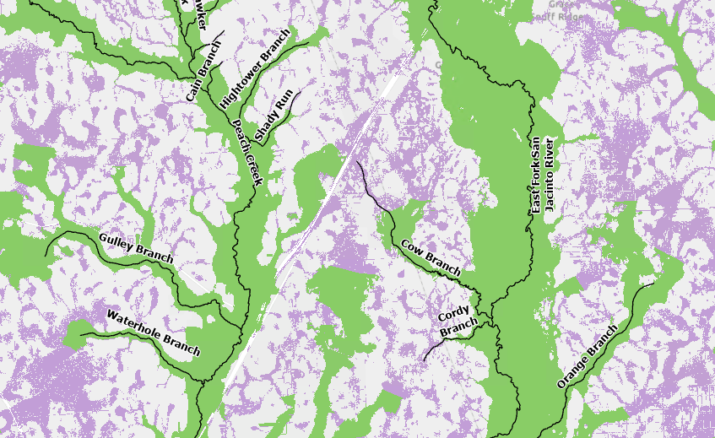
Task 2A – Existing Condition Flood Risk Analysis
1D BLE vs Fathom
1D BLE provides a more accurate depiction of flood risk along tributaries.
Fathom to be utilized in areas outside of 1D BLE extents.
Legend
1D BLE
Fathom

Slide 27
Task 2A – Existing Condition Flood Risk Analysis
RFPG to consider approving the hierarchy for prioritizing datasets available to complete Task 2A.
  Pending ongoing discussions with HCFCD on mapping Harris County flood risk.

Slide 28
Task 3A – Evaluation and Recommendation of Floodplain Management Practices

Slide 29
Task 3A – Scope Requirements
General description and summary of floodplain management practices
Summary of key floodplain management practices by the respective regulatory entities
Summary of recommendations and/or adopted minimum standards for floodplain management practices
RFPG Standards are either:
Recommendations for consideration by local entities or
They represent RFPG adopted minimum standards that are required to be adopted by local entities prior to the RFPG including any FMEs, FMSs, or FMPs that are sponsored by or that will otherwise be implemented by that entity in the RFP

Slide 30



Task 3A – 2023 SJRFP Minimum Standards
Recommended Minimum Standards
Participation in the National Flood Insurance Program (NFIP)
Development of No Adverse Impact Policies
Establish Minimum Finished Floor Elevations (FFE)
Encourage Use of Best Available Data
Compensatory Storage Requirements in the 1.0% ACE Floodplain
Compensatory Storage Requirements in the 0.2% ACE Floodplain
Development of Detailed Hydrologic and Hydraulic Analysis Criteria/Requirements
Incentivizing the Preservation of the Floodplain
Add specification to previously recommended standards
Expand the list of minimum standards
Consider adopting standards

Slide 31
Task 3A Schedule
Collect Survey Responses
Technical Committee
Review data collected with Tech Comm
Interactive Workshop on Minimum Standards
Desktop Analysis of updated DCMs, NFIP and CRS participation, TFMA Higher Standards Survey
Develop Updated List of Minimum Standards to distribute to the RFPG
Fall 2025
RFPG to Recommend and/or Adopt Minimum Standards
Review and Compare to 2024 State Flood Plan/ Other 2023 Regional Flood Plans

Slide 32
Task 4C – Performance of FMEs

Slide 33


Tracks for FMEs to FMPs in 2nd Cycle
1. Technical Consultant performs in 2nd Cycle
2. TWDB Performs in 2nd Cycle
3. Sponsor performs via other initiative
(FIF funding, CDBG-MIT COG MOD, GLO RBFS, etc.)
FMP
FME
4. FME deferred for future opportunity

Slide 34
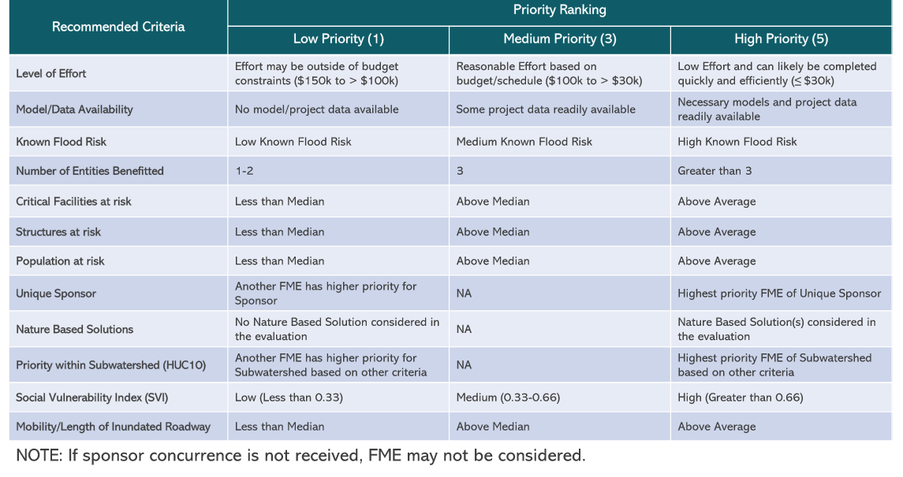
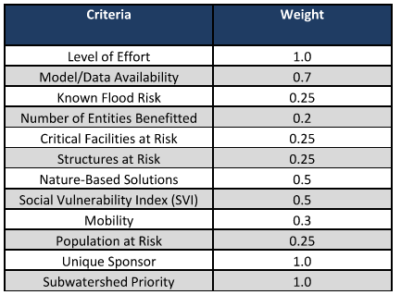
Task 4C – Performance of FMEs
Task 4C Budget = $942,500
FME criteria based on Task 12 methodology from the First RFP Cycle

Slide 35
Task 4C – Performance of FMEs
See attached ranked FME list.
Task 4C Budget = $942,500
Ranked based on Task 12 prioritization criteria from the 1st cycle
Filtered to <= $100,000
FMEs with rural sponsors to be removed and recommended to be performed by TWDB
Ranked list subject to change based on additional coordination with FME sponsors
  Verify need and applicability

Slide 36
Task 4C – Performance of FMEs
RFPG to consider approving the methodology for prioritizing FMEs to perform under Task 4C
RFPG to consider authorizing the Technical Consultant to conduct outreach to sponsors to confirm the following with sponsors of high ranking FMEs:
  Scope description
  Level of effort
  Interest in RFPG performing the FME

Slide 37
2025 Meeting Dates & Content
Meeting | Milestone/Action
January 2025 | RFPG Meeting 2028 RFP Overview, Task 1, Amendment Update Discuss Process to Select FMEs to Perform (Task 4C)
March 2025 | RFPG Meeting – Action Taken Recommend FMXs; Adopt Amendment Finalize Public Survey Review Task 1, Task 2A/2B, Task 4C
May 2025 | RFPG Meeting – Action Needed Select FMEs to Perform (Task 4C) Overview of Minimum Standards (Task 3A)
June/August 2025 | RFPG Meeting Review results of Tasks 2A/2B – Pending MAAPnext Availability Task 3B Needs Analysis – Moved from May Consider updates to goals (Task 3C)
September 2025 | RFPG Meeting – Action Needed Adopt Goals (Task 3C); Recommend Min Standards (Task 3A) Present list of identified FMXs for recommendation
November 2025 | RFPG Meeting – Action Needed Vote to Approve Tech Memo Discuss FIF Technical Assistance ahead of FY26-27 Call for Apps

Slide 38
ITEM 11
Consider Agenda Items for Next Meeting

Slide 39
ITEM 12
Public Comments – Limit 3 Minutes Per Person

Slide 40
ITEM 13
Adjournment

