Slide 1


Region 6 - San Jacinto Regional Flood Planning Group
Planning Meeting April 17, 2025 9:00 AM Public Engagement Meeting

Slide 2

ITEM 1 Call to Order

Slide 3
ITEM 2 Welcome and Roll Call

Slide 4
ITEM 3 Registered Public Comments on Agenda Items (Limit of 3 Minutes Per Person)

Slide 5
ITEM 4 Nominations, Discussion, and Action to elect Committee Chair, Vice Chair, and Secretary

Slide 6
ITEM 5 Approval of Meeting Minutes

Slide 7
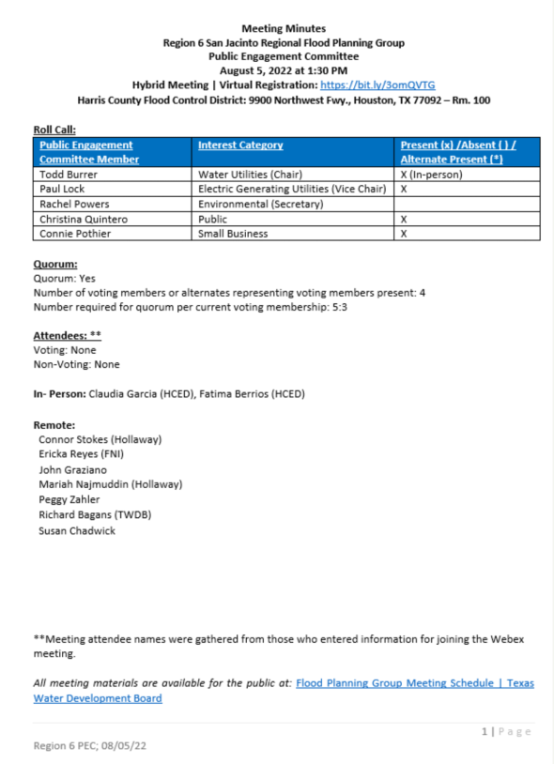
ITEM 5 Approval of Meeting Minutes

Slide 8
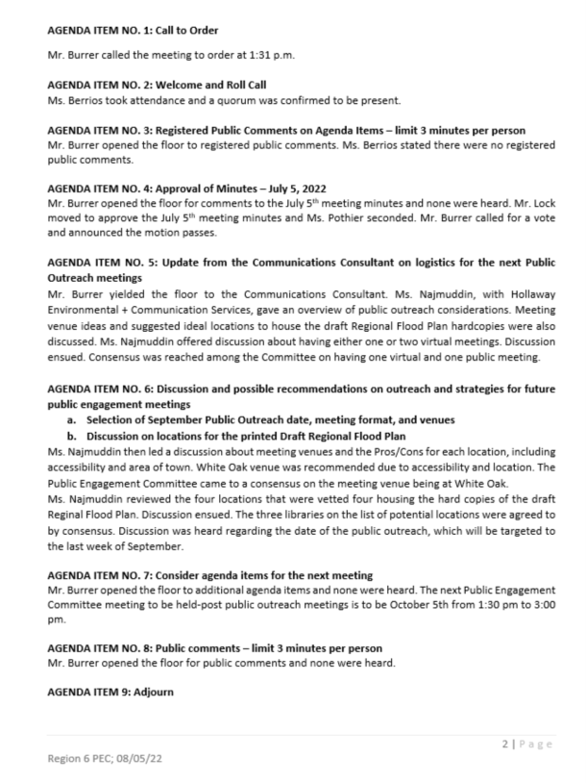
ITEM 5 Approval of Meeting Minutes

Slide 9
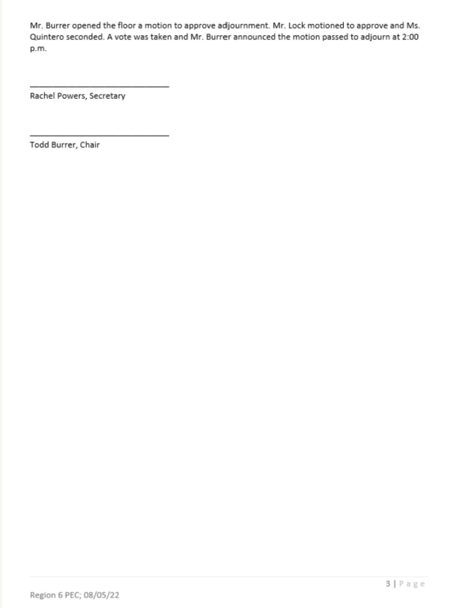
ITEM 5 Approval of Meeting Minutes

Slide 10
ITEM 6 Task 1 Discussion – RFPG Public Survey and data collection.
Task 1 Discussion – RFPG Public Survey and data collection.
Task 1 Discussion – RFPG Public Survey and data collection.

Slide 11
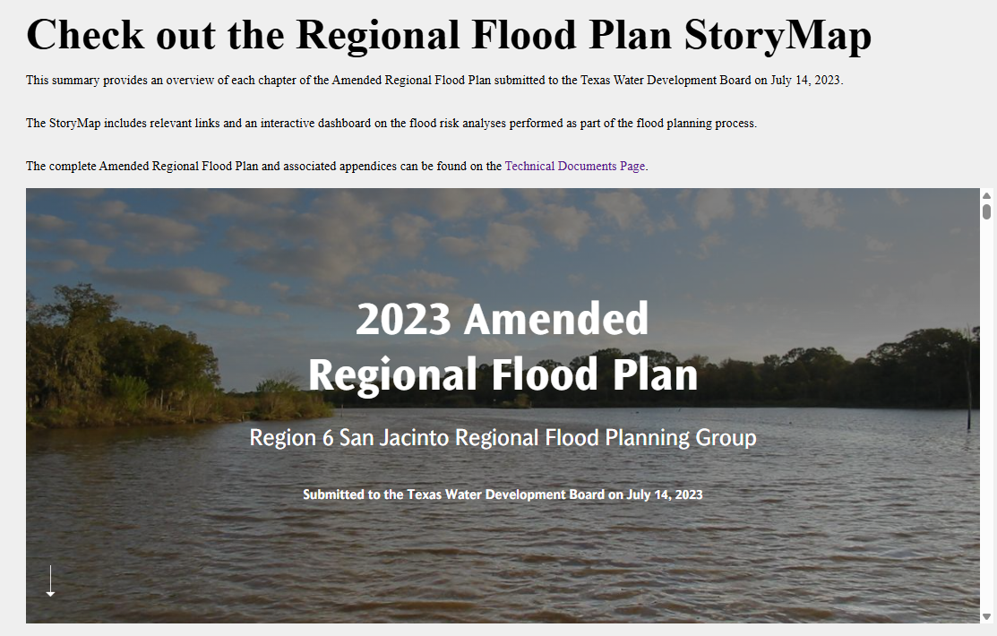
Recap from 1st Cycle
Public Meetings
Flood Prone areas
Types of FMEs, FMSs, and FMPs
Input on the Draft Plan
Tools/Materials Developed
Communications Plan
Survey; Key Data request table
Interactive GIS dashboard
GIS Storymap
Regular Outreach
Monthly eBlasts; 1:1 stakeholder outreach
Social Media updates
Presentations to interest groups

Slide 12
Discuss Strategy for Distributing Survey
Survey intended to collect feedback from general public and regional stakeholders to support development of the plan.
Communicate a deadline? Leave open?
Leverage RFPG contacts for more personal touch?
Leverage other established interest group contact databases?
Distribute broadly to SJRFPG contact database?

Slide 13
Discuss Strategy for Announcing Amendment #2
FMXs recommended in the 2023 San Jacinto RFP Amendment #2 will be eligible to apply for FY2026 – 2027 FIF Funds.
Distribute broadly to SJRFPG contact database?
How to improve accessibility for stakeholder to support future FIF funding applications?
Additional materials for RFPG members to leverage to better engage their constituencies?

Slide 14


Brainstorm 2nd Cycle Outreach
Public Meeting requirements:
Input on flood prone areas
Types of FMEs, FMSs, and FMPs in the plan
Input on the Draft Plan
Target regional stakeholders:
1:1 outreach
Regular updates to relevant groups (ex: HGAC RFMC)
Others?
Strategy & Activities Discussion
What changes from 1st cycle activities & strategies should be considered?
Social media, website,

Slide 15
2028 Flood Planning Cycle – Schedule
Technical Consultants under Contract Fall 2024
Tech Memo Due Jan 2026
RFP Amendments due to TWDB April 1, 2025
Submit FMEs to TWDB
Mar 2026
Draft 2028 RFP Due May 2027
Final 2028 RFP Due Jan 2028
2025
2026
2027
2028

Slide 16
Future Meeting Dates & Content
Meeting | Milestone/Action
January 2025 | RFPG Meeting 2028 RFP Overview, Task 1, Amendment Update Discuss Process to Select FMEs to Perform (Task 4C)
March 2025 | RFPG Meeting – Action Needed Recommend FMXs; Adopt Amendment Finalize Public Survey Review Task 1, Task 2A, Task 3A
May 2025 | RFPG Meeting – Action Needed Select FMEs to Perform (Task 4C) Discuss Task 2B, Task 3B Needs Analysis Consider updates to Minimum Standards (Task 3A)
July 2025 | RFPG Meeting Review results of Tasks 2A/2B Review results of Needs Analysis (Task 3B) Consider updates to goals (Task 3C)
September 2025 | RFPG Meeting – Action Needed Adopt Goals (Task 3C); Recommend Min Standards (Task 3A) Present list of identified FMXs for recommendation
November 2025 | RFPG Meeting – Action Needed Vote to Approve Tech Memo Discuss FIF Technical Assistance ahead of FY26-27 Call for Apps

Slide 17
ITEM 7 Consider Agenda Items for Next Meeting

Slide 18
ITEM 8 Public Comments – Limit 3 Minutes Per Person

Slide 19
ITEM 9 Adjournment

