Slide 1


Region 6 - San Jacinto Regional
Flood Planning Group
Planning Meeting
March 13, 2025
9:00 AM
Public Meeting

Slide 2

ITEM 1
Call to Order

Slide 3
ITEM 2
Welcome and Roll Call

Slide 4
ITEM 3
Registered Public Comments on Agenda Items
(Limit of 3 Minutes Per Person)

Slide 5
ITEM 4
Texas Water Development Board Update

Slide 6
ITEM 5
Approval of Meeting Minutes

Slide 7
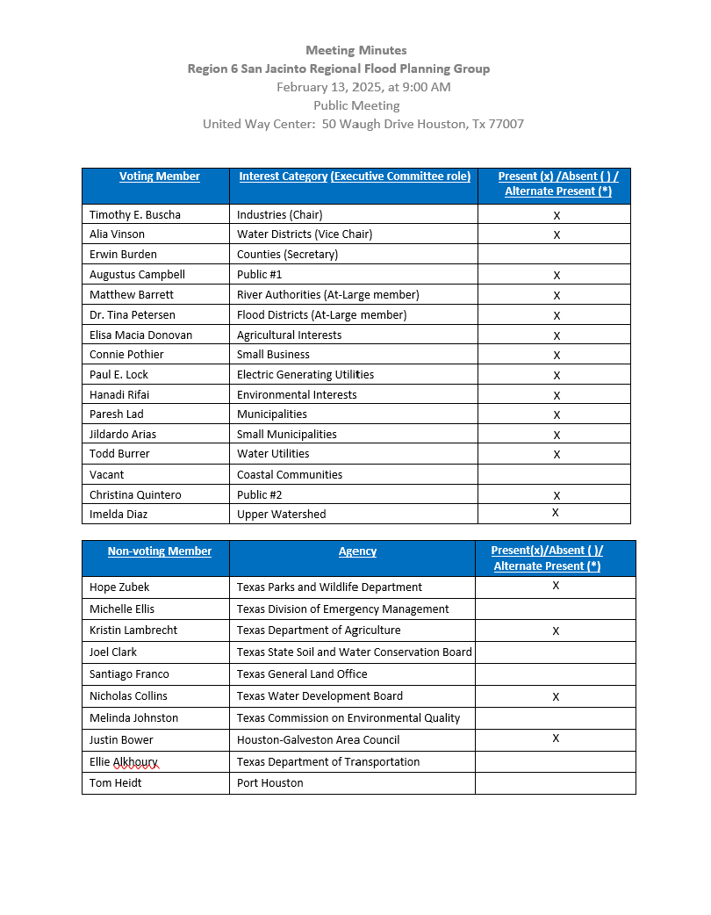
ITEM 5
Approval of Meeting Minutes

Slide 8
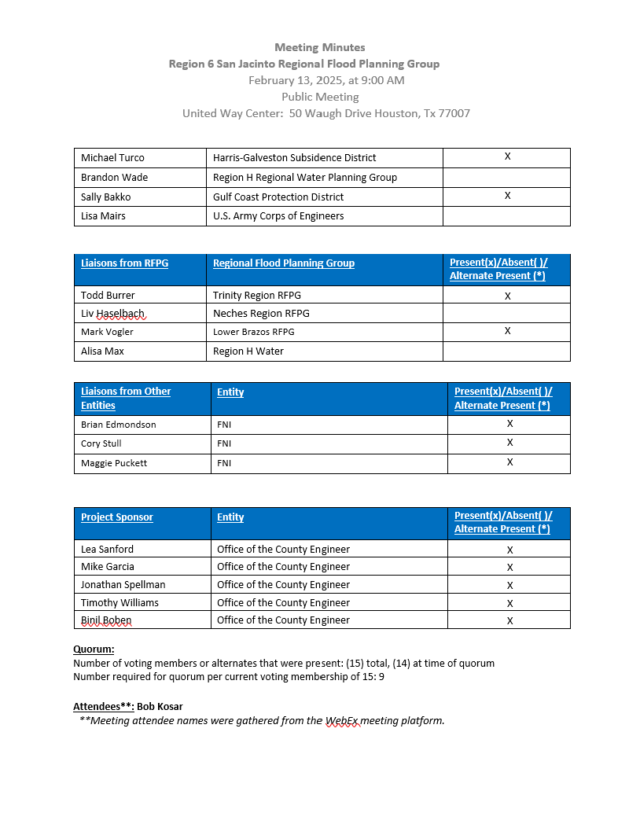
ITEM 5
Approval of Meeting Minutes

Slide 9
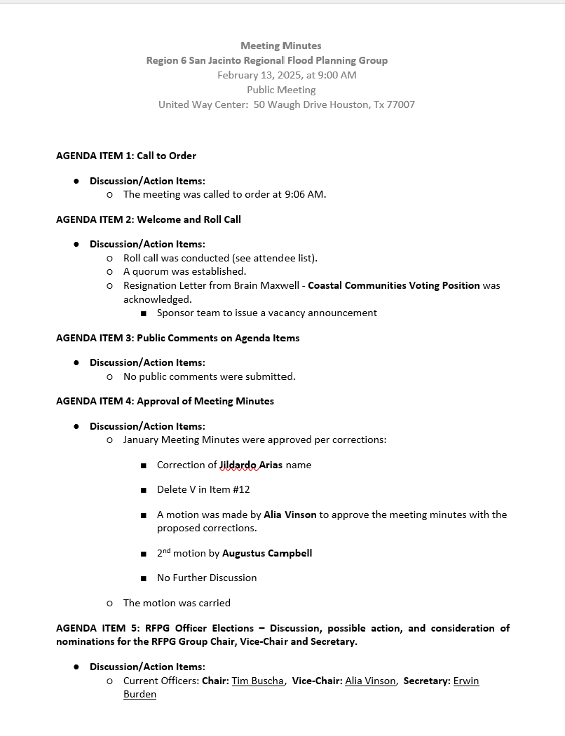
ITEM 5
Approval of Meeting Minutes

Slide 10
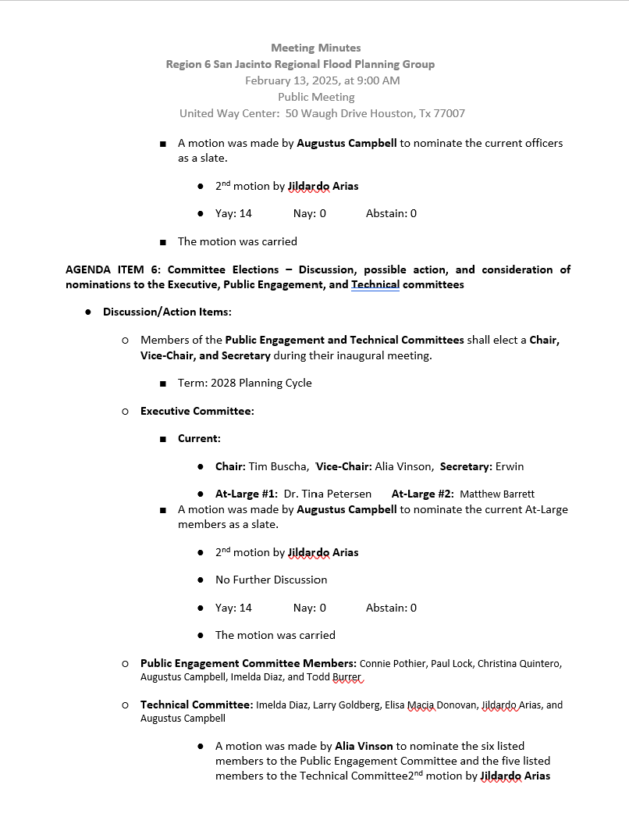
ITEM 5
Approval of Meeting Minutes

Slide 11
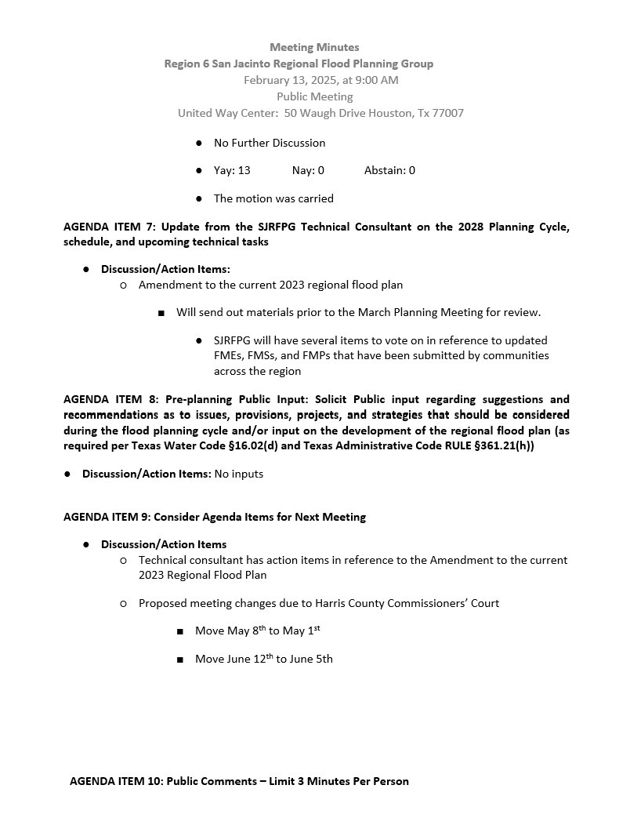
ITEM 5
Approval of Meeting Minutes

Slide 12
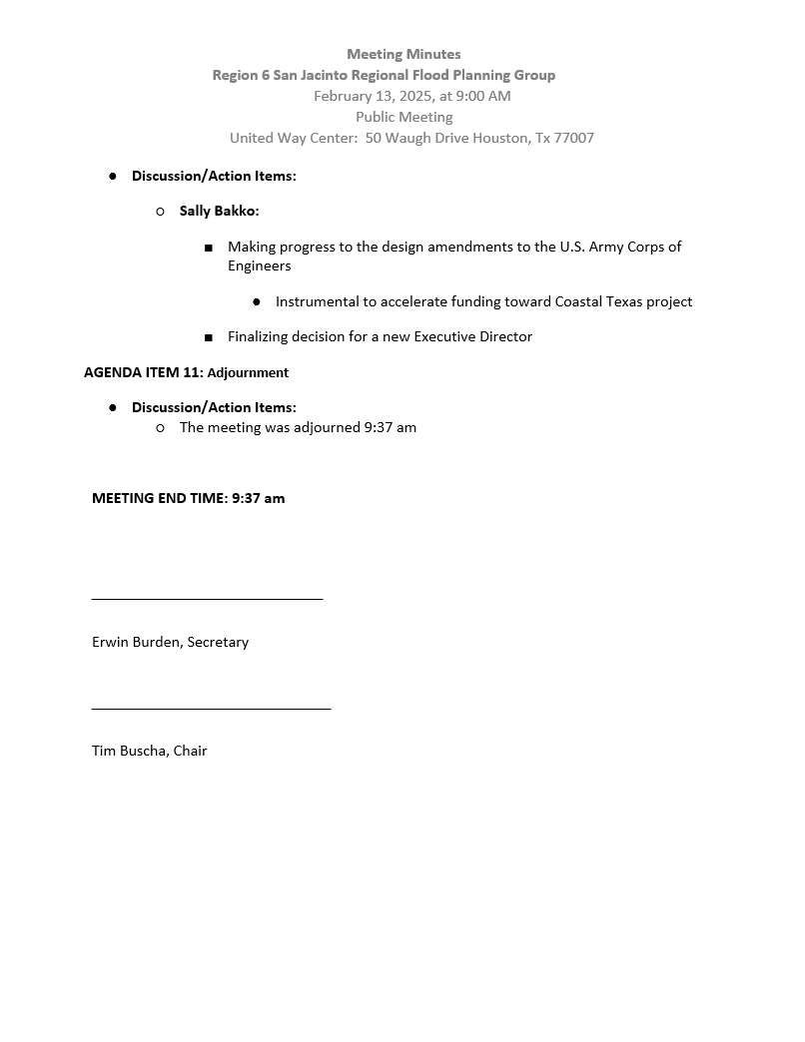
ITEM 5
Approval of Meeting Minutes

Slide 13
ITEM 6
Liaison Reports Pertaining to Other Region(s) Progress and Status and other Related Entities:
a. Trinity Region
b. Neches Region
c. Lower Brazos Region
d. Region H Water
e. Gulf Coast Protection District (GCPD)

Slide 14
ITEM 7
Discussion and possible action to recommend modification to or addition of FMEs, FMSs, and FMPs in the 2023 San Jacinto Regional Flood Plan

Slide 15
Agenda Item #7
Discussion and possible action to recommend modification to or addition of FMEs, FMSs, and FMPs in the 2023 San Jacinto Regional Flood Plan

Slide 16
Agenda Item #7
FMX | FMX Removed | FMX Added | Original FMX Count | Amended Count | Original Estimated Cost | Amended Total Est. Cost
FME | 9 | 67 | 405 | 463 | $905,377,000 | $956,203,000
FMP | 2 | 38 | 70 | 106 | $31,685,213,000 | $33,030,634,000
FMS | - | 11 | 65 | 76 | $1,199,622,720 | $1,320,511,720
Total | 11 | 116 | 540 | 645 | $33,790,212,720 | $35,307,352,720

Slide 17
Changes to FMEs, FMSs, FMPs
Changes to FMEs
Changes to FMSs
Changes to FMPs
New submittals:
  HCFCD
  Chambers County
  Grimes County
  Coastal Prairie Conservancy
  SJRA
Subdivided components of San Jacinto Regional Master Drainage Plan (SJRMDP) proposed projects into FMEs for further study and optimization
Recommendations from Chambers County FIF Study
Floodplain Preservation
Flood Warning and Forecasting
Participation in NFIP Community Rating System
Drainage Criteria Manual Updates
Recommendations from Chambers County FIF Study
City of Houston, HCFCD advanced FMEs to FMPs
Subdivided select SJRMDP projects into individual project components to position for FIF funding
New submittals:
  HCFCD
  Taylor Lake Village
  Bellaire

Slide 18
ITEM 8
Discussion and possible action to adopt Amendment #2 to the 2023 San Jacinto Regional Flood Plan and authorize the SJRFPG Technical Consultant to submit Amendment #2 to the TWDB on behalf of the SJRFPG

Slide 19
Agenda Item #8
Discussion and possible action to adopt Amendment #2 to the 2023 San Jacinto Regional Flood Plan and authorize the SJRFPG Technical consultant to submit amendment #2 to the TWDB on behalf of the SJRFPG

Slide 20
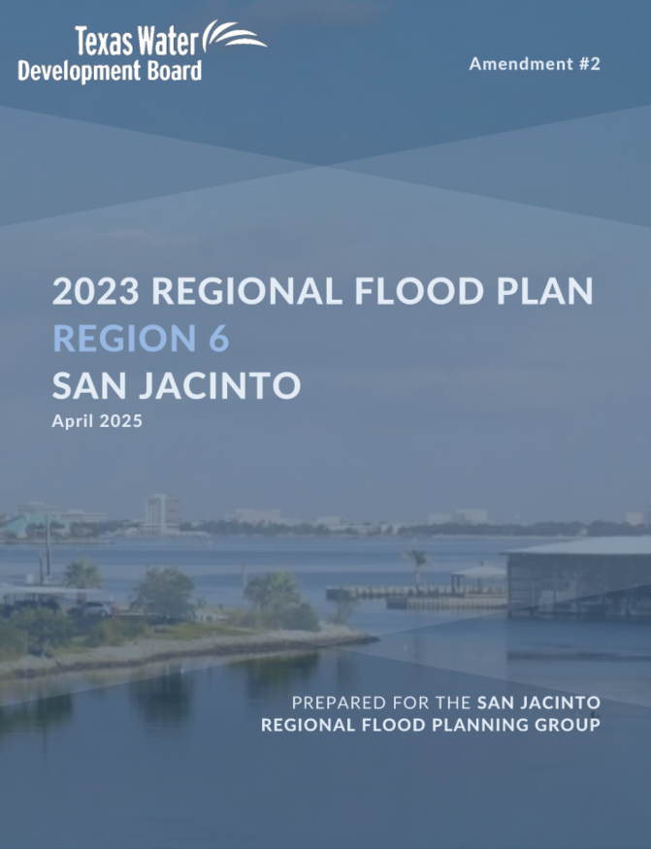
Agenda Item #8 – Supplemental Material
Draft 2023 San Jacinto Regional Flood Plan Amendment #2 posted to website March 6th
Amendment #2 Documentation:
  Summary of Changes
  Changes to report text
  Revised Appendices
Due to TWDB April 1st

Slide 21
Agenda Item #8
Public Comment

Slide 22
ITEM 9
Update from the SJRFPG Technical Consultant on the 2028 Planning Cycle, schedule, and upcoming technical tasks

Slide 23
Technical Consultant Update
March 13, 2025
Notes:
Introduction

Slide 24

Agenda
Red icon indicates need for action from the RFPG
Task 1 – Planning Area Description
  Approve Public Survey for Launch
  Infrastructure Toolkit Overview
Preview Upcoming Technical Committee Agenda
  Task 2A – Existing Flood Risk
  Task 2B – Future Flood Risk
  Selection of FMEs to Perform under Task 4C
2028 Regional Flood Planning Schedule

Slide 25
Task 1 & Public Survey

Slide 26
Task 1 – Survey
2023 Cycle Survey:
Differentiated Surveys:
  Regional Stakeholders (54 Qs)
  Members of the Public (6 Qs)
Included:
  Webmap to collect:
    Flood prone areas
    Projects in Progress
  Data Upload
  Spanish-language option
Proposed 2028 Cycle Survey:
Differentiated Surveys:
  Regional Stakeholders (49 Qs)
  Members of the Public (< 10 Qs)
Inclusion Plan:
  Webmap to collect:
    Flood prone areas
    Projects in Progress
  Data Upload – Encourage 1:1 with TC team
  Spanish-language option
Notes:
65 Total Survey Responses last cycle

Slide 27

Task 1 – Survey
RFPG to consider launching the public survey and distributing to stakeholders to begin collecting input and data for use in the 2028 Cycle.
Survey Components:
Survey questionnaire (supplemental materials)
  Regional stakeholder version
  Member of the Public version (English and Spanish)
Webmap
  Displays data from 2023 RFP
  Collect info on projects and flood prone areas
  Google translate plug-in available

Slide 28
Task 1 – Planning Area Description
Scope includes General Descriptions of:
Social and economic character of the region
Areas that are flood prone and the types of major flood risks
Key historical flood events
Key political subdivisions with flood-related authority
Local regulation and development codes relevant to flood risk
Ag and natural resources most impacted by flooding
Existing/ongoing local and regional flood plans

Slide 29
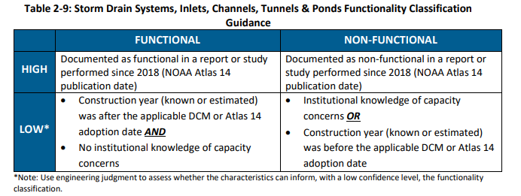
Task 1 – Planning Area Description
Describe the location, condition, adequacy, and functionality of major flood related natural and constructed infrastructure.
  TWDB Infrastructure Toolkit released 2/28
    Provides sponsors with tools to support asset management
    Include guidance on how to classify the condition and functionality of infrastructure
Describe proposed/ongoing flood mitigation projects
Excerpt from Toolkit Guidance:

Slide 30
Tasks 2A, 2B, and 4C

Slide 31
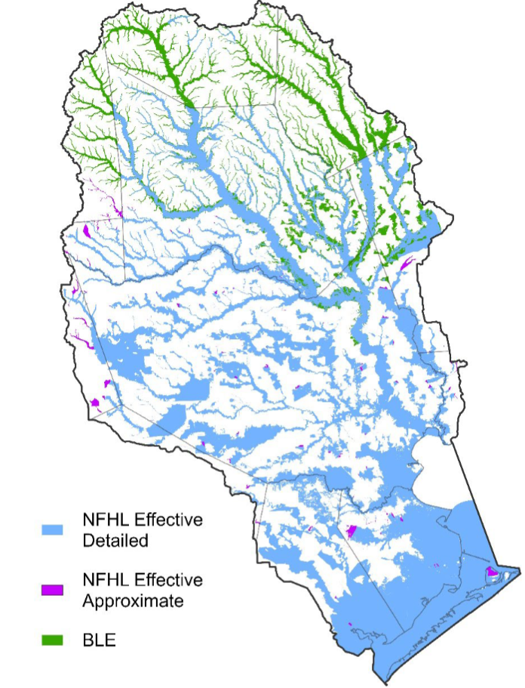
Task 2A – Existing Condition Flood Risk Analysis
Best Available Data from 2023 SJRFP:
Existing condition flood hazard for 10%, 1%, and 0.2% annual chance events
Enhance understanding of flood risk
  Opportunity to leverage recent studies that incorporate Atlas 14 rainfall, recent development, latest modeling software, and have been calibrated to recent flood events
Other guidance and data updates:
  Texas Flood SVI (TX F-SVI)
  Added fields for base elevations for structures, inundation depth, and velocity

Slide 32
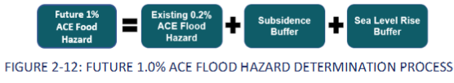
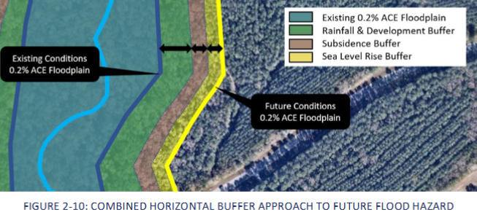
Task 2B – Future Conditions Flood Risk Analysis
Last Cycle RFPGs were charged with developing methodologies to rapidly define future flood risk

Slide 33
Task 2B – Future Conditions Flood Risk Analysis
Last Cycle RFPGs were charged with developing methodologies to rapidly define future flood risk
In the 2028 Cycle, “future condition flood hazard information generated by TWDB… shall be utilized,” per Exhibit C.
Future Conditions Fathom Data (Year 2060)
Future climate, rainfall, sea level, land subsidence, and landuse change
Not yet available
Once released, will be reviewed against existing conditions flood hazard data

Slide 34


Tracks for FMEs to FMPs in 2nd Cycle
1. Technical Consultant performs in 2nd Cycle
2. TWDB Performs in 2nd Cycle
3. Sponsor performs via other initiative
(FIF funding, CDBG-MIT COG MOD, GLO RBFS, etc.)
FMP
FME
4. FME deferred for future opportunity

Slide 35
Task 4C – Performance of FMEs
Task 4C Budget = $942,500
Top ranked FMEs in State Flood Plan
Estimated Costs < $900k
FME ID | FME Name | Sponsor | FME Type | Estimated Cost ($)
061000197 | Harris County Wide - Investigation of City of Houston Properties for Conversion to Stormwater Detention Basins | Harris County Flood Control District | Project Planning | $ 500,000.00
061000438 | Greens Bayou, Jackson Bayou, White Oak Bayou, Cypress Creek and San Jacinto River Areas Subdivision Drainage Mitigation Project | Harris County | Project Planning | $ 30,000.00
061000439 | Greens Bayou, White Oak Bayou and Cypress Creek Areas Subdivision Drainage Mitigation Project | Harris County | Project Planning | $ 30,000.00
061000465 | Catalina | Houston | Project Planning | $ 30,000.00
061000421 | Clear Creek - Hughes Stormwater Detention (SWD) Basin | Harris County Flood Control District | Project Planning | $ 30,000.00
061000180 | Brays Bayou Watershed Study | Harris County Flood Control District | Watershed Planning | $ 620,000.00
061000534 | Brays Bayou Local Drainage Study | Harris County | Watershed Planning | $ 334,000.00
061000420 | Clear Creek - Friendswood Detention Basin Near FM 528 in Friendswood | Harris County Flood Control District | Project Planning | $ 30,000.00
061000191 | Spring Creek - Construction of a Reservoir along Spring Creek | Harris County Flood Control District | Project Planning | $ 870,000.00
061000539 | Spring Creek Local Drainage Study | Harris County | Watershed Planning | $ 343,000.00

Slide 36
Future Meeting Dates & Content
Meeting | Milestone/Action
January 2025 | RFPG Meeting 2028 RFP Overview, Task 1, Amendment Update Discuss Process to Select FMEs to Perform (Task 4C)
March 2025 | RFPG Meeting – Action Needed Recommend FMXs; Adopt Amendment Finalize Public Survey Review Task 1, Task 2A/2B, Task 4C
May 2025 | RFPG Meeting – Action Needed Select FMEs to Perform (Task 4C) Discuss Task 2B, Task 3B Needs Analysis Consider updates to Minimum Standards (Task 3A)
June/August 2025 | RFPG Meeting Review results of Tasks 2A/2B Review results of Needs Analysis (Task 3B) Consider updates to goals (Task 3C)
September 2025 | RFPG Meeting – Action Needed Adopt Goals (Task 3C); Recommend Min Standards (Task 3A) Present list of identified FMXs for recommendation
November 2025 | RFPG Meeting – Action Needed Vote to Approve Tech Memo Discuss FIF Technical Assistance ahead of FY26-27 Call for Apps

Slide 37
ITEM 10
Discussion and possible action to approve the proposed schedule extension for interim submittal deadlines and authorize the sponsor to execute contract amendments to reflect the proposed schedule

Slide 38
Agenda Item #10
Discussion and possible action to approve the proposed schedule extension for interim submittal deadlines and authorize the sponsor to execute contract amendments to reflect the proposed schedule

Slide 39
2028 Flood Planning Cycle – Schedule
+4 mo
+3 mo
Technical Consultants under Contract Fall 2024
Tech Memo Due Jan 7, 2026
Draft 2028 RFP Due May 26, 2027
+2 mo
RFP Amendments due to TWDB
April 1, 2025
Submit FMEs to TWDB
Mar 26, 2026
Final 2028 RFP Due Jan 2028
2025
2026
2027
2028
TWDB proposed schedule extension on interim milestones

Slide 40
ITEM 11
Consider Agenda Items for Next Meeting

Slide 41
ITEM 12
Public Comments – Limit 3 Minutes Per Person

Slide 42
ITEM 13
Adjournment

