Slide 1


Region 6 - San Jacinto Regional Flood Planning Group
Planning Meeting February 13, 2025 9:00 AM Public Meeting

Slide 2

ITEM 1 Call to Order

Slide 3
ITEM 2 Welcome and Roll Call

Slide 4
ITEM 3 Registered Public Comments on Agenda Items (Limit of 3 Minutes Per Person)

Slide 5
ITEM 4 Approval of Meeting Minutes

Slide 6
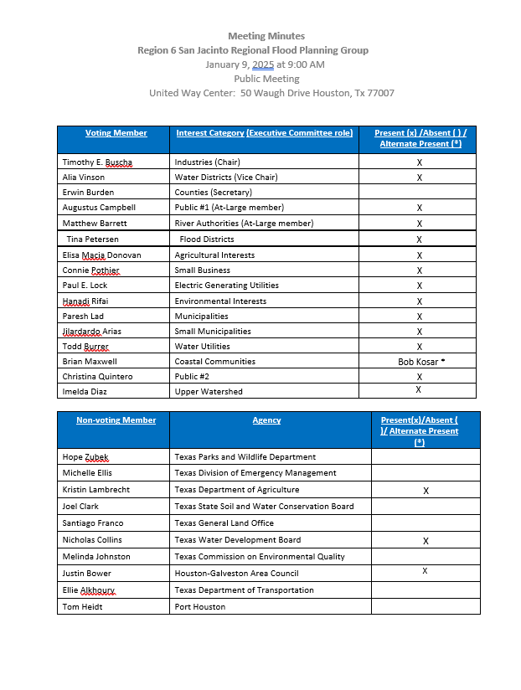
ITEM 4 Approval of Meeting Minutes

Slide 7
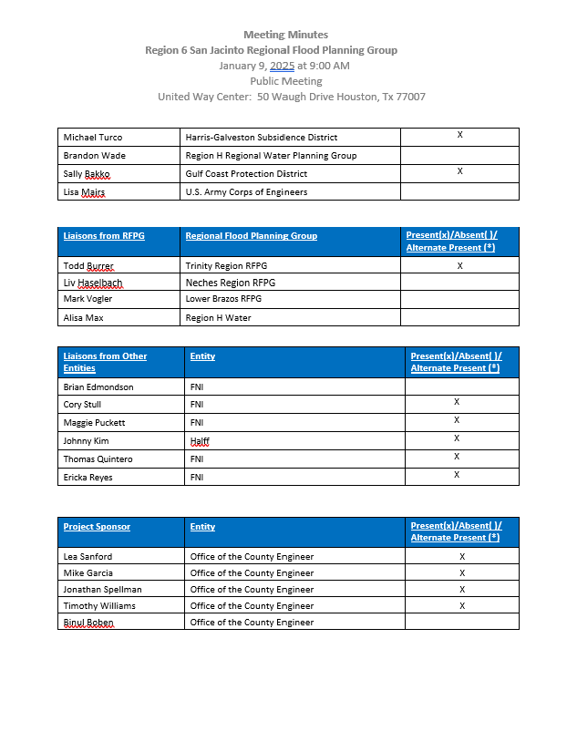
ITEM 4 Approval of Meeting Minutes

Slide 8
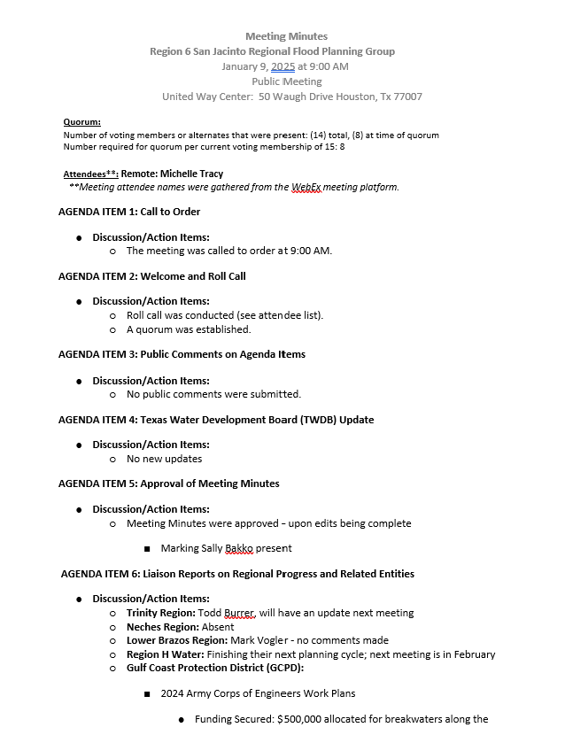
ITEM 4 Approval of Meeting Minutes

Slide 9
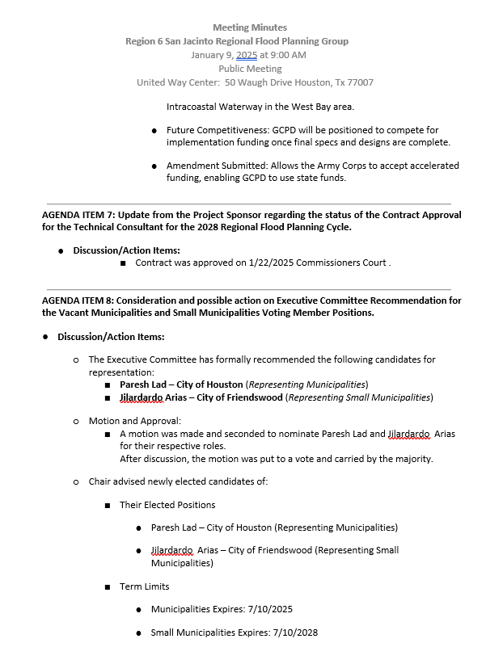
ITEM 4 Approval of Meeting Minutes

Slide 10
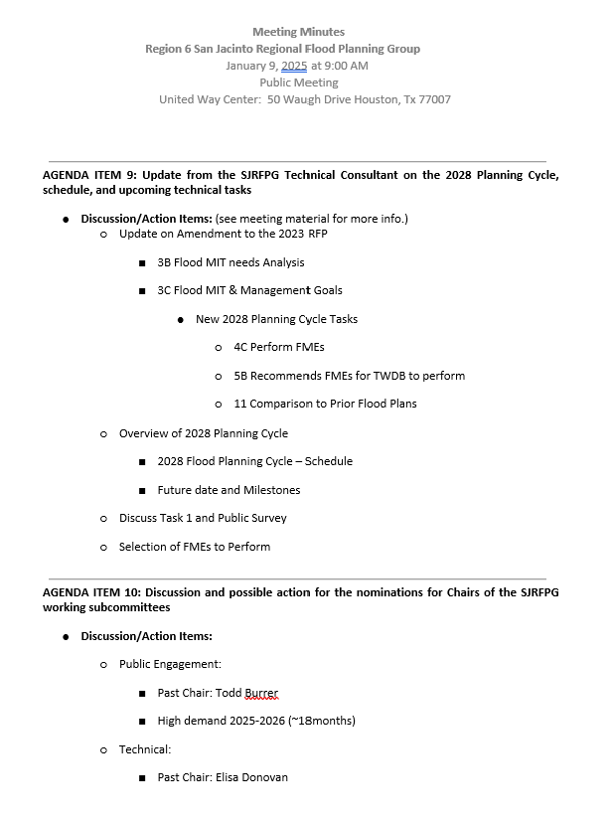
ITEM 4 Approval of Meeting Minutes

Slide 11
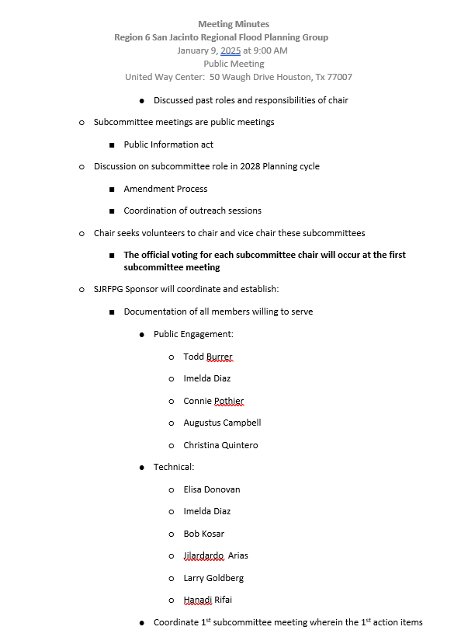
ITEM 4 Approval of Meeting Minutes

Slide 12
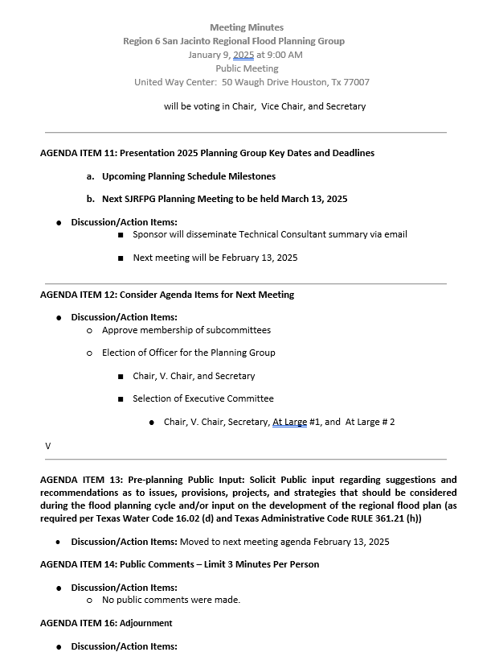
ITEM 4 Approval of Meeting Minutes

Slide 13
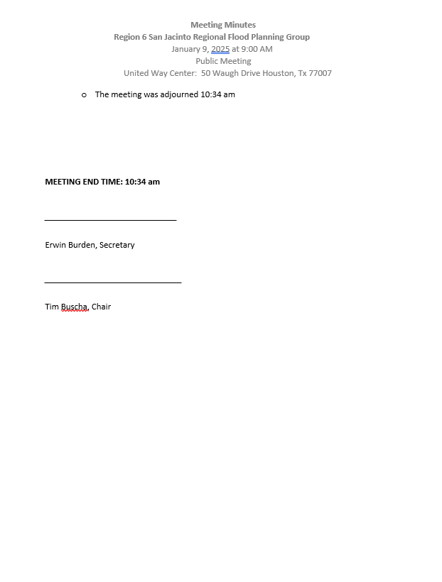
ITEM 4 Approval of Meeting Minutes

Slide 14
ITEM 5 RFPG Officer Elections – Discussion, possible action, and consideration of nominations for the RFPG Group Chair, Vice-Chair and Secretary

Slide 15
ITEM 6 Committee Elections – Discussion, possible action, and consideration of nominations to the Executive, Public Engagement, and Technical Committees

Slide 16
ITEM 7 Update from the SJRFPG Technical Consultant on the 2028 Planning Cycle, schedule, and upcoming technical task

Slide 17
ITEM 8 Pre-planning Public Input: Solicit Public input regarding suggestions and recommendations as to issues, provisions, projects, and strategies that should be considered during the flood planning cycle and/or input on the development of the regional flood plan (as required per Texas Water Code §16.02(d) and Texas Administrative Code RULE §361.21(h))

Slide 18
ITEM 9 Consider Agenda Items for Next Meeting

Slide 19
ITEM 10 Public Comments – Limit 3 Minutes Per Person

Slide 20
ITEM 11 Adjournment

