Slide 1
Region 6 - San Jacinto Regional Flood Planning Group
Executive Meeting December 20, 2024 9:00 AM Hybrid Meeting

Slide 2
ITEM 1 Call to Order

Slide 3
ITEM 2 Welcome and Roll Call

Slide 4
ITEM 3 Registered Public Comments on Agenda Items (Limit of 3 Minutes Per Person)

Slide 5
ITEM 4 Approval of Meeting Minutes

Slide 6
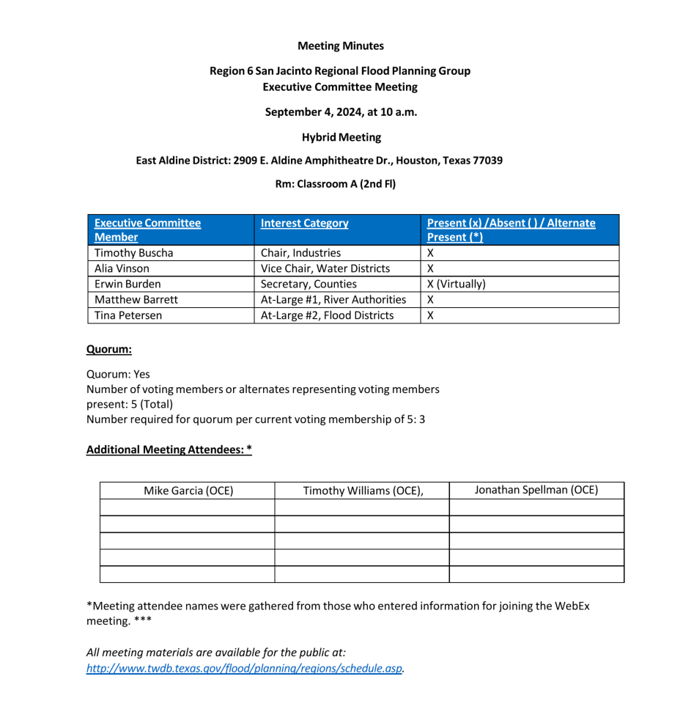
ITEM 4 Approval of Meeting Minutes

Slide 7
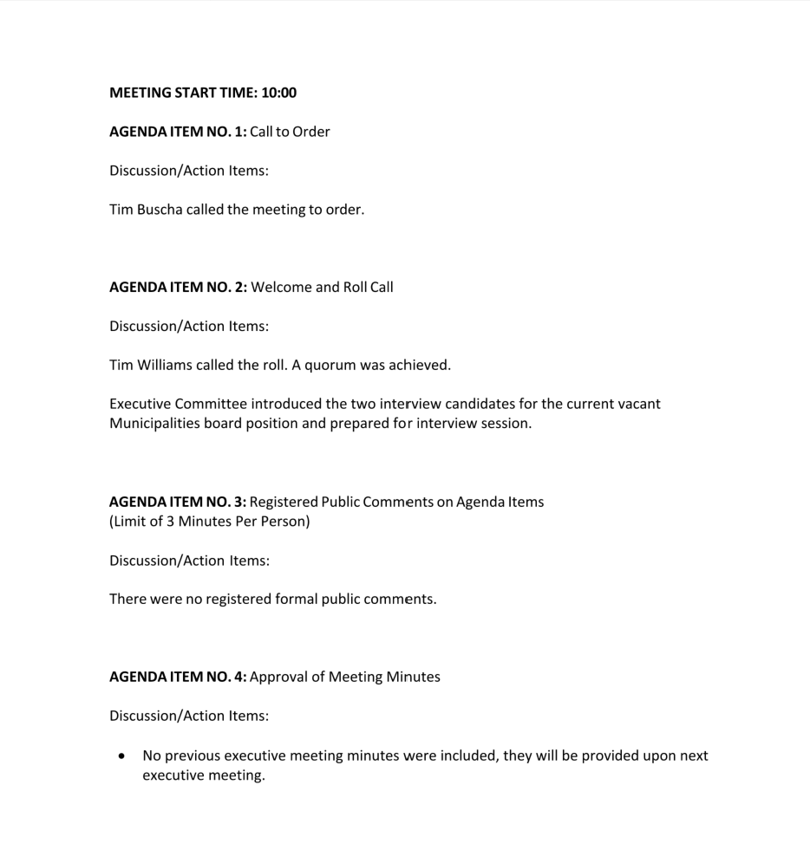
ITEM 4 Approval of Meeting Minutes

Slide 8
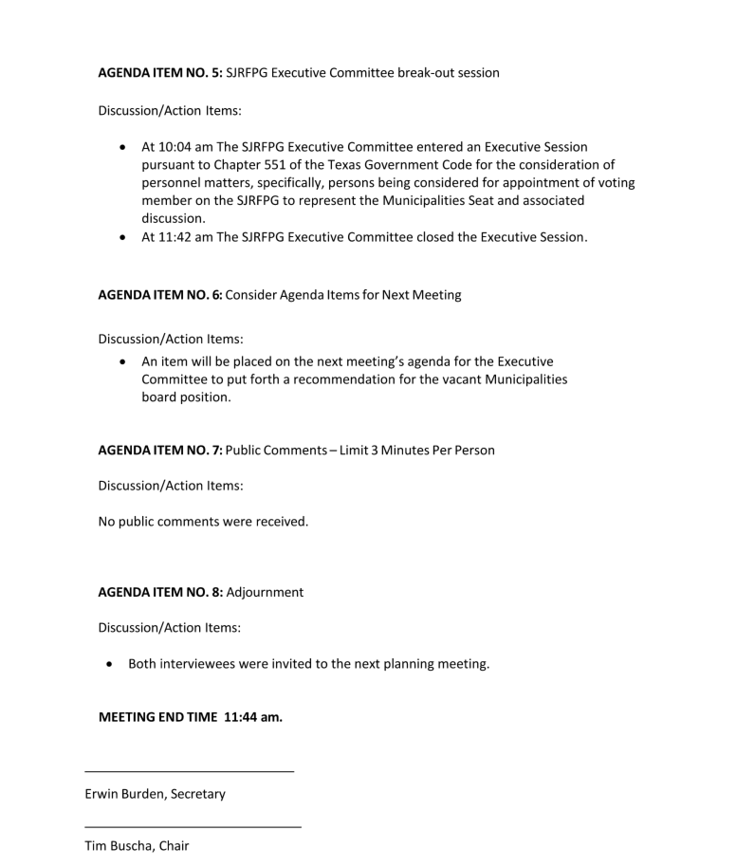
ITEM 4 Approval of Meeting Minutes

Slide 9
ITEM 5 The SJRFPG Executive Committee may go into an Executive Session pursuant to Chapter 551 of the Texas Government Code for the consideration of personnel matters, specifically, persons being considered for appointment of voting member on the SJRFPG to represent the Municipalities and Small Municipalities Seat

Slide 10
ITEM 6 The SJRFPG Executive Committee may go into an Executive Session pursuant to Chapter 551 of the Texas Government Code for the consideration of personnel matters, specifically, persons being considered for appointment of sub-committee chair of public and technology sub committee.

Slide 11
ITEM 7 Public Comments - Limit of 3 Minutes Per Person

Slide 12
ITEM 8 Adjournment

