Slide 1
Region 6 - San Jacinto Regional Flood Planning Group
Planning Meeting November 11, 2024 9:00 AM Hybrid Meeting

Slide 2
ITEM 1 Call to Order

Slide 3
ITEM 2 Welcome and Roll Call

Slide 4
ITEM 3 Registered Public Comments on Agenda Items (Limit of 3 Minutes Per Person)

Slide 5
ITEM 4 Texas Water Development Board Update

Slide 6
ITEM 5 Approval of Meeting Minutes

Slide 7
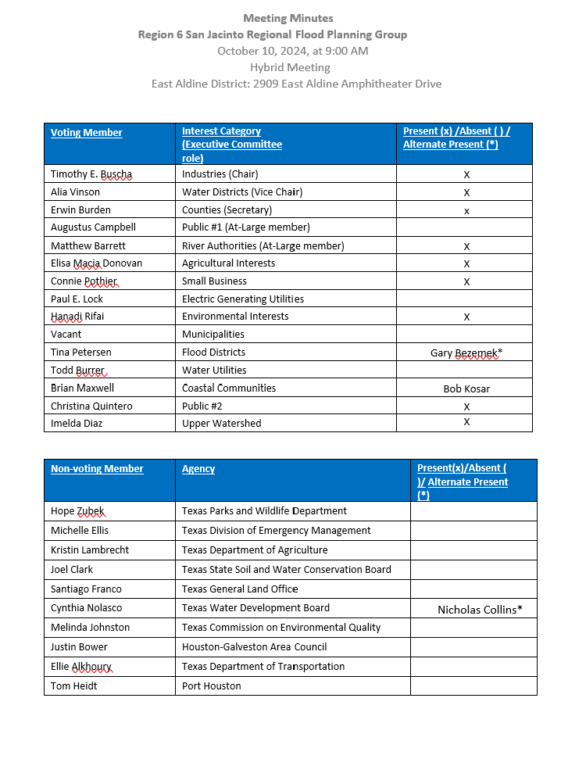
ITEM 5 Approval of Meeting Minutes

Slide 8
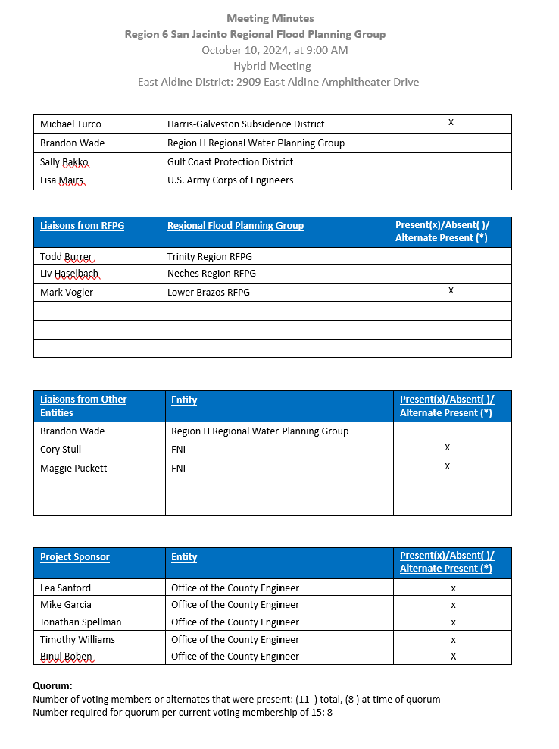
ITEM 5 Approval of Meeting Minutes

Slide 9
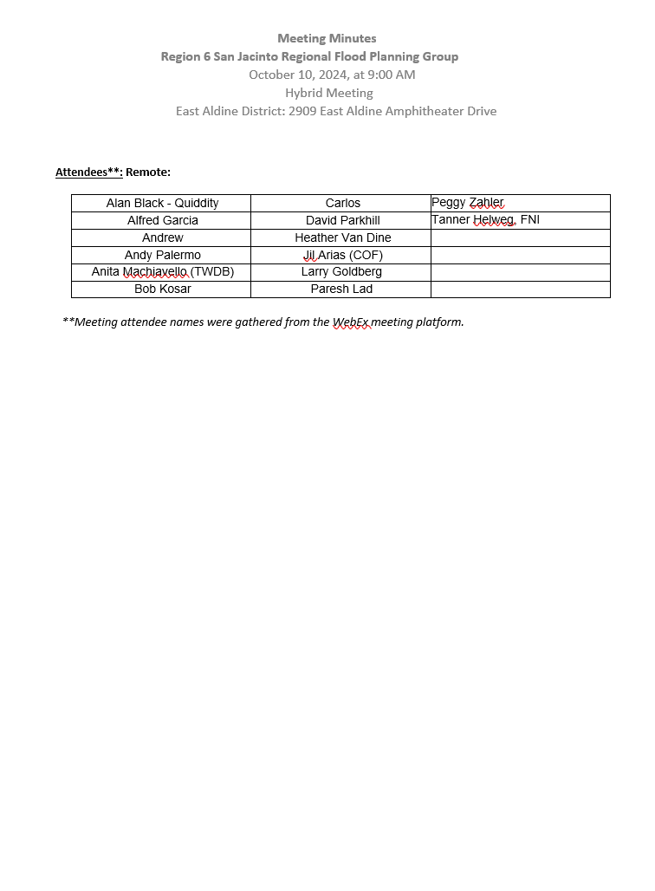
ITEM 5 Approval of Meeting Minutes

Slide 10
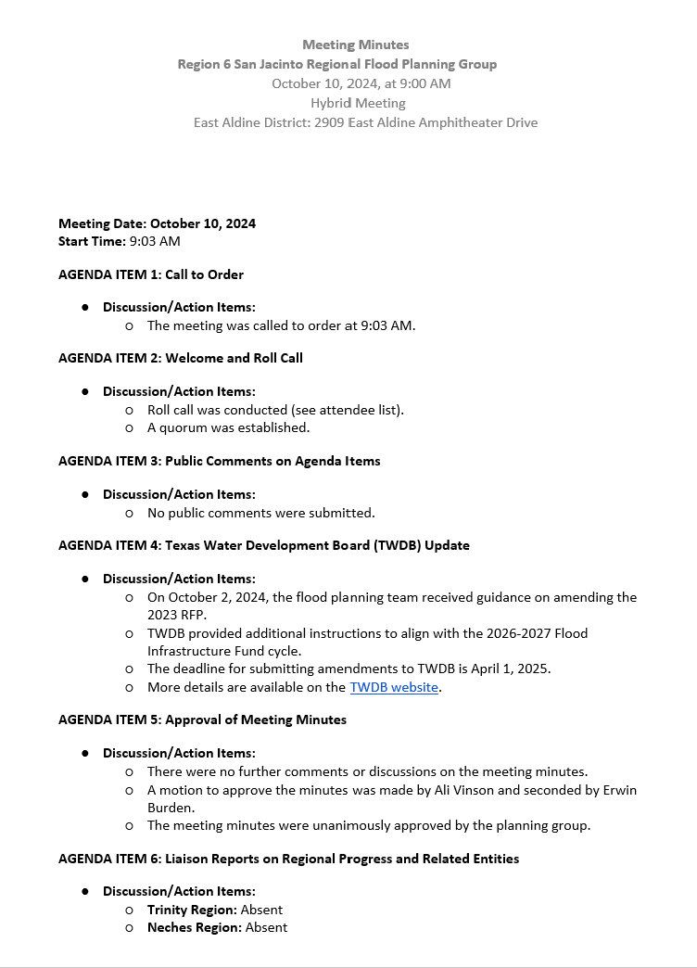
ITEM 5 Approval of Meeting Minutes

Slide 11
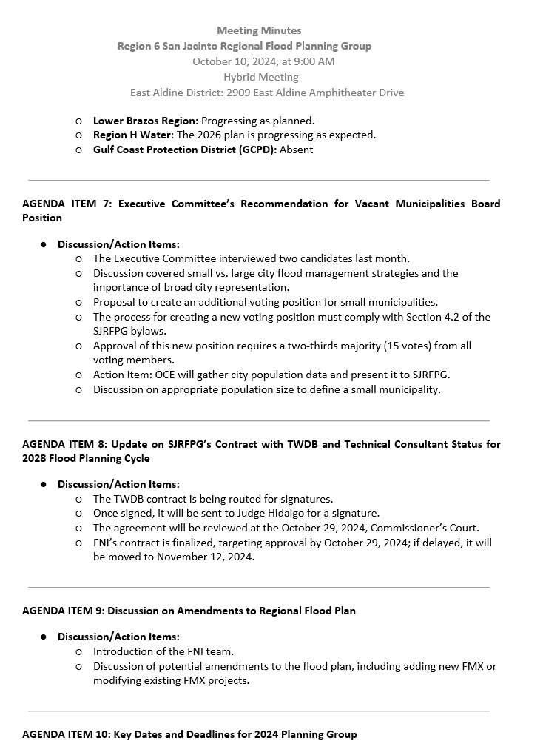
ITEM 5 Approval of Meeting Minutes

Slide 12
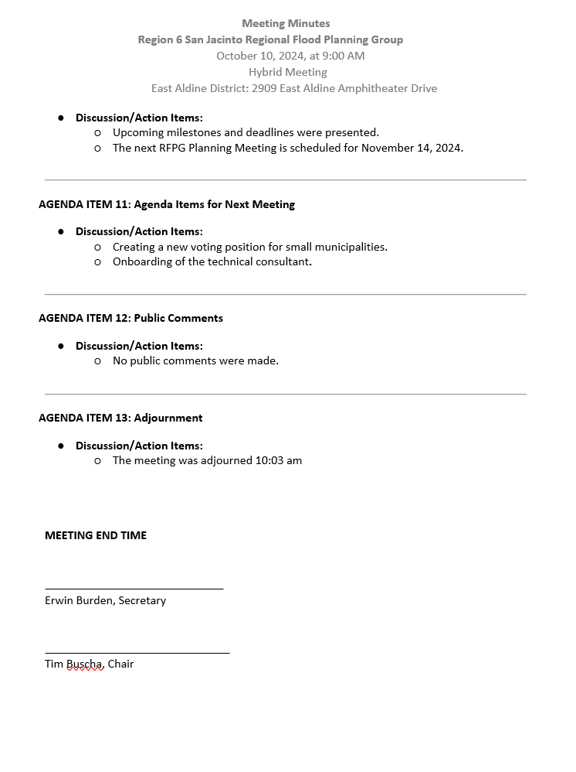
ITEM 5 Approval of Meeting Minutes

Slide 13
ITEM 6 Liaison Reports Pertaining to Other Region(s) Progress and Status and other Related Entities:
a. Trinity Region
b. Neches Region
c. Lower Brazos Region
d. Region H Water
e. Gulf Coast Protection District (GCPD)

Slide 14
ITEM 7
Update by the Project Sponsor regarding the status of the Contract Approval for the Technical Consultant for the 2028 Regional Flood Planning Cycle.Update by the Project Sponsor regarding the status of the Contract Approval for the Technical Consultant for the 2028 Regional Flood Planning Cycle.

Slide 15
ITEM 8 Discussion about future amendments to the regional flood plan to add a new FMX or modify an existing FMX

Slide 16
RFP Amendment Advertising
Outreach performed since the October RFPG meeting:
Amendment flyer posted to the website
Sent out an Eblast to the SJRFPG contact database
Presented at the HGAC RFMC meeting on 10/23
Flyer was circulated to the HGAC RFMC listserv after the meeting
Targeted outreach to sponsors who submitted public comments on the 2023 RFP

Slide 17
Anticipated FMXs to be Submitted
The following communities have submitted NOIs or indicated interest:
City of Houston
Montgomery County
Harris County Flood Control District
Grimes County
City of Taylor Lake Village
City of Bellaire
Coastal Prairie Conservancy (2023 Public Comment)
Brazoria County Drainage District #4 (2023 Public Comment)
City of Galveston (2023 Public Comment)

Slide 18
ITEM 9 Discussion and consideration of action for creation of a new voting member position on the Regional Flood Planning Group Board for Small Municipalities.

Slide 19
ITEM 10 Consideration of Executive Committee’s Recommendation for the Vacant Municipalities Board Position

Slide 20
ITEM 11 Discussion of the need to re-establish the SJRFPG working subcommittees

Slide 21
ITEM 12 Discussion and possible action for the nominations for Chairs of the SJRFPG working subcommittees.

Slide 22
ITEM 13 Presentation of 2024 Planning Group Key Dates and Deadlines:
a. Upcoming Planning Schedule Milestones
b. Next SJRFPG Planning Meeting to be held December 12, 2024

Slide 23
ITEM 14 Consider Agenda Items for Next Meeting

Slide 24
ITEM 15 Public Comments – Limit 3 Minutes Per Person

Slide 25
ITEM 16 Adjournment

