Slide 1
Region 6 - San Jacinto Regional Flood Planning Group December 14, 2023 9:00 AM Hybrid Meeting

Slide 2
ITEM 1 Call to Order

Slide 3
ITEM 2 Welcome and Roll Call

Slide 4
ITEM 3 Registered Public Comments on Agenda Items (Limit of 3 Minutes Per Person)

Slide 5
ITEM 4 Texas Water Development Board Update

Slide 6
ITEM 5 Approval of Meeting Minutes - October 2023

Slide 7
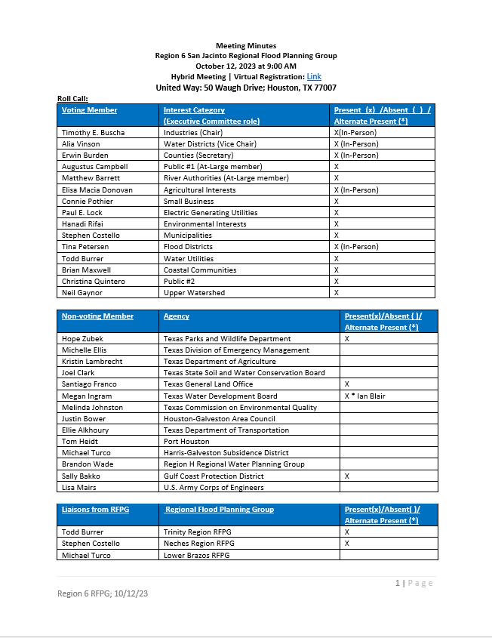
ITEM 5 Approval of Meeting Minutes

Slide 8
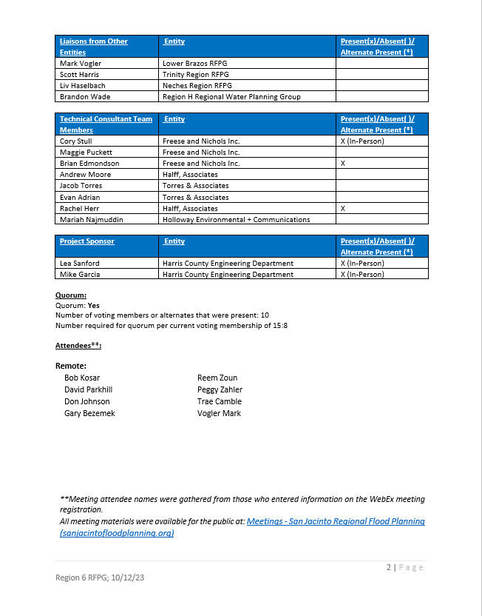
ITEM 5 Approval of Meeting Minutes

Slide 9
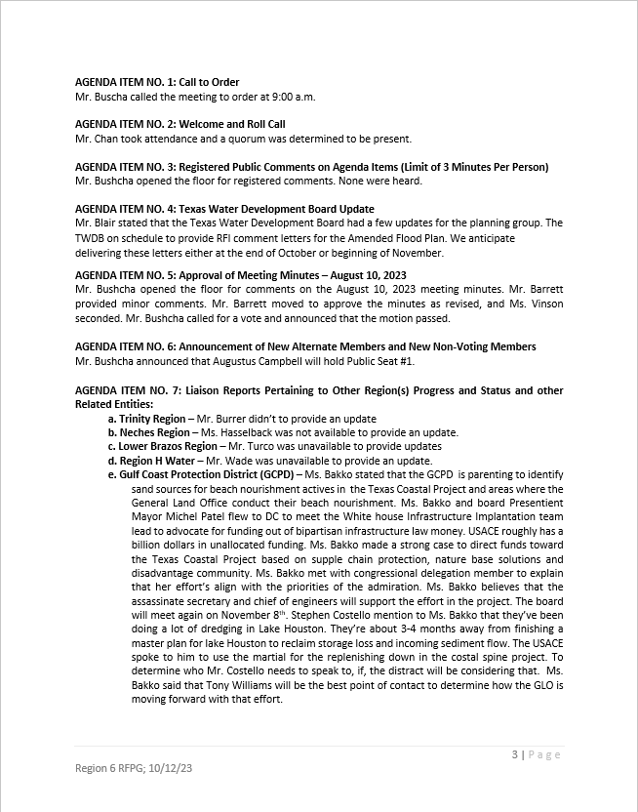
ITEM 5 Approval of Meeting Minutes

Slide 10
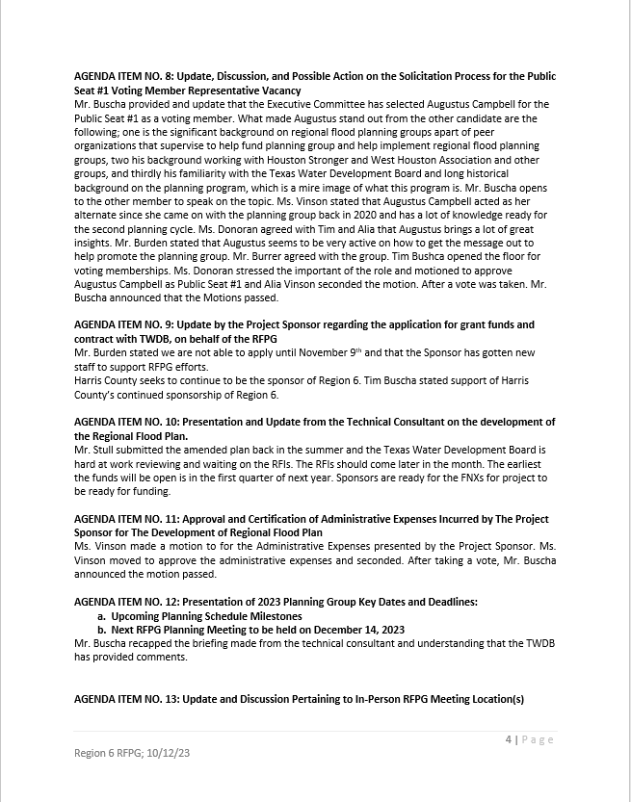
ITEM 5 Approval of Meeting Minutes

Slide 11
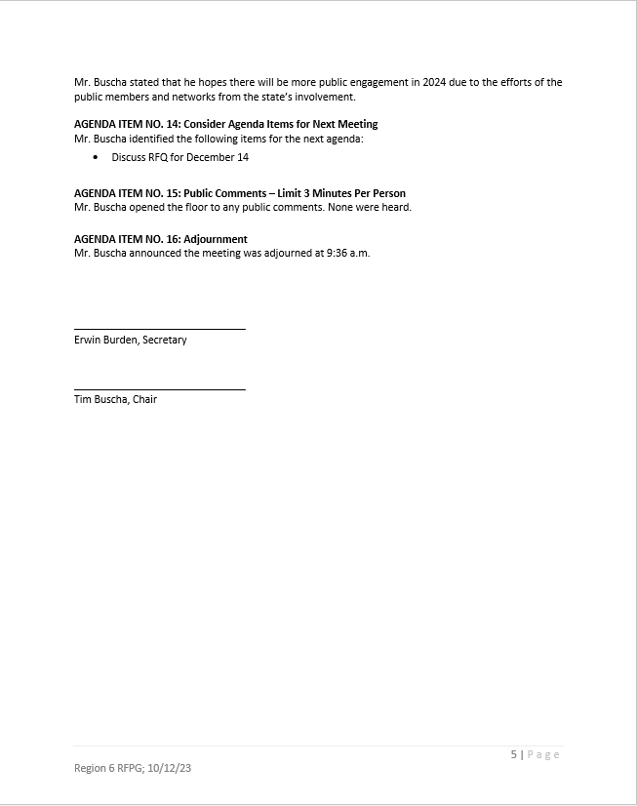
ITEM 5 Approval of Meeting Minutes

Slide 12
ITEM 6 Announcement of New Alternate Members and New Non-Voting Members

Slide 13
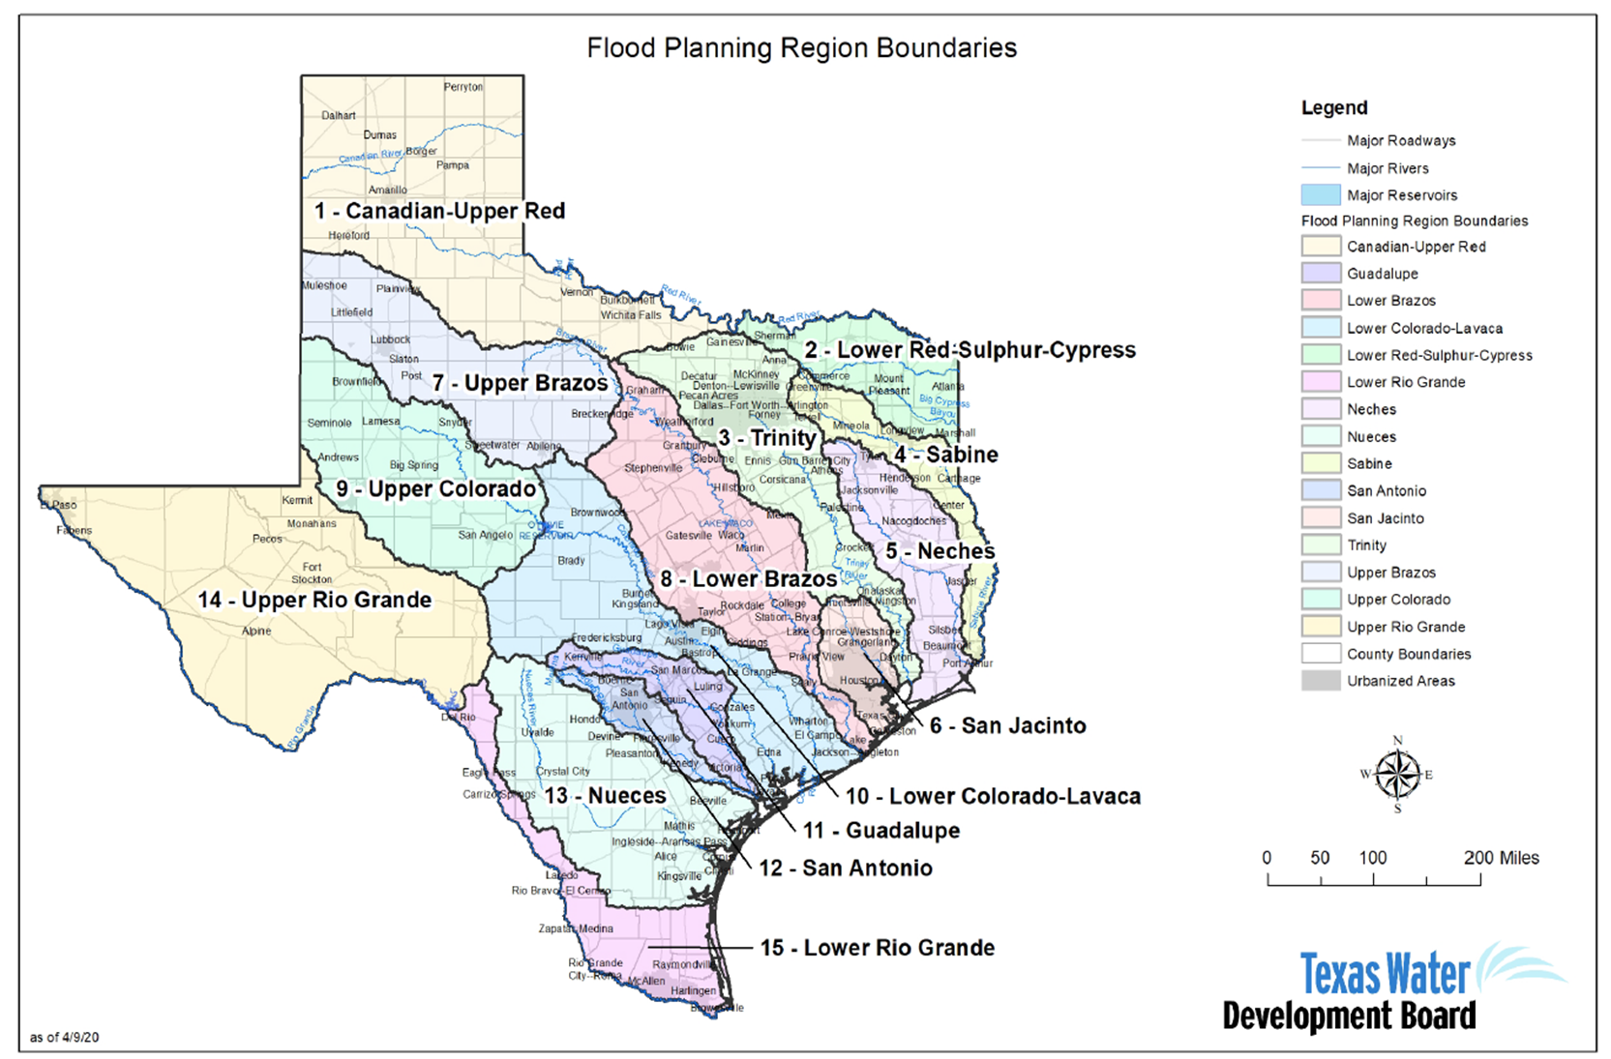

Slide 14
ITEM 7 Liaison Reports Pertaining to Other Region(s) Progress and Status and other Related Entities: a. Trinity Region b. Neches Region c. Lower Brazos Region d. Region H Water e. Gulf Coast Protection District (GCPD)

Slide 15
ITEM 8 Update by the Project Sponsor regarding the application for grant funds and contract with TWDB, on behalf of the RFPG

Slide 16
ITEM 9 Discussion and possible action related to issuing the Request for Qualifications for and beginning the procurement process of the Technical Consultant for the 2028 Regional Flood Planning Cycle in accordance with applicable federal, state and the local sponsor’s procurement requirements

Slide 17
ITEM 10 Presentation and Update from the Technical Consultant on the development of the Regional Flood Plan

Slide 18
Technical Consultant Update
December 14, 2023
Notes:
Introduction

Slide 19
Agenda
Updates since October RFPG Meeting
Upcoming Schedule Milestones

Slide 20
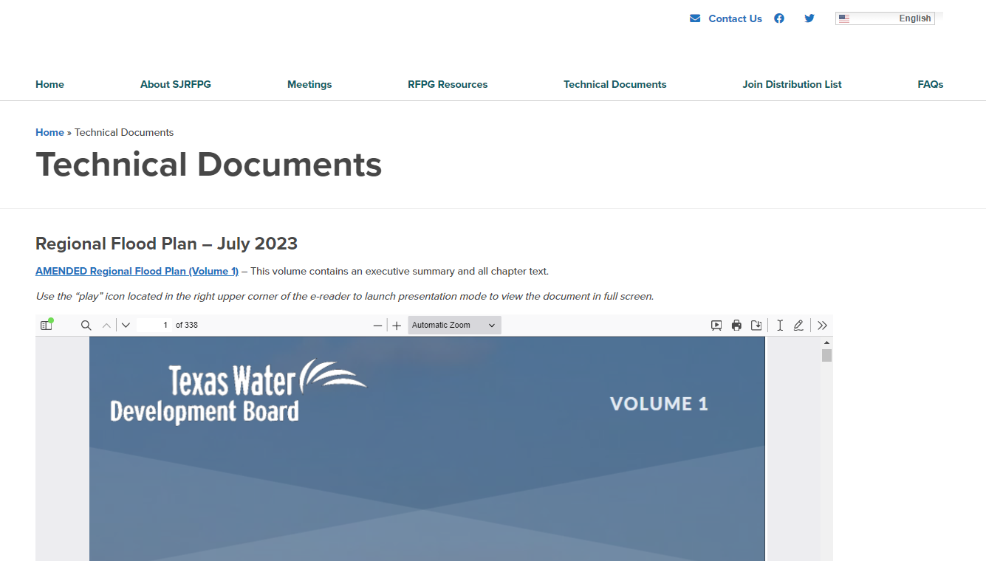
Updates Since October RFPG Meeting
TWDB Issued RFIs on the Amended RFP on November 7th.
Responses and updated materials submitted on November 20th.
Updates made to the Technical Documents tab and storymap on the website (sanjacintofloodplanning.org) to reflect the latest version of the RFP.

Slide 21
Updates Since October RFPG Meeting
TWDB Issued RFIs on the Amended RFP on November 7th.
Responses and updated materials submitted on November 20th.
Updates made to the Technical Documents tab and storymap on the website (sanjacintofloodplanning.org) to reflect the latest version of the RFP.

Slide 22
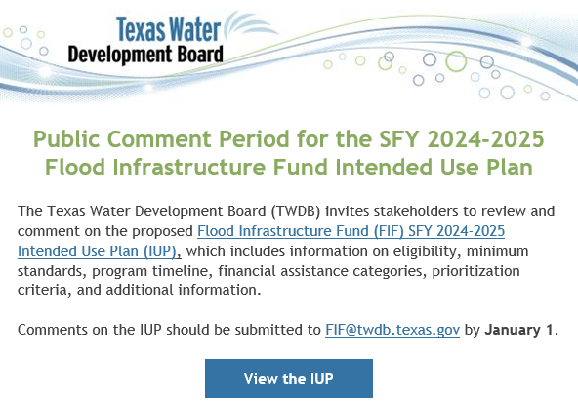
Updates Since October RFPG Meeting
TWDB published Flood Infrastructure Fund Intended Use Plan (IUP)
Eblast distributed to San Jacinto RFPG contact database December 11th.
To be discussed in depth under Agenda Item #12.

Slide 23
Upcoming Schedule Milestones
December
February
September
1
1
1
RFPG meeting to authorize the local sponsor to issue RFQ for 2028 RFP TC
Discuss comments on the Draft FIF IUP
Final reimbursable date for 2023 RFP TC is Dec 29th
Deadline for local sponsor to apply for grant funds Feb 22nd
Local sponsor to begin/continue contracting with TWDB
Procurement for TC can occur in parallel to contracting with TWDB
TWDB anticipated all contracting across the state between sponsors and technical consultants to be executed, at the latest, by Sep 2024

Slide 24
ITEM 11 Approval and Certification of Administrative Expenses Incurred by The Project Sponsor for The Development of the Regional Flood Plan

Slide 25
Administrative Expenses Incurred by Project Sponsor for 9/9/2023 – 11/17/2023
Name | From | To | Hours Worked | Total Salary | Social Security | Group Insurance | Workers Comp | Unemployment | Retirement | Total
Mike Garcia | 10/7/2023 | 10/20/2023 | 4 | 176.96 | 13.54 | 34.68 | 1.56 | 0.18 | 26.72 | 253.67
Lea Sanford | 10/7/2023 | 10/20/2023 | 4 | 250.00 | 19.13 | 34.68 | 2.20 | 0.25 | 37.75 | 344.01
 |  | Total | 8 | 426.96 | 32.67 | 69.36 | 3.76 | 0.43 | 64.47 | 597.68

Slide 26
ITEM 12 Presentation by the Technical Consultant and Discussion of the TWDB released Draft FY2024-2025 FIF Intended Use Plan (IUP)

Slide 27
Agenda Item #12
December 14, 2023

Slide 28
Agenda
Discuss open request for comments by TWDB
Provide Overview of Draft FIF IUP
Discuss approach/need to issue San Jacinto RFPG comments

Slide 29
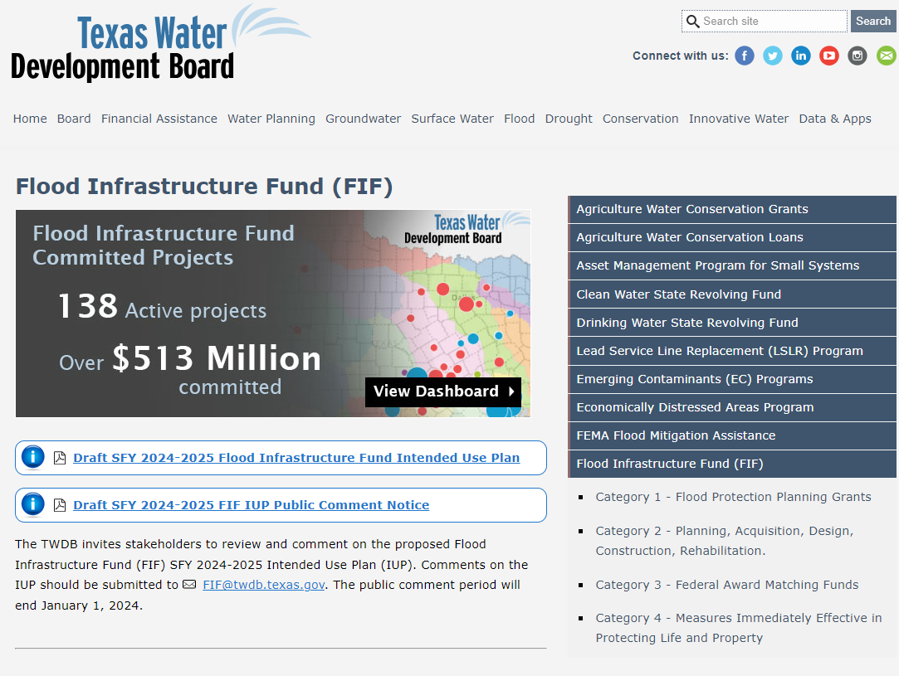
Call for Comments
Public Comments on Draft FIF IUP Due January 1, 2024.
Comments to be provided via email to FIF@twdb.texas.gov
Documents available at TWDB website

Slide 30
Draft IUP Overview
Covers 2024-2025
Distributes $375M ($625M appropriated by 88th legislative session)
Only FMEs, FMPs, and FMSs recommended in July 14, 2023 Amended Regional Flood Plans are eligible
Two step application process: Abridged and Complete Applications
Combination of grants and 0% interest loans
For federal matching funds, applicant must have an existing federal award (e.g. FMA FY 2019-2022 may receive 70% grant for local match)
Prioritization is primarily based on state flood plan ranking
Grant/loan percentage is based primarily on AMHI (income), with some consideration for rural and NBS

Slide 31
Draft IUP Overview
Max total grant allocation is 50% ($187,500,000)
Max single project grant application is 10% ($18,750,000)

Slide 32
Draft IUP Overview

Slide 33
Draft IUP Overview
First round categories replaced by FMX categories
Flood Management Evaluations
Watershed Studies, feasibility assessments, flood control planning
FEMA FIRM Mapping is NOT eligible
Design is NOT eligible
Flood Mitigation Projects
Design and construction of projects – structural or non-structural
Flood Management Strategies
Policies and regulations, buyouts, public outreach, flood warning systems

Slide 34
Draft IUP Overview
Anticipated FIF Application Process:

Slide 35
San Jacinto RFPG Comments
Objective for discussion:
Discuss FIF IUP as a group to identify any feedback specific to the San Jacinto region
Decide how to submit feedback on behalf of the SJRFPG and how the Technical Consultant team can support

Slide 36
ITEM 13 Presentation of 2023 Planning Group Key Dates and Deadlines: a. Upcoming Planning Schedule Milestones b. Next RFPG Planning Meeting to be held on February 8, 2024

Slide 37
ITEM 14 Update and Discussion Pertaining to In-Person RFPG Meeting Location(s)

Slide 38
ITEM 15 Discussion Regarding Necessary Changes or Updates to the SJRFPG By-Laws

Slide 39
ITEM 16 Consider Agenda Items for Next Meeting

Slide 40
ITEM 17 Public Comments – Limit 3 Minutes Per Person

Slide 41
ITEM 18 Adjournment

Slide 42
Thank You !

