Slide 1
Region 6 - San Jacinto Regional Flood Planning Group October 12 , 2023 9:00 AM Hybrid Meeting

Slide 2
Item 1: Call to Order

Slide 3
Item 2: Welcome and Roll Call

Slide 4
Item 3: Registered Public Comments on Agenda Items (Limit of 3 Minutes Per Person)

Slide 5
Item 4: Texas Water Development Board Update

Slide 6
Item 5: Approval of Meeting Minutes - August 10, 2023

Slide 7
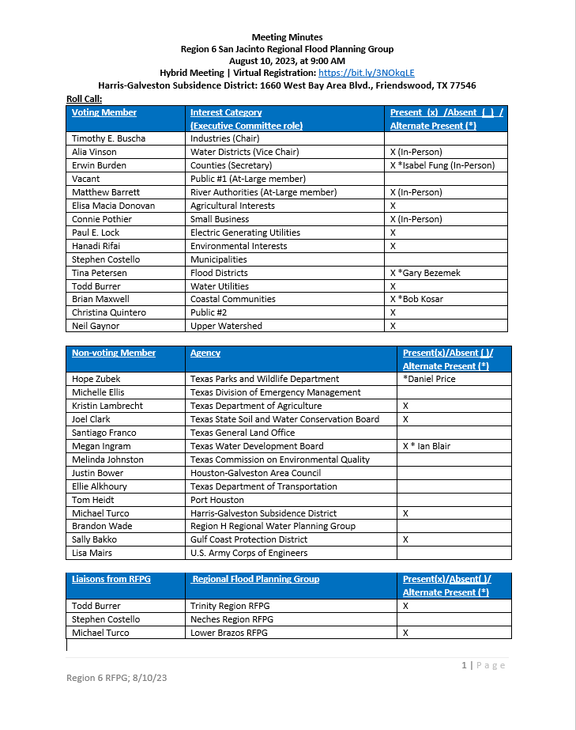

Slide 8
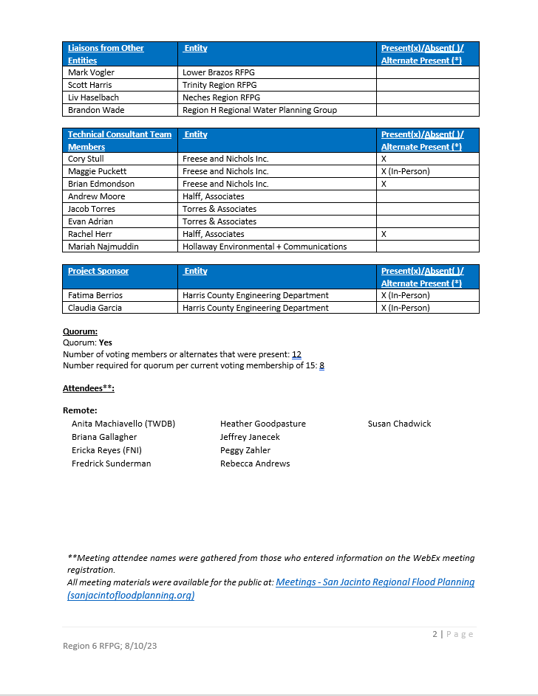

Slide 9
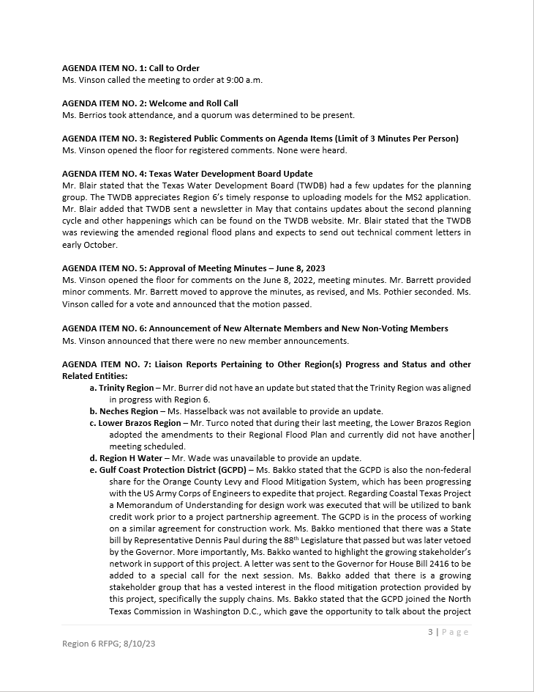

Slide 10
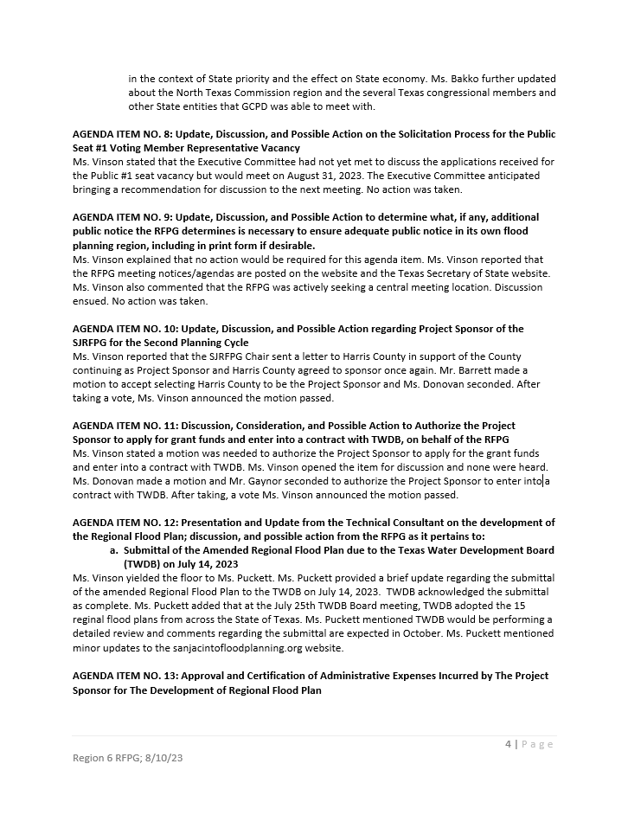

Slide 11
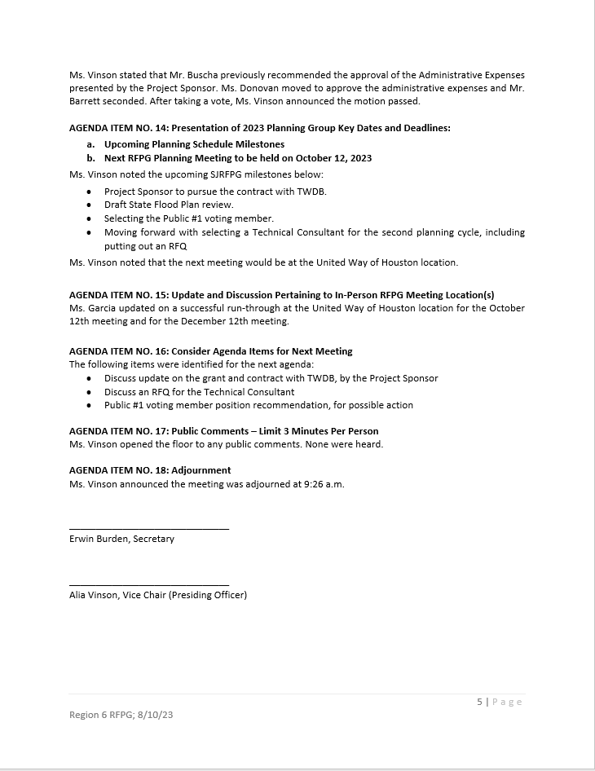

Slide 12
Item 6: Announcement of New Alternate Members and New Non-Voting Members

Slide 13
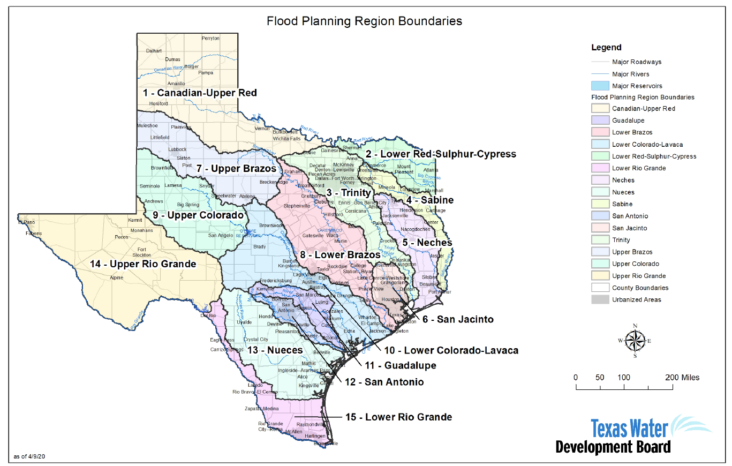

Slide 14
Item 7: Liaison Reports Pertaining to Other Region(s) Progress and Status and other Related Entities: a. Trinity Region b. Neches Region c. Lower Brazos Region d. Region H Water e. Gulf Coast Protection District (GCPD)

Slide 15
Item 8: Update, Discussion, and Possible Action on the Solicitation Process for the Public Seat #1 Voting Member Representative Vacancy

Slide 16
Item 9: Update by the Project Sponsor regarding the application for grant funds and contract with TWDB, on behalf of the RFPG

Slide 17
Item 10: Presentation and Update from the Technical Consultant on the development of the Regional Flood Plan.

Slide 18
Item 11: Approval and Certification of Administrative Expenses Incurred by The Project Sponsor for The Development of Regional Flood Plan

Slide 19
Administrative Expenses Incurred by Project Sponsor for 7/15/2023 – 9/8/2023

Slide 20
Item 12: Presentation of 2023 Planning Group Key Dates and Deadlines: a. Upcoming Planning Schedule Milestones b. Next RFPG Planning Meeting to be held on December 14, 2023

Slide 21
Item 13: Update and Discussion Pertaining to In-Person RFPG Meeting Location(s)

Slide 22
Item 14: Consider Agenda Items for Next Meeting

Slide 23
Item 15: Public Comments – Limit 3 Minutes Per Person

Slide 24
Item 16: Adjournment

