Slide 1
Region 6 - San Jacinto Regional Flood Planning Group Executive Committee Meeting September 28, 2023 2:00 PM Hybrid Meeting

Slide 2
Item 1: Call to Order

Slide 3
Item 2: Welcome and roll call

Slide 4
Item 3: Registered Public Comments on Agenda Items – 3 minutes per person

Slide 5
Item 4: Approval of meeting minutes – August 31, 2023

Slide 6
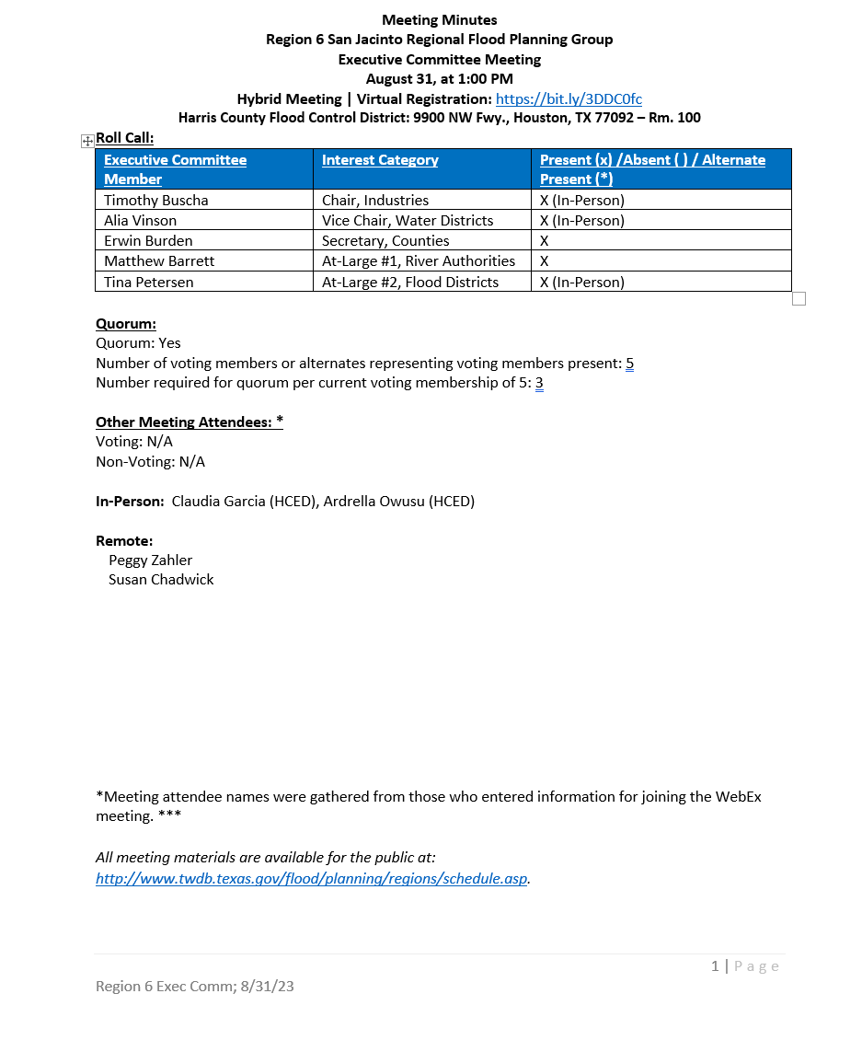

Slide 7
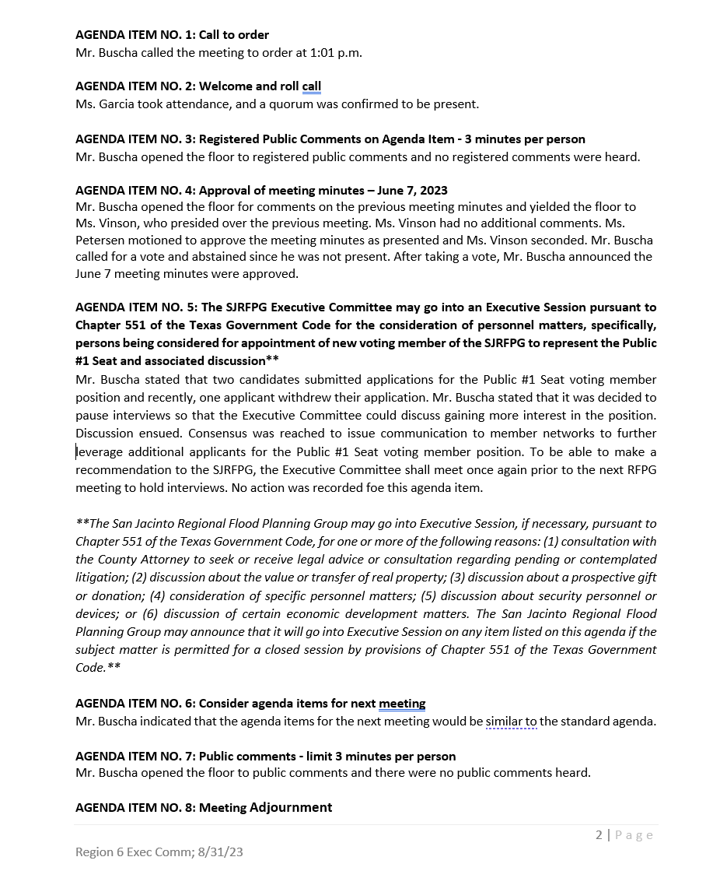

Slide 8
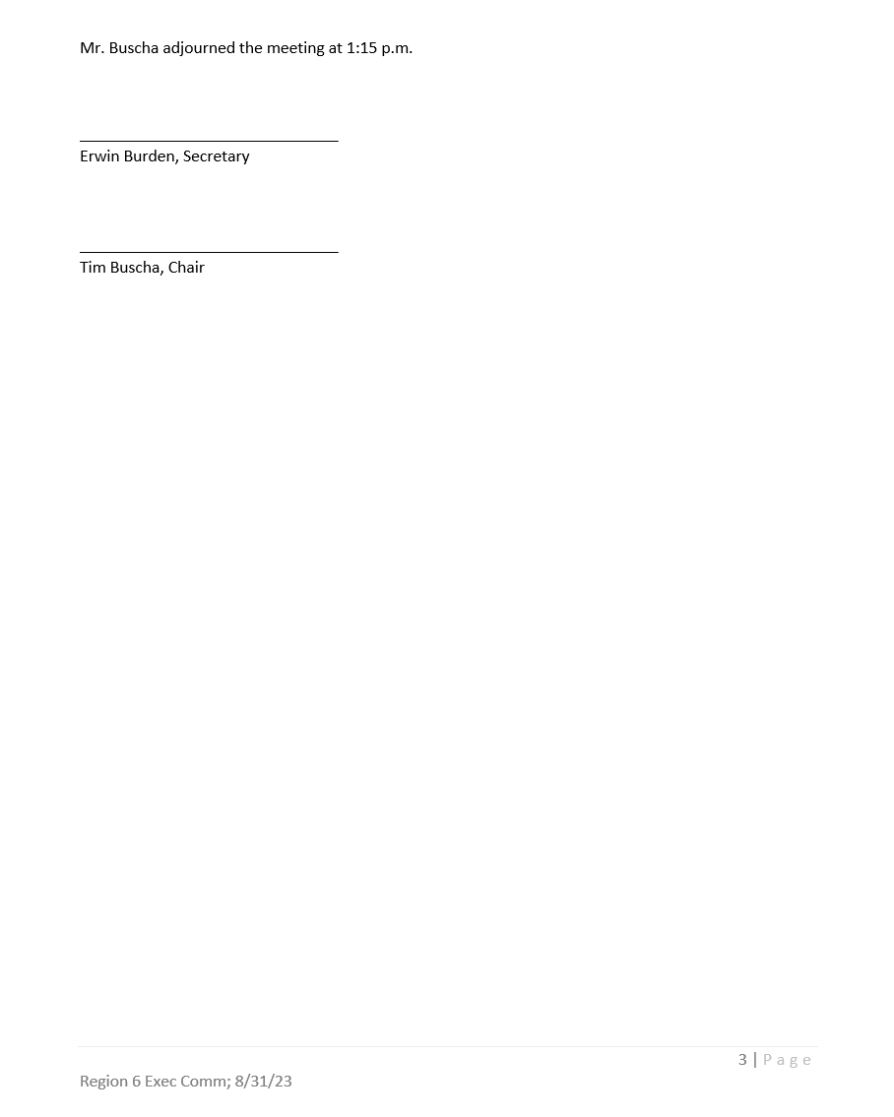

Slide 9
Item 5: The SJRFPG Executive Committee may go into an Executive Session pursuant to Chapter 551 of the Texas Government Code for the consideration of personnel matters, specifically, persons being considered for appointment of voting member on the SJRFPG to represent the Public #1 Seat and associated discussion**

Slide 10
**The San Jacinto Regional Flood Planning Group Executive Committee may go into Executive Session, if necessary, pursuant to Chapter 551 of the Texas Government Code, for one or more of the following reasons: (1) consultation with the County Attorney to seek or receive legal advice or consultation regarding pending or contemplated litigation; (2) discussion about the value or transfer of real property; (3) discussion about a prospective gift or donation; (4) consideration of specific personnel matters; (5) discussion about security personnel or devices; or (6) discussion of certain economic development matters. The San Jacinto Regional Flood Planning Group Executive Committee may announce that it will go into Executive Session on any item listed on this agenda if the subject matter is permitted for a closed session by provisions of Chapter 551 of the Texas Government Code.**

Slide 11
Item 6: Consider agenda items for next meeting

Slide 12
Item 7: Public Comments - limit 3 minutes per person

Slide 13
Item 8: Meeting Adjournment

